Slide 1
Managing Your Farm Financials
Willy Wildcat- Extension Agent
Robin Reid-K-State Ag. Economics Extension Associate
Kevin Herbel-Kansas Farm Management Association Executive Director
Notes:
Willy Wildcat is a placeholder to emphasize this is a presentation for agents/economists themselves to give

Slide 2
4 Subject Areas and Associated Activities
Keeping Quality Farm Records
Balance Sheet
Income Statement
Cash Flow
**Will be posted to www.AgManager.info/pft (password is KSREAgent)
Notes:
You probably should modify, delete, or hide this slide in a producer presentation. This is for the agents/economist’s knowledge

Slide 3
Keeping Quality Farm Records

Slide 4
Why talk about this?
To meet your goals and objectives for the future
You must…
KNOW YOUR NUMBERS and
USE YOUR NUMBERS
Keeping quality records and using those records in decision making is important for successful farm management

Slide 5
Record keeping can be:
Tedious
Complex
Time consuming
. . . . and many of us “just don’t like paperwork!”

Slide 6
But your record keeping
system can be—
A VALUABLE BUSINESS MANAGEMENT TOOL!

Slide 7
Why keep records?
Income tax filing
Working with lender
Management of operation
The road to good record keeping is paved with good intentions…….
But good intentions aren’t much help in
creating the financial information needed
for decision making

Slide 8
Why keep records?
Income tax filing
Working with lender
Management of operation
You need your records much more than either
your lender or the IRS
Good records are one of the keys to your farm
operation’s success . . . .
One you can’t do without

Slide 9
What do you need in a record keeping system?
Regular record keeping – develop a habit of keeping up to date
Reconcile your records to your bank statements
Appropriate accounts (or columns) for your farm business and personal activities
Sufficient detail for you to understand and analyze your business, and make improved decisions
Notes:
Record keeping is much more efficient and accurate when it is completed on a regular basis. Receipts and other needed items are easier to find closer to the point of occurrence…and most of us remember better before too much time passes…
Reconciling records is essential to ensure accuracy and completeness. Many times essential information in missed inadvertently when reconciling is not completed.
A record keeping system needs to provide the information that is necessary for management decisions. Not having the right outputs from the system will only lead to frustration and a desire to not keep records up to date. Defining the appropriate accounts for the records system is important so that the desired information is available.
Sufficient detail is necessary…but too much detail can be overwhelming. As a record keeping system is used for decision making purposes, the level of detail can be increased to provide better measures, better understanding, better information for management decisions. Don’t move to a high level of detail before you are ready/able to keep the records consistently, and use the information.

Slide 10
What do you need in a record keeping system?
Accrual accounting—accurately measure your operation’s profitability (discuss cash vs. accrual)
Ability to track your operation’s financial position and profitability over time
Ability to compare with others and with standards
Important to separate into profit centers to identify where you are making or losing money
Information to help you answer the question “is this really the best use of my resources?”
Notes:
Most farms use cash basis accounting for income tax filing purposes. While this can make tax filing and tax planning easier in some instances, it does not provide a good measure of the profitability of a business. Decisions made based on tax management, line of credit availability, discounts for prepayment of inputs, and other reasons, may influence the cash activity and make the cash income and expense inaccurate in measuring farm profitability. Adjustments for inventory changes, and for differences in accrued income and expense, from the beginning to the end of the year, are necessary to accurately measure and understand the profitability and financial performance of a business.
Comparing an operation with itself over time can provide helpful information on the direction of the farms financial performance and the progress (or lack of progress) toward meeting the goals and objectives that are desired. Comparing with others or with industry standards for various financial measures is important. Each of these comparisons can be referred to as benchmarking…benchmarking with self overtime; benchmarking with industry standards; benchmarking with other operations of similar farm type, farm size, or other characteristic. A record keeping system should allow for these comparisons.
Enterprise, or profit center, records can help measure an operation’s performance at the level in which most decisions are being made. Some decisions effect the entire operation but many are based on what is being produced. Having the ability to keep records to measure the performance of each profit center can be very useful information for the one making decisions on the operation. This information can be used for benchmarking purposes and for identifying areas of profit or loss. It can also be useful for marketing planning and similar activities, providing the farm manager with information of the cost of production of what is produced.
What is the best use of the resources available to you in your operation? A farm manager must know and understand the information for their operation to answer this question accurately. This can only be accomplished with information from a quality record keeping system.

Slide 11
So…Why keep records?
Record keeping is the first step to good management
History of performance
  Track progress
  Understand resource base and how it is being used
  Compare with benchmarks
  Identify strengths and weaknesses
Control of operation
  Know cost of production
  Detect problems and concerns
  Make adjustments and changes

Slide 12
So…Why keep records?
Record keeping is the first step to good management
Plan for the future
  Goals and objectives
  Long- and Short-run decision making
Filing of reports
  IRS
  Lender
  Crop Insurance
  FSA
  Other

Slide 13
How should I use my records?
Balance Sheet
  Financial Position at a point in time
  Change in Net Worth
  Earned vs. FMV Net Worth
Accrual Income Statement
  Accrual Accounting gives more accurate picture
Statement of Cash Flows
  Source and uses of funds
  Amount and timing
Comparative Analysis
Trend Analysis
Notes:
Will get more into this in later sections

Slide 14
Keeping Records
Accurate record keeping takes time and effort
Once per year won’t get it done effectively
Don’t use the shoebox method
Know your operation…know your financial position…better than anyone else

Slide 15
Methods of Keeping Financial Records
Manual record book
  Low cost
  Easy to get started
  Time consuming
  Opportunity for errors
    Can be difficult to reconcile to bank statements
    Can reduce errors by reconciling
  Difficult to get reports and analyze records

Slide 16
Methods of Keeping Financial Records
Computer Spreadsheet
  Low cost
  More difficult to get started
  Need for skills with use of spreadsheet
  Time consuming
  Opportunity for errors
    Can be difficult to reconcile to bank statements
    Can reduce errors by reconciling
  Difficult to get reports and analyze records

Slide 17
Methods of Keeping Financial Records
Computer Accounting Software
  Increase in cost – depends on software product
  Can be time saving
    Import of bank statements
    Memorized vendors
    Check printing
  Reduced opportunity for errors
    Account reconciliation
  Track account and loan balances
  Important to have appropriate accounts set up

Slide 18
Methods of Keeping Financial Records
Computer Accounting Software
  Built in reports for review and analysis of records
  Some products allow for payroll and invoicing
  Choose software that you can use efficiently and that provides useful data and reports
  The more detailed the results desired, the more time it will take to keep the records
  The software you learn to use first and are most familiar with, will almost always be the “best”

Slide 19
Software for Farm Record Keeping
Quicken
QuickBooks/QB Pro/QB for Mac
FarmBooks
Farm Works – Farm Trac, Acctg, Stock
Red Wing – Center Point Acctg for Ag
Numerous others…
Notes:
Quicken is good for personal records and for small farm operations. There is less ability to keep detailed records with this program.
Within the KFMA program, the primary computer record keeping systems supported and used are QuickBooks and FarmBooks.

Slide 20
Software for Farm Record Keeping
Quicken
  Low cost, import bank stmts, memorized vendors, reconcile accts, built in reports, cash basis only
QuickBooks/QB Pro/QB for Mac
  More expensive, added flexibility for business records, double entry acctg, options for payroll, A/R, A/P and invoicing, accrual reports
FarmBooks
  More expensive, farm specific accounts and reports, built in payroll and invoicing, accrual reports

Slide 21
Software for Farm Record Keeping
Farm Works – Farm Trac, Acctg, Stock
  Includes mapping, field records, inventory, payroll, built in reports, cash & accrual w/ single entry acctg
Red Wing – Center Point Acctg for Ag
  Higher cost, double entry acctg, more difficult to use

Slide 22
Links for Information on Software
Quicken
http://quicken.intuit.com/
QuickBooks (QB, QB Pro and QB for Mac)
http://quickbooks.intuit.com/
FarmBooks
http://www.sanderssoftware.com/programs-farmbooks.htm

Slide 23
Links for Information on Software
Farm Works
http://farmworks.com/products/accounting
Red Wing
http://www.redwingsoftware.com/rwssn/?page=308

Slide 24
Balance Sheet
-A Financial Management Tool
Notes:
Pass out associated publication “MF 291 Balance Sheet-A Financial Management Tool” at http://www.agmanager.info/finance-business-planning/financial-statements-ratios
Have them look at the example balance sheet in that publication as you are going through the presentation

Slide 25
Balance Sheet
Definition and Purpose
Systematic organization of everything “owned” and “owed” by a business or individual at a given point in time
Features:
  Provides a SNAPSHOT of the business
  Fundamental to sound management decision making
  Measurement of financial success
  Communicates financial position to creditors
Notes:
SNAPSHOT in time: Gives the financial picture of the business on that specific date in time
By knowing your financial position, you can make informed decisions about paying for upcoming operating expenses, expanding your business, buying new equipment or land, etc.
Can compare balance sheets year-to-year to evaluate net worth growth or changes in the business, can compare financial ratios to other farms to see how you are performing relative to them
Lenders will typically require you to have a balance sheet for them to make loan approval decisions

Slide 26
Balance Sheet
Key Measures
Total Assets:
  The value of all financial and capital resources owned by the business
Total Liabilities:
  The value of total debt obligations
Owner’s Equity or Net Worth:
  The value of the owner’s investment as determined by subtracting total liabilities from total assets
Assets − Liabilities = Net Worth (Equity)
Notes:
Examples of Assets: Cash, Grain/Hay in storage, Cattle, Equipment, Land, etc.
Liabilities: Operating Notes (Line of Credit), loans on machinery/cattle/land, possibly personal debt (mortgage, vehicles, credit cards)
Net Worth: If all liabilities were paid off with assets, how much would be left?
Note: Some times a Balance sheet will be referred to as a Net Worth Statement

Slide 27
Completing a Balance Sheet
Current Assets
  Cash
  Accounts Receivable
  Fertilizer and Supplies
  Investment in Growing Crops
  Crops Held for Sale
  Market Livestock
Notes:
A current asset is cash or other assets that can be quickly converted into cash in the normal business processes within 1 year.

Slide 28
Completing a Balance Sheet
Noncurrent Assets:
  Breeding Livestock
  Machinery and Equipment
  Buildings
  Investments in Cooperatives
  Land
Notes:
Noncurrent assets are those resources that are used mainly to support farm production. Unlike current assets, they are not expected to be sold in the normal business process. These assets have a more permanent value. They are needed to produce income, but may not be easily converted to cash.

Slide 29
Completing a Balance Sheet
Current Liabilities:
  Accounts Payable/Accrued Expenses
  Taxes Payable (Income and Social Security)
  Current Portion: Deferred Taxes
  Current Loans Due within One Year
  Current Portion of Term Debt
  Accrued Interest
Notes:
Accounts Payable/Accrued Expenses- Any outstanding bills to be paid or services received that were not yet billed on the balance sheet date. Ex: Remaining real estate taxes, commercial crop storage, co-op account balance, etc.
Income & Social Security Taxes Payable- Anticipated income & social security taxes payable on balance sheet date
Current Portion: Deferred Taxes- Typically only included on the balance sheet if capital asset sales or farm liquidation will take place. Most current assets will have zero tax basis since the cost of production has already been deducted. It these items are liquidated without further production expenses the following year, income and self employment tax will be owed. See publication Computation of Deferred Tax Liability for more information on how this can be calculated.
Current Loans Due within One Year- Operating loan balance(s) on balance sheet date
Current Portion of Term Debt- Principle balance of intermediate and long-term loans that must be paid within the next year
Accrued Interest- Interest that has accumulated on all loans from the last payment to balance sheet date

Slide 30
Completing a Balance Sheet
Noncurrent Liabilities:
  Noncurrent Portion: Deferred Taxes
  Noncurrent Portion: Notes Payable
  Noncurrent Portion: Real Estate Debt
Notes:
Noncurrent Portion: Deferred Taxes- Typically only included on the balance sheet if capital asset sales or farm liquidation will take place. “Tax Planning” is used on most operations to manage the amount of tax owed in a given year. Taking of accelerated depreciation is one way this is accomplished. This, alone with already deducted production expenses to produce non-current assets, leads to a deferred tax liability on these assets. Owned land will appreciate in value creating a deferred tax liability as well. See publication Computation of Deferred Tax Liability for more information on how this can be calculated.
Noncurrent Portion: Intermediate Loans- Principle balance of machinery, breeding livestock, and other loans that is not payable this year
Noncurrent Portion: Long-term Loans- Principle balance of all Real Estate and other Long-term loans (restructures) that is not due this year
Note that the portions of the noncurrent liabilities that are due within 12 months are current liabilities.

Slide 31
Balance Sheet Example
ASSETS:
 | January 1 | December 31 | Average
1) Cash | $13,019 | $7,473 | $10,246
2) Accounts Receivable | $205 | $550 | $378
3) Fertilizer and Supplies | $67,905 | $80,600 | $74,253
4) Investment in Growing Crops | $45,563 | $30,375 | $37,969
5) Crops Held for Sale and Feed | $50,850 | $52,875 | $51,863
6) Market Livestock | $37,800 | $36,750 | $37,275
7) Other Current Assets | $0 | $0 | $0
8) TOTAL CURRENT ASSETS | $215,342 | $208,623 | $211,982
9) Breeding Livestock | $295,100 | $296,200 | $295,650
10) Machinery and Equipment | $465,035 | $423,279 | $444,157
11) Buildings | $40,201 | $71,040 | $55,621
12) Investments in Cooperatives | $25,453 | $27,763 | $26,608
13) Land | $1,904,000 | $1,904,000 | $1,904,000
14) TOTAL NONCURRENT ASSETS | $2,729,789 | $2,722,282 | $2,726,036
15) TOTAL FARM ASSETS | $2,945,131 | $2,930,905 | $2,938,018
LIABILITIES AND NET WORTH:
 | January 1 | December 31 | Average
16) Accounts Payable/Accrued Expenses | $550 | $800 | $675
17) Income & Social Security Taxes Payable | $16,500 | $17,810 | $17,155
18) Current Portion: Deferred Taxes | $0 | $0 | $0
19) Current Loans Due Within One Year | $130,048 | $150,000 | $140,024
20) Current Portion of Term Debt | $80,578 | $72,019 | $76,299
21) Accrued Interest | $28,477 | $25,660 | $27,069
22)TOTAL CURRENT LIABILITIES | $256,153 | $266,289 | $261,221
23) Noncurrent Portion: Deferred Taxes | $0 | $0 | $0
24) Noncurrent Portion: Intermediate Loans | $154,933 | $112,497 | $133,715
25) Noncurrent Portion: Long-term Loans | $526,495 | $496,552 | $511,523
26) TOTAL NONCURRENT LIABILITIES | $681,428 | $609,049 | $645,238
27) TOTAL FARM LIABILITIES | $937,581 | $875,338 | $906,459
28) FARM NET WORTH | $2,007,549 | $2,055,567 | $2,031,558
29) TOTAL LIABILITIES AND NET WORTH | $2,945,131 | $2,930,905 | $2,938,018
Notes:
Here we are comparing Net Worth Changes from the beginning to the ending of the year.
Highlight the different sections of the balance sheet
Note that Total Farm Assets decreased, but Total Farm Liabilities decreased even more, showing a growth in Net Worth

Slide 32
Completing a Balance Sheet
Valuation Issues
  Sources of Equity
    Contributions of equity from owners
    Retained earnings—Net income less owner withdrawals
    Valuation equity—Market value over cost of noncurrent assets
      Unearned and may never be realized
Notes:
How does Net Worth/Equity grow in a business?
Contributions: Off Farm income is being invested the business by paying operating expenses, loan principle, etc.
Retained: Money earned by the business, if not used for family living, or other non-farm uses, it can be reinvested back into the business to pay operating expenses and principle on loans, purchase equipment, purchase land, etc.
Valuation: Example-increases in land value over time. On a market value balance sheet, equity may be increasing solely due to this and not business activities
It is important to identify and understand a farm’s valuation equity and earned equity or earned net worth change. This way the source of growth can be identified.

Slide 33
Completing a Balance Sheet
Valuation Issues
  Cost Approach —Initial cost plus improvements less depreciation
    More accurate measure of actual performance of invested capital
    Critical to the examination of changes in equity
  Market Value Approach —Estimate asset values using current prices for similar assets
    Easy to derive
    More comparable across farms
    Includes opportunity cost
    Often required by lenders
Notes:
It is common for farm business balance sheets to be prepared using market valuation, with the value of each asset representing the current fair market value. Cost-basis valuation is also used, with assets valued at their original cost less any accumulated depreciation. The difference in valuation methods primarily affects capital assets (i.e. breeding stock, machinery/equipment, land) while current assets are typically handled similarly in both methods, with inputs and supplies at cost and assets for sale in the next year at market price. Market valuation can be useful for measuring the net worth position of the operation and for identifying the available security value for debt obligations. Cost-basis valuation can help with consistency between balance sheets and is useful to identify and assess the net worth that has been earned through the production activities of the farm.
There are also hybrids or modified-cost basis balance sheets which combine elements of both.

Slide 34
Completing a Balance Sheet
Do you include Personal Assets and Liabilities?
  Sometimes hard to distinguish between
  If included, clearly separate them and define them if possible
Notes:
In many farm businesses, there is no sharp distinction between farm business and nonfarm assets and liabilities of the farm family. This is particularly true where the farm and family living expenses are paid for out of the same bank account, where funds may flow back and forth from farm to nonfarm items. Although this is common, it is highly recommended that separate accounts be used for farm and nonfarm items. In many situations both farm and non-farm items may be reflected on a balance sheet but should be clearly separated and defined when possible (see balance sheet template).

Slide 35
Completing a Balance Sheet
Tips for Preparing
  Prepare at the same time each year
  Focus on completeness
    Inventories
    Accounts receivable and payable
    Accrued income and expense
  Focus on accuracy
    Inaccurate financial statements lead to a false sense of financial security (or insecurity)
Notes:
Talk about keeping underlying schedules (see publication for example). This way each category contains the same items every year.

Slide 36
Balance Sheet
Interpretation and Use
Trends
  Net worth increases
    Realized—profits generated
    Unrealized—asset appreciation
    Consistent vs. volatile changes
Structure
  Types of assets—liquid or not
  Types of liabilities
  Collateral available

Slide 37
Balance Sheet
Interpretation and Use
  Measuring Liquidity
  Current ratio = Current Assets/Current Liabilities
  Working Capital = Current Assets – Current Liabilities
    Compares sources of cash with needs for cash in the next twelve months
    Affects owner’s ability to make decisions
    Critical in the management of a farm business
  Working Capital/Gross Farm Income
    Or
    Working Capital/(Total Operating Expenses+Interest)
Notes:
Liquidity looks at the current portion of our assets and liabilities, assessing how financial obligations can be met as they come due
Current Ratio: If all current farm assets were liquidated, to what extent would they cover current farm liabilities? Bigger is better (greater liquidity in business) Ex. 1.5 would indicate you have $1.50 of CA for every $1 of CL
Working Capital: By subtracting current liabilities from current assets, the remaining amount (hopefully positive) will give how much cash is available to purchase inputs for the coming year, what you don’t have in working capital will need to be financed with an operating loan or other sources of capital
Working Capital/Gross Farm Income: Dividing working capital by gross farm income puts a scale to the value to compare with other farms. Larger farms will need more working capital. You will need the income statement to get gross farm income (which will be discussed in the next section).
Working Capital/Total Operating Expenses+Interest: This gives a measure that is relative to the size of the operation and also provides a measure of how much of the following years’ expenses needs can be met by the working capital available. It’s good to have at least 50% of the expenses + interest as working capital (more is always better)

Slide 38
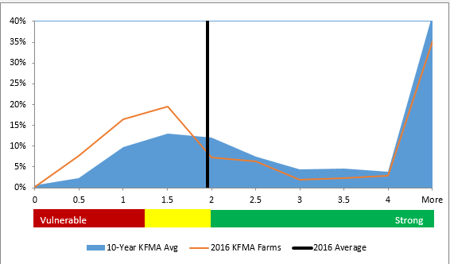
Benchmarking the Current Ratio
Notes:
This is KFMA farms with operators 40-60 years of age
More precise benchmarking groups by region of Kansas, crop acres and cattle numbers, etc. can be found at: http://www.agmanager.info/finance-business-planning/financial-statements-ratios/financial-benchmarking-tool

Slide 39
Balance Sheet
Interpretation and Use
  Measuring Solvency
  Debt to Asset Ratio = Total Liabilities/Total Assets
    Indicator of ability to take on risk
    Dictates intensity of management required
    Affects capacity to expand
Notes:
Solvency looks at all assets and liabilities in the farm business (doesn’t matter if they are current or non-current)
Debt/Asset is most commonly used to express what proportion of total farm assets are owed to creditors. Overtime, this value can decrease as debts are paid off. Ex. A D/A of 31% means that 31% of your total assets are owed to creditors.
You can also look at Equity/Assets and Debt/Equity to evaluate Solvency

Slide 40
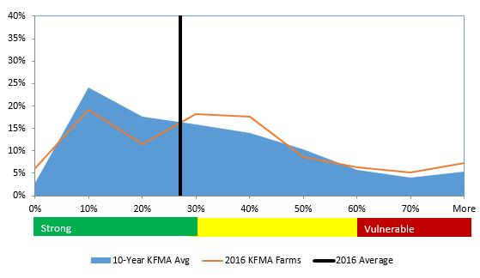
Benchmarking the Debt/Asset Ratio
Notes:
This is KFMA farms with operators 40-60 years of age
More precise benchmarking groups by region of Kansas, crop acres and cattle numbers, etc. can be found at: http://www.agmanager.info/finance-business-planning/financial-statements-ratios/financial-benchmarking-tool

Slide 41
Balance Sheet
An Important Tool in Agricultural Financial Management
Complete a balance sheet annually
Use it to set parameters for major financial decisions
Be honest in asset valuation
Be thorough in listing liabilities
Be fundamentally sound in these Volatile yet Exciting Times
Notes:
You may want/need to do a balance sheet more often if investment changes or in a position of high risk

Slide 42
Income Statement
-A Financial Management Tool
Notes:
Pass out associated publication “Income Statement: Financial Management Tool” at http://www.agmanager.info/finance-business-planning/financial-statements-ratios
Have them look at the example income statement in that publication as you are going through the presentation

Slide 43
Income Statement
Definition and Purpose
Measures the success (profitability) of a business over a period of time in terms of net income or loss
Features:
  Lists income earned and expenses incurred to derive that income
  A progress report of the business
  Can be compared across years to show growth or decline in profitability
Notes:
An income statement is used to determine Net Farm Income
Most commonly completed for a calendar year time period, although can be for a fiscal year or for a time period less than 12 months

Slide 44
Income Statement
Definition and Purpose
  It is best to have an Accrual Adjusted Income Statement
  Matches income produced with the expenses used to generate that income
  Example: Holding a crop over to the next calendar year before sale, but expenses to generate that crop are incurred in the current year
  If you have a beginning and ending Balance Sheet for the time period, making accrual adjustments is not too difficult
Notes:
It is important that your income statement be accrual adjusted, meaning changes in inventory are taken into account so actual profitability, or net income, can be evaluated. For example, to see the true income from crops in this year, the difference in beginning and ending inventories (crops in the bin, growing crops) is added to cash receipts and crop insurance proceeds.

Slide 45
Income Statement
Definition and Purpose
  An Accrual Adjusted Income Statement will not equal the net income on the Schedule F from tax return for a farm
  Cash basis accounting is frequently used for tax preparation purposes for farms
  Depreciation for tax purposes may be accelerated
  If accrual accounting is used for tax preparation purposes it will usually be a “hybrid” accrual system that does not completely account for all inventory items
Notes:
Schedule F can be a starting place to go to see your income and expenses if a more complete system is not available, however…
You may have expenses for harvested grain that is not yet sold, and vice versa
You may have used section 179 expensing, or bonus depreciation, to accelerate the deprecation deduction taken. To get a true picture of Net Farm Income you want to use actual loss of economic value on machinery and equipment during the time period (will get into that more in detail later)
All income and expense adjusting items from the balance sheets should be accounted for in completion of an accrual adjusted income statement

Slide 46
Income Statement
Key Measures
Farm Business Receipts
Cash Income
Inventory changes
Farm Business Expenses
Cash Operating Expenses
Expense Inventory changes
Interest
Depreciation
Difference = Net Farm Income
Notes:
Inventory Changes in Receipts examples are grain is storage, planted crops, livestock on hand
Expense Inventory Change examples: Fertilizer, fuel, supplies

Slide 47
Income Statement
Key Measures
Farm Business Receipts
Cash Income from Crop and Livestock Sales
Adjustment for inventory changes
  Difference in beginning/ending stored and growing crops
  Difference in beginning/ending livestock values, adjusted for purchases
  Difference in beginning/ending accounts receivable
Crop Insurance Indemnities, Agricultural Program Payments, Other Farm Income
Notes:
Accounts receivable: Income earned but not yet received (ex: custom work you completed but have not received payment for, hay sold but check not received yet, etc.)

Slide 48
Income Statement
Key Measures
Farm Business Expenses
  Cash Expenses- Feed, Fuel, Seed, Fertilizer, etc.
  Inventory Expense Adjustment
    Difference in beginning/ending supplies on hand
    Difference in Accounts Payable/Accrued Expenses
  Interest Expense
    Cash interest paid plus change in accrued interest
  Depreciation
Notes:
Accounts Payable/Accrued Expenses: Expenses that were realized to generate income but not yet paid for. (ex: Co-op bill for fertilizer/chemical that is not been paid)
Accrued interest is also from the beginning and ending balance sheets; represents interest that has accumulated on loans since the most recent payment was made

Slide 49
Income Statement
Key Measures
Depreciation
  Loss in asset value due to gradual wear and obsolescence
  Example of straight-line depreciation:
  Purchase a truck for $40,000 that you expect to last 5 years and have a remaining value of $10,000
  $40,000-$10,000 = $30,000 loss in value
  $30,000/ 5 years = $6,000 per year deprecation expense
Notes:
A purchased item (investment) that will last more than one year is called a capital expenditure. Depreciation is the method used to charge-off capital expenditures in each annual accounting period for the life of the capital asset. Depreciation represents the annual loss in value of capital assets. This loss is from gradual wear and obsolescence.

Slide 50
Income Statement
Key Measures
Depreciation
  Loss in asset value due to gradual wear and obsolescence
  Methods of determining economic depreciation:
  Adjust actual market values for each asset every year–the difference is the economic depreciation value
  Assume a percentage reduction in the beginning balance sheet values – 10% for machinery/ equipment, 5% for buildings
  Estimate by adjusting the depreciation taken for income tax purposes by adding accelerated depreciation back in
Notes:
An estimate will usually need to be used to arrive at a value for economic depreciation. The most accurate method is to update the market value of machinery, equipment and buildings each year. The difference between the beginning and ending values, after adjusting for purchases and sales, will be the economic depreciation, or loss of value, for the year
A quick and dirty method to use in arriving at this value is to assume a percentage reduction in the beginning balance sheet values. A rule of thumb is to use 10% for the reduction of machinery and equipment values and to use 5% for buildings and similar assets.
If the only source of information available is an income tax return, the tax depreciation can be used as a proxy for economic depreciation by adding back in the amount of any accelerated depreciation taken by utilizing the Section 179 expense election or bonus depreciation.

Slide 51
Income Statement - Example
Notes:
When measuring and evaluating economic profitability, it is important that an income statement be accrual adjusted. This means that changes in inventory are taken into account. For example, to see the true income from crops in this year, the difference in beginning and ending inventories (crops in the bin, growing crops) is added to cash receipts and crop insurance proceeds.
Similarly, an adjustment is made for beginning and ending inventory of livestock (and purchased amounts) and accounts receivable. This brings you to Gross Farm Income. Purchased feed is kept separate for a calculation of Value of Farm Production. This is particularly important for farms that purchase large amounts of feed (backgrounding/feedlot). Value of farm production is used instead of Gross Revenue for the calculation of some ratios.
Expenses for the time period are listed and then adjusted for inventory levels as well (accrual adjustment). Fertilizer and Supplies, Accounts Payable/Accrued Expenses
Interest and Depreciation are separated out to be used when calculating expense ratios. Note that interest is also accrual adjusted.
While many of the numbers from an income statement are used to measure and assess the efficiency of a business, net farm income is number considered most frequently. Net farm income is a measure of the overall profitability of the farm business during the time period. The net farm income generated is what is used to make principle payments on loans, to reinvest in, or expand the business, pay family living, essentially providing the return to the operator’s labor

Slide 52
Completing an Income Statement
Should personal income and expenses be included on a business income statement?
  Generally, the answer to this question is no, since the purpose is to assess the profitability and efficiency of the business operations
  For many family farm operations, non-farm income and expenses do have an impact of the activity of the farm operation
  When non-business items are included on an income statement, clearly define and separate business and non-business items, with a separate section for the non-business activity
  A separate non-farm income statement can be prepared to see the full picture of farm and non-farm income and expenses
Notes:
If personal expenses and income are included you will not get a true picture of the farm’s financial performance
When non-business items are included they should be clearly defined and shown in a separate section on the income statement
Maybe do a second income statement if you want to see a full picture of your farm and personal life

Slide 53
Completing an Income Statement
Tips for Preparing
  Prepare at the same time each year, preferably with a beginning and ending balance sheet
  Focus on completeness
    If you have done well on the balance sheet(s), this should be much easier
    Accurate recordkeeping for the year is vital
  Focus on accuracy
    Inaccurate financial statements lead to a false sense of financial security (or insecurity)

Slide 54
Income Statement
Interpretation and Use
Trends (with multiple income statements)
  Is profitability increasing, decreasing, level?
  Does the income statement show changes reflective of the ag industry in the region?
  What differences are seen? For good? For bad?
Ratio Analysis
Notes:
A good example is the downturn in the farm economy; NFI has fallen because of low commodity prices. Gross income has decreased while expenses have decreased only slightly, if at all, for most operations
Handout Financial Ratios Used in Financial Management publication found at: http://www.agmanager.info/finance-business-planning/financial-statements-ratios

Slide 55
Income Statement
Interpretation and Use
Profitability
  Rate of Return on Farm Assets (ROA)
  Rate of Return on Farm Equity (ROE)
  Operating Profit Margin Ratio
  Net Farm Income
Notes:
ROA: Average return rate generated by the earnings on all of the assets used in production on the farm, whether owned with equity or borrowed dollars. For much of Kansas, during 2008-2014 incomes and rates of return were very strong, with may farms earning a 5-6% return on assets. The last several years, with the downturn in the ag economy, this has decrease to zero or is negative for many farms. ROA can be looked at as an opportunity cost of farming vs. other investments. Preferably the ROA should be greater than the average interest rate paid on borrowed funds. In this instance, the borrowed dollars are generating income for the operation. A 2% ROA is not a good return in the long run (less than average interest paid I’m sure), but given the current ag. environment, this level is better than many farms (as you can see later when benchmarking)
ROE-return to the owner’s equity capital (return to what the owner has invested in the business) Ex. 2% means the farm business is earning a 2% return on the owner’s capital that is invested in the business. It is desired for ROE > ROA.
OPM ratio- Return per dollar of Value of Farm Production. Shows how profitable the operation is after accounting for the operator’s labor.
Net Farm Income: Dollar amount directly off the income statement, farmer’s return to labor, management, and their equity. Used to pay family living and reinvest in business (pay off debt)

Slide 56
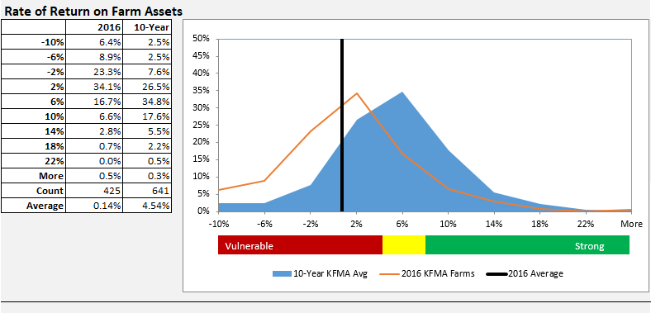
Notes:
This is KFMA farms with operators 40-60 years of age
More precise benchmarking groups by region of Kansas, crop acres and cattle numbers, etc. can be found at: http://www.agmanager.info/finance-business-planning/financial-statements-ratios/financial-benchmarking-tool
The average farm in the last 10 years is earning 4-5%, in the current agricultural environment this has slipped to near 0

Slide 57
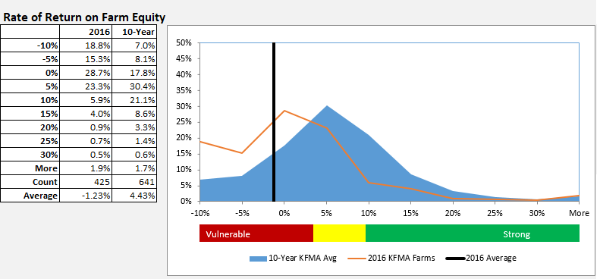
Notes:
This is KFMA farms with operators 40-60 years of age
More precise benchmarking groups by region of Kansas, crop acres and cattle numbers, etc. can be found at: http://www.agmanager.info/finance-business-planning/financial-statements-ratios/financial-benchmarking-tool
The average farm in the last 10 years is earning 4-5%, in the current agricultural environment this has slipped to 0 or negative

Slide 58
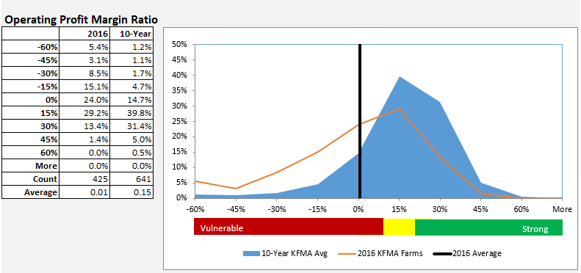
Notes:
This is KFMA farms with operators 40-60 years of age
More precise benchmarking groups by region of Kansas, crop acres and cattle numbers, etc. can be found at: http://www.agmanager.info/finance-business-planning/financial-statements-ratios/financial-benchmarking-tool

Slide 59
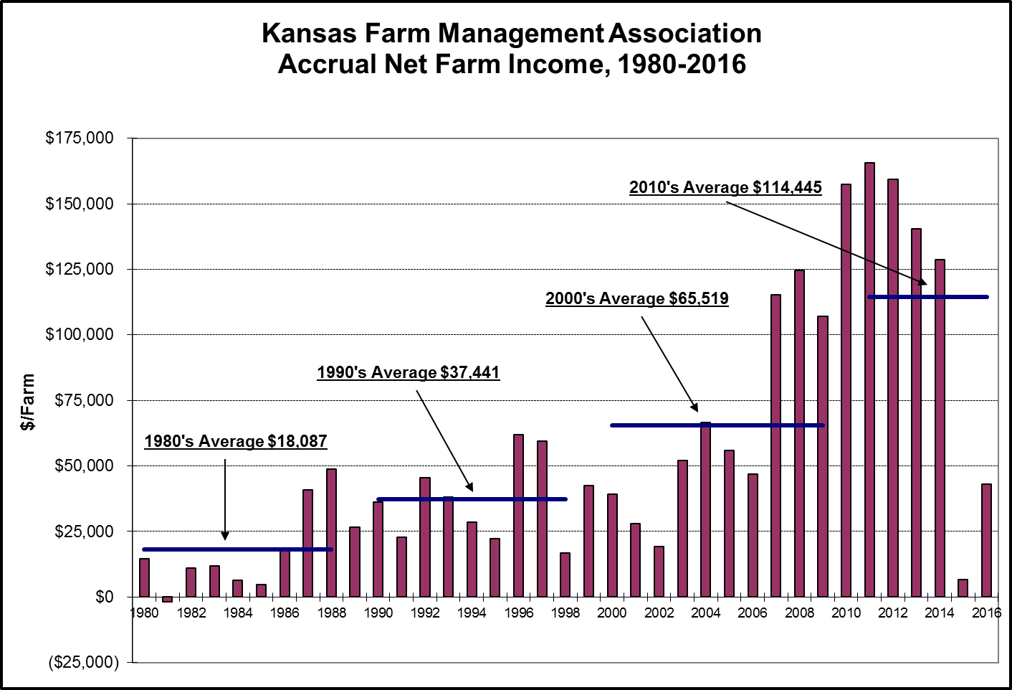
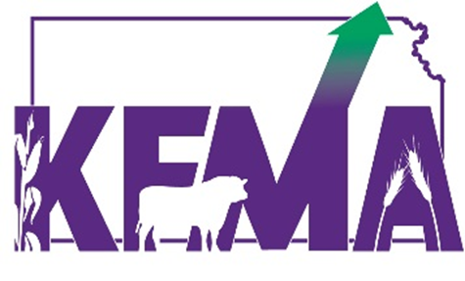
Notes:
KFMA Accrual Net Farm Income, State, 1980-2016 with averages for each decade.

Slide 60
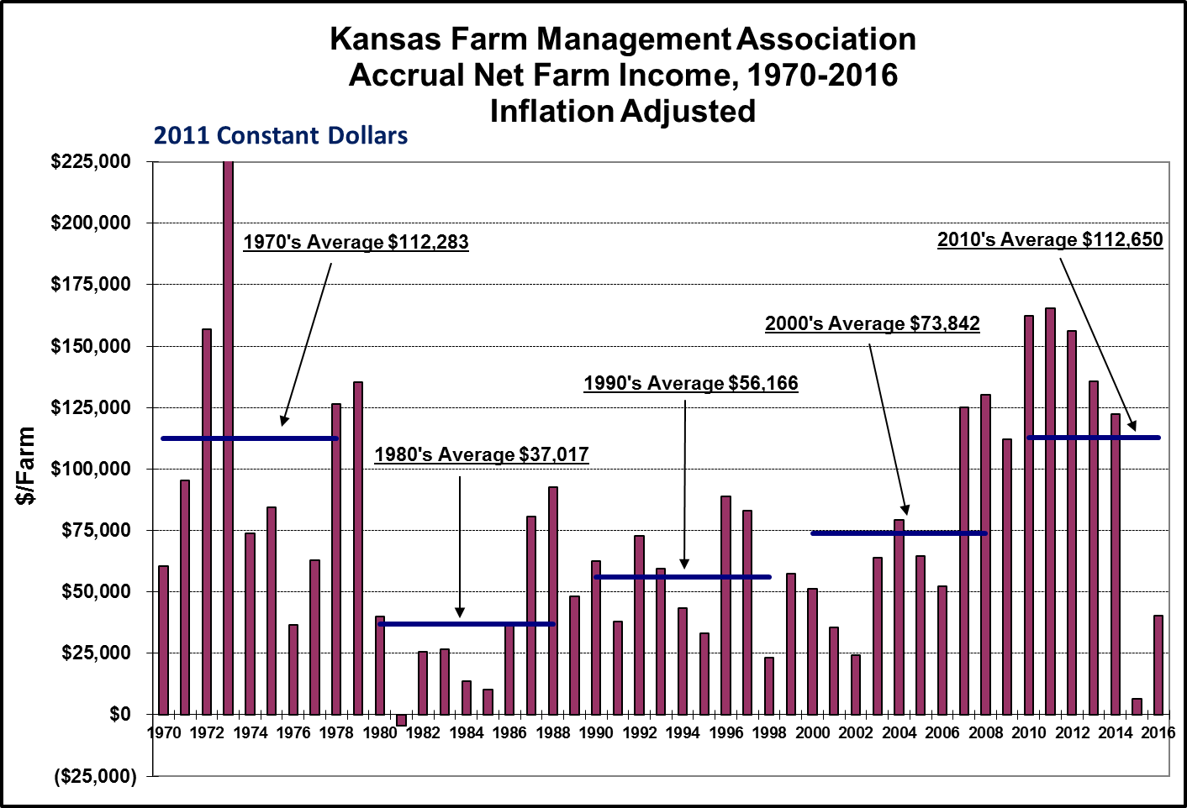
Notes:
Inflation Adjusted (2011 dollars) KFMA Accrual Net Farm Income, State, 1970-2016 with averages for each decade.

Slide 61
Income Statement
Interpretation and Use
Case Farm:
22.6%
72.5%
6.8%
6.1%
14.6%
Financial Efficiency
  Asset Turnover Ratio
  Operating Expense Ratio
  Depreciation Expense Ratio
  Interest Expense Ratio
  Net Farm Income Ratio
Notes:
ATR: Measures how efficiently the dollars invested in the operation generate revenue. With an asset turnover ratio of 22.6%, it will take our case farm about 4 ½ years to generate revenue equal to their value of assets (4 ½ years to “turnover” their assets)
Expense ratios: Proportion of farm income used to pay operating expenses, depreciation, interest, or left over for Net Farm Income (the total of the four ratios will add up to one). For every dollar generated by the farm business, 72.5 cents was spent on operating expenses, 6.8 cents spent on interest, and 6.1 cents on depreciation, leaving 14.6 cents of every dollar generated to pay debt, family living, expand, etc. A very rough rule of thumb for these ratios would be 60 (oper exp)-10 (depr)-10 (int)-20 (NFI). More specifically these could be referenced as: 60-70 or less for operating expense, 4-10 for depreciation, 8 or less for interest and 20 or greater for net farm income. As anyone of the expense ratios is above the preferred levels there will be a need to reduce another expense or net farm income will be reduced. Due to the decreased gross income levels with lower commodity prices, operating expense ratios have tended higher the last two years which has led to reduced net farm income.

Slide 62
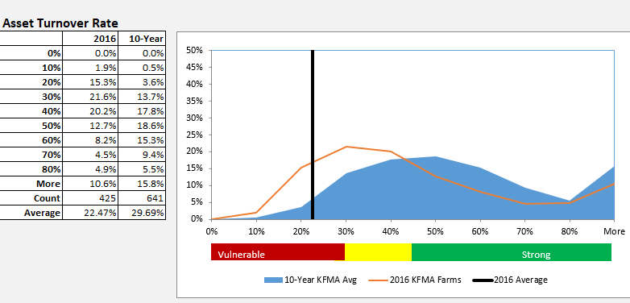
Notes:
This is KFMA farms with operators 40-60 years of age
More precise benchmarking groups by region of Kansas, crop acres and cattle numbers, etc. can be found at: http://www.agmanager.info/finance-business-planning/financial-statements-ratios/financial-benchmarking-tool

Slide 63
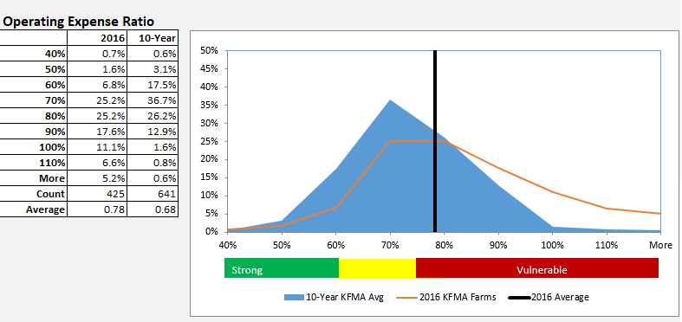
Notes:
This is KFMA farms with operators 40-60 years of age
More precise benchmarking groups by region of Kansas, crop acres and cattle numbers, etc. can be found at: http://www.agmanager.info/finance-business-planning/financial-statements-ratios/financial-benchmarking-tool

Slide 64
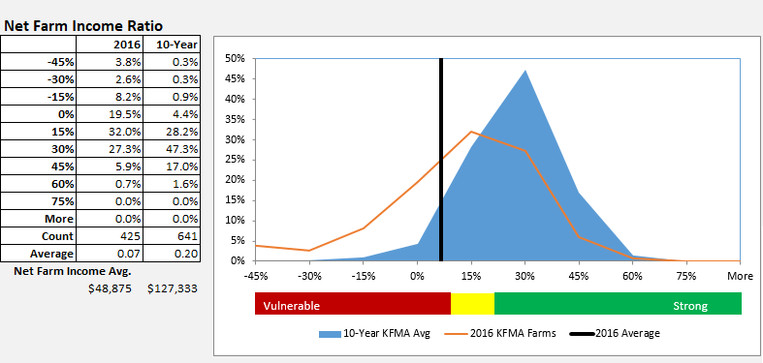
Notes:
This is KFMA farms with operators 40-60 years of age
More precise benchmarking groups by region of Kansas, crop acres and cattle numbers, etc. can be found at: http://www.agmanager.info/finance-business-planning/financial-statements-ratios/financial-benchmarking-tool

Slide 65
Income Statement
An Important Tool in Agricultural Financial Management
Complete an income statement annually
Be consistent with accrual adjustments
Use it to set parameters for major financial decisions
Know and understand your farm’s financial position better than others
Use this information to guide your decision making

Slide 66
Cash Flow Statement
-A Financial Management Tool
Notes:
Pass out associated publication “Cash Flow Projection for Operating Loan Determination” at http://www.agmanager.info/finance-business-planning/financial-statements-ratios

Slide 67
Cash Flow
Definition and Purpose
Recording of the dollars coming and going out of the business
Features:
  Shows where the money comes from (inflows) and where it goes (outflows)
  Indicates how much will need to be borrowed to pay operating expenses and when it is needed

Slide 68
Cash Flow
Key Measures
Cash Inflow Items
  Sales of crops/livestock
  Agricultural Program Payments/Crop Insurance
  Capital Assets Sales
  Off-Farm Income?
Cash Outflow Items
  Seed, Fertilizer, Chemicals, Feed, Veterinary, etc.
  Livestock & Capital Assets Purchases
  Family Living
  Taxes
Difference = Net Cash Flow

Slide 69
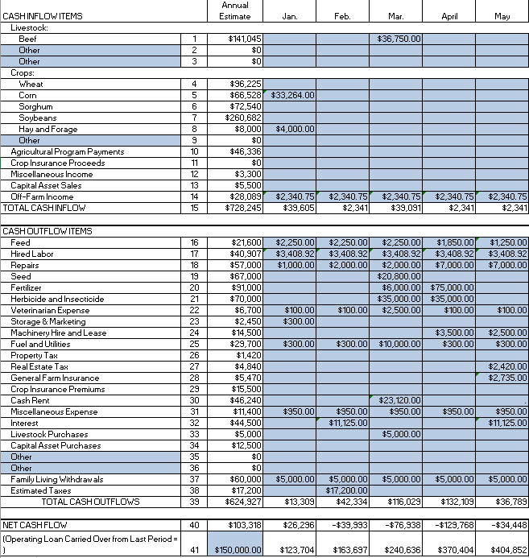
Cash Flow
Example
Notes:
In the example, line 15 shows the total cash inflow (not including loan receipts) and line 39 shows the total cash outflow (not including operating loan payments). Net cash flow is the difference between cash inflow and cash outflow, and is shown on line 40 for the annual estimate and for each monthly period.
The net cash flow may be positive or negative. If the cash inflow for the period is greater than the cash outflow for the period, the net cash flow is positive. If the opposite is true, the net cash flow is negative. For example, the January projected total cash inflow of $39,605 is greater than the total cash outflow of $13,309 so the net cash flow for January is $26,296.
The projected operating loan balance for each month is calculated on line 41. The operating loan carried over from the last period should be written in the appropriate space after the caption on line 41. In the example on the inside fold, the operating loan carried over from the previous December is $150,000. For each monthly period, the projected operating loan balance is determined by combining the previous balance with line 40 net cash flow for that period. A negative cash flow figure for a month increases the operating loan balance so it is added to the previous projected operating loan balance to determine the projected operating loan balance for that period.
A positive net cash flow for a month has the effect of reducing the previous month’s projected operating loan balance. If the net cash flow for a month is greater than the projected operating loan balance for the previous month, the difference can be labeled surplus.
The projected operating loan balances (line 41) for each month can be used as a guide in projecting the approximate amount of loan funds needed and timing of the loan fund needs.

Slide 70
Completing a Cash Flow
  Historical vs. Projected Cash Flow
  Historical = What actually happened in that time period?
  Projected = When will cash come in and flow out? What will my operating loan requirements be?
  Obviously you need to start somewhere, but the best way to make a projected cash flow is with an historical cash flow!
Notes:
A record of cash inflow and outflow that has already occurred in a business is an actual or historical cash flow. An estimate or forecast of cash inflow and outflow into some future period is a cash flow projection. The actual cash flow of a business provides important information for making a cash flow projection into the future. The cash flow projection provides information on the cash-generating ability and the cash requirements of a business, and it indicates the timing of both.

Slide 71
Completing a Cash Flow
  Total Business or Partial Business Cash Flow?
  Do you include family living and off-farm income?
    If it will effect your farm’s cash flow = YES
  You can just do a cash flow for one enterprise or part of the farm
  You do a partial cash flow for an expansion or change in the business
  Monthly intervals? Full year?
Notes:
A cash flow can be set up for either the entire farm business (including family living expenses and nonfarm income), or it can be set up to study only a segment of the business. For example, it may summarize all the cash expenses and income from a specific enterprise. A cash flow projection will often include only the cash inflow and outflow effect of a proposed business expansion.
A cash flow projection may be on a monthly, bimonthly, quarterly, semiannual or annual basis. Cash flows can be completed at the beginning of the year and modified as the year goes along. Some lenders will ask for an actual cash flow for part of the year and a projection for the rest, if you are renegotiating a loan mid-year

Slide 72
Projecting a Cash Flow
Information for preparing a cash flow projection comes from many sources including:
1. Records of actual cash flow or other farm records from past years
2. Tax returns
3. Publications listing investment requirements for crops and livestock enterprises (to determine projected periodic cash payments)
4. Feed records or if not, publications listing feed requirements for livestock enterprises
5. Price and yield estimates.
Notes:
A good strategy is to determine an “Annual Estimate”, maybe using income statements from previous year, and then allocate the income and expenses out to various months or periods
The best beginning point for a cash flow estimate is the farm’s actual yield history, feed records, etc. Good farm records are critical.

Slide 73
Cash Flow
Interpretation and Use
  Evaluating Feasibility
  Two management questions that need to be studied regarding proposed business changes are:
  1. Will the changes be profitable in the long run?
  2. Will the changes be feasible in the short run?
Notes:
Long-run profitability refers to a period of 5 to 10 years or more. Long-run profitability is usually studied through the use of projected income statements. With an income statement, capital expenditures are prorated over the life of the assets using depreciation methods.
Short-run feasibility refers to the income-generating ability of a business in a short period of time, usually 1 to 5 years in length. Short-run feasibility is usually studied through the use of a projected cash flow. Capital expenditures are counted in the period they are actually paid. Projected cash inflow and outflow during the period are compared, reflecting payment requirements from credit agencies as well as normal expenditures and receipts.

Slide 74
Cash Flow
Interpretation and Use
  Indicates how much will need to be borrowed and when
  Can compare to actual cash flow to projections and discrepancies can alert the management about a potential problem
  Provides basis for planning additional investments in the farm business
Notes:
As farm businesses grow and as larger quantities of cash are needed, a cash flow projection becomes a more essential tool in the financial management of farm businesses. A cash flow projection provides the farm operator with a basis for studying the financing of the business. It indicates how much needs to be borrowed and when it is needed.
A cash flow projection provides for “control” of the business. By comparing the projected cash flow to the actual cash flow that occurs, the variance of each item can be noted. If receipts are less than expected or expenses more than expected, the cash flow will alert the manager to a possible problem.
A cash flow projection provides the basis for planning additional investments in the farm business. To be sound, an investment must be profitable in the long run. It must also be able to generate enough cash to make the payments on principal and interest.

Slide 75
Cash Flow
An Important Tool in Agricultural Financial Management
Complete a historical and projected cash flow annually
Monitor the projected cash flow against actual cash flow throughout the time period
  The process of completing a projected cash flow statement will prepare a farm manager to respond and adapt as changes occur during the year
Use the cash flow as an evaluation tool
  Feasibility!

Slide 76
Questions or More Information
Kansas Farm Management Association (KFMA)
      www.AgManager.info/KFMA
Extension Agricultural Economics
    www.AgManager.info
Notes:
Probably want to add local contact information

