Slide 1


Overview of the Farm Financial Situation
Dr. Allen Featherstone & Dr. Mykel Taylor
Department of Ag Economics-Kansas State University

Slide 2
Net Farm Income

Slide 3
Net Farm and Ranch Income

Slide 4
Distribution of 2014 and 2015 Kansas Farm Management Net Farm Income

Slide 5
Distribution of 2014 and 2015 Kansas Farm Management Net Farm Income

Slide 6
Change Kansas Farm Economy

Slide 7
Kansas Farm Economy
The financial situation in the agricultural economy has changed considerably over the last two years
2015 farm income in Kansas was the lowest since 1985
What drove the change in farm income?

Slide 8
Recent and Projected Kansas Farm-Level Crop Prices

Slide 9
Forward Price Computation
Using the futures prices at harvest through 2019, prices are more like the 2007 to 2009 period subtracting a $0.44 basis for soybeans, a $0.33 basis for wheat, and a $0.12 for corn (Salina, KS – 5 year average)
Accuracy of futures prices as long term price expectations?

Slide 10
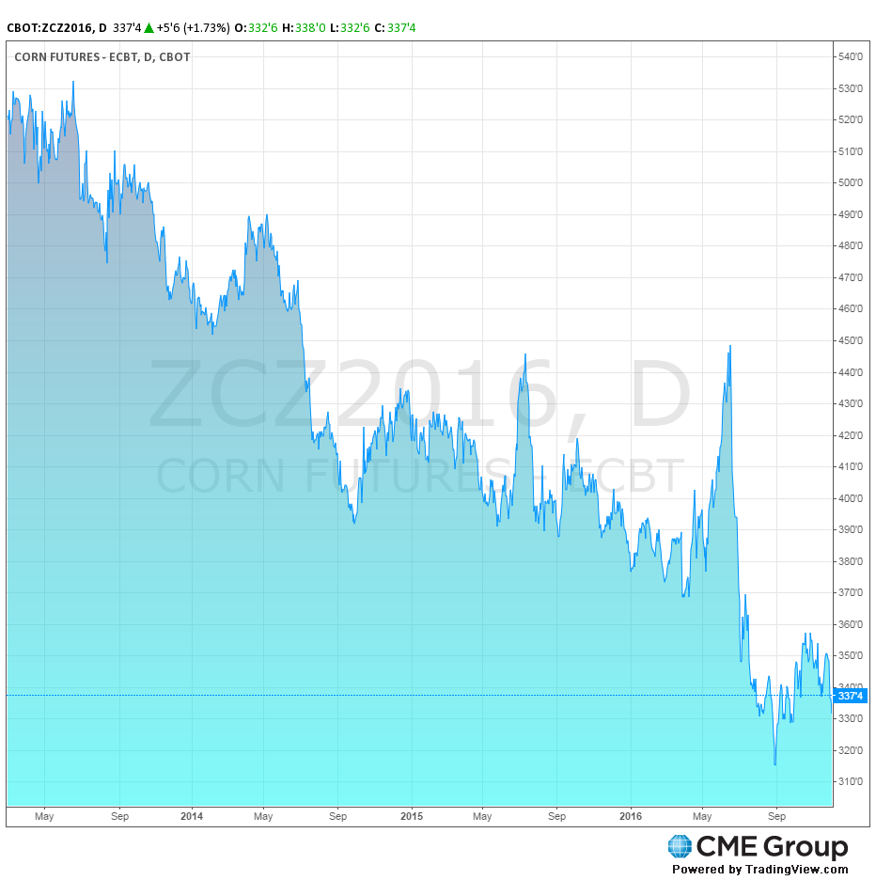
Markets Can Change Quickly

Slide 11
Brazilian Real U.S. Dollar Exchange Rate

Slide 12
Non-Irrigated Kansas Cost of Production per Acre
 | Corn | Soybean | Wheat
Year | Variable Cost | Variable Cost | Variable Cost
2015 | $312 | $225 | $180
2014 | $322 | $229 | $172
2013 | $308 | $224 | $182
2012 | $325 | $202 | $183
2011 | $281 | $192 | $158
2010 | $268 | $176 | $148
2009 | $267 | $173 | $160
2008 | $265 | $167 | $153
2007 | $231 | $145 | $117
2006 | $191 | $125 | $98
2005 | $188 | $118 | $95

Slide 13
Kansas Farm Economy
Prices have fallen
  Subject to volatility
  Subject to world economy
Cost of production has increased since 2009
  17% for corn
  29% for soybeans
  13% for wheat
How does that affect a farmer’s ability to repay debt?

Slide 14
Repayment Capacity
Repayment capacity is key
  Fell from 152.8% to 16.3% from 1979 to 1981
Two key factors
  Increase in interest payments by 65.3%
  Decline in value of farm production by 15.7%
Land values could no longer be supported
Repayment capacity has deteriorated significantly in the last two years

Slide 15
Repayment Capacity

Slide 16
Average Kansas Farm Probability of Default
BB-

Slide 17
Change in Risk Rating 2014 to 2015

Slide 18
Repayment Capacity Summary
Repayment capacity is an important issue
The repayment situation has deteriorated
  2015 repayment capacity in Kansas was the lowest since 1981
  2016 looks to be a continuation of 2015
  2017 could be more negative yet unless adjustments are made

Slide 19
The Farm Safety Net
Crop Revenue Insurance
  Prices are set in February for corn based on the December futures contract
  Prices are set from August 15th to September 14th for wheat in Kansas based on the July futures KCBT contract
  Prices and thus revenue are only protected within the season, not across seasons

Slide 20
Farm Safety Net
Crop Insurance Minimum Revenue Guarantee Corn Example
 | 2013 | 2014 | 2015 | 2016 | 2017
APH (bushel) | 150 | 150 | 150 | 150 | 150
Coverage Election | 80% | 80% | 80% | 80% | 80%
Guaranteed Bushel | 120 | 120 | 120 | 120 | 120
Base Price (per bushel) | $5.65 | $4.62 | $4.15 | $3.86 | $3.88
Coverage (per acre) | $678 | $554 | $498 | $463 | $466
31% decline since 2013

Slide 21
Farm Safety Net
Crop Insurance Minimum Revenue Guarantee Soybean Example
 | 2013 | 2014 | 2015 | 2016 | 2017
APH (bushel) | 40 | 40 | 40 | 40 | 40
Coverage Election | 80% | 80% | 80% | 80% | 80%
Guaranteed Bushel | 32 | 32 | 32 | 32 | 32
Base Price (per bushel) | $12.87 | $11.36 | $9.73 | $8.85 | $10.00
Coverage (per acre) | $412 | $364 | $311 | $283 | $320
22% decline since 2013
Notes:
Wheat Price was $8.57 in 2013 and 6.73 in 2014

Slide 22
Farm Safety Net
Crop Insurance Minimum Revenue Guarantee Wheat Example (Kansas)
 | 2013 | 2014 | 2015 | 2016 | 2017 | 2018
APH (bushel) | 40 | 40 | 40 | 40 | 40 | 40
Coverage Election | 80% | 80% | 80% | 80% | 80% | 80%
Guaranteed Bushel | 32 | 32 | 32 | 32 | 32 | 32
Price (per bushel) | $8.78 | $7.02 | $6.30 | $5.20 | $4.59 | $5.08
Coverage (per acre) | $281 | $225 | $202 | $166 | $147 | $163
48% decline since 2013 (2017 crop)
42% decline since 2013 (2018 crop)
Notes:
Wheat Price was $8.57 in 2013 and 6.73 in 2014

Slide 23
Farm Safety Net
Crop | PLC Price | LDP Barton County | PLC Enrollment | ARC-CO Enrollment
Corn | $3.70 | $2.07 | 13% | 86%
Sorghum | $3.95 | $3.31 | 54% | 46%
Soybean | $8.40 | $4.85 | 10% | 89%
Wheat | $5.50 | $3.14 | 24% | 75%
Notes:
Wheat Price was $8.57 in 2013 and 6.73 in 2014

Slide 24
Kansas Farm Economy
Earlier in the year, prices rebounded allowing some marketing opportunities
Those opportunities are no longer there
It appears that the safety net using revenue products will continue to erode for corn and wheat, but will rebound a bit for soybeans
Wheat looks that it could rebound in 2018
LDPs may be in the future
How has this affected the land market?

Slide 25
Kansas Inflation-Adjusted Land Values

Slide 26
Kansas Inflation-Adjusted Land Values

Slide 27
Projected Income per Crop Acre

Slide 28
Land Value Effects
The long-run multiplier is 21.71 or an implied capitalization rate of 4.61%
  Long-run elasticity is 96.9%
At a net farm income per acre of $46, the projected long-run Kansas land price is $999, a decline of about 50%

Slide 29
Kansas Farm Economy
Land values are a concern
  28% higher in inflation-adjusted terms than previous boom period
  9% lower than two years ago in inflation-adjusted terms
Return to landlord follows sector income
Land market is not in balance with historical norms
With a concern of declining land values what is the debt picture?

Slide 30
Kansas Farm Management Association Debt Levels

Slide 31
Change in Kansas Farm Debt 2013

Slide 32
Change in Kansas Farm Debt 2014

Slide 33
Change in Kansas Farm Debt 2014

Slide 34
Kansas Farm Economy
Debt has increased
Majority of increase in current liabilities
Some indication of refinancing beginning to occur

Slide 35
Its in the Tails
During the last default, only 10.9% of loans originated during the critical period by a national lender defaulted
Most buyers of farmland are other farmers
  Between 72% and 81% of Iowa farmland buyers are other farmers over period of 2008 to 2015
  Last two years were 81% and 79%, respectively
The average will not drive a bust but the tails (margin) can
The tails (margin) will drive the average

Slide 36
Debt to Asset Ratio is Lower in 2015 than 1979
Average debt to asset ratio for Kansas Farm Management Farms:
  1979 – 24.6%
  2014 – 19.7%
  2015 – 23.7%
Farms Greater than 40% debt to assets
  1979 – 19.4%
  2014 – 13.6%
  2015 – 20.3%
Farms Greater than 70% debt to assets
  1979 – 1.3%
  2014 – 2.3%
  2015 – 3.8%

Slide 37
Debt to Asset Ratio is Lower in 2015 than 1979

Slide 38
Distribution of Debt to Asset Under Land Value Declines

Slide 39
Debt to Asset Ratios under Declining Land Values
Scenario | Average Debt/Asset Ratio | % of Farms > 40% | % of Farms > 70%
2015 | 23.7% | 20.3% | 3.8%
2015 (-7.7%) | 24.4% | 22.1% | 4.2%
2015 (-10%) | 24.7% | 23.0% | 4.3%
2015 (-20%) | 25.8% | 25.1% | 5.1%
2015 (-30%) | 27.0% | 27.0% | 6.1%

Slide 40
Kansas Farm Economy
Previous analysis has examined only a change in land values
Repayment capacity is a serious issue that could lead to additional borrowing
2016 will further erode working capital likely leading to increased debt
2017 could be more troublesome than 2016 if yields return to normal with no upward adjustment in price

Slide 41
Conclusion
2016 will be another difficult year income wise.
2017 will be a pivotal year in production agriculture
Average 2015 net farm income was the lowest they have been since 1985
Given the 2016 income levels, some agricultural producers and lenders to make difficult decisions before entering the spring of 2017

Slide 42
Questions?

Slide 43

Opportunities to Save on Cost of Production
Dr. Dustin Pendell & Dr. Mykel Taylor & Robin Reid
Department of Ag Economics-Kansas State University
Dustin Pendell joined the Department of Agricultural Economics as an Associate Professor in 2015. He received his BS in Agribusiness from Illinois State University, MS in Agribusiness Economics from Southern Illinois University and PhD in Agricultural Economics from Kansas State. His research and extension programs are focused in the areas animal health and livestock production economics. He teaches a course at the undergraduate level in data analysis and optimization.
Email: dpendell@ksu.edu Phone: 785-532-3525
Robin Reid joined the Agricultural Economics Department at K-State as the Commercial Agriculture Economist in August, 2014. She previously worked for four years as an Extension Agent in the River Valley District, with a focus on livestock production and farm management. Robin grew up on a farm in Wisconsin and earned a B.S. in Agricultural Business from UW-River Falls. She also holds a M.S. in Agricultural Economics from K-State.
Email: robinreid@ksu.edu Phone: 785-532-0964
*Dr. Taylor’s bio and contact information are in section #5

Slide 44
Livestock

Slide 45
USDA Long-Term Projection
Notes:
Point out: the feeder steer and fed cattle prices are lower in the next 10 years compared to 2015. Fed cattle and feeder cattle are projected to be 29% lower and 42% lower in 2025 compared to 2015. These are only projections and will be updated in February, but the point is…prices don’t appear to be head back to the 2015 levels. We aren’t going to do a full blown Outlook talk, but Glynn has one on AgManager and we will point you to the location at the end of this talk. So, what does the projected lower prices imply? Lets turn to the turn to the Cow-Calf profitability analysis.

Slide 46
ESTIMATED AVERAGE COW CALF RETURNS
Returns Over Cash Cost (Includes Pasture Rent), Annual
Data Source: USDA-NASS
Livestock Marketing Information Center

Slide 47
USDA Long-Term Projection
2015 vs. 2025
Production: +17%
Exports: +26% ( 9.5% of production in 2015 vs. 10.3% in 2025)
Consumption: 3.9%
Notes:
Robin – I hide this slide. This is more for our information.

Slide 48
Managing Costs &
Returns
What are the cost-return categories that separate the top third profitable farms from the bottom third?

Slide 49
Managing Costs &
Returns
Price & Weight - Not really
37.6% of difference in net return to management between high- and low-profit farms is due to gross income

Slide 50
Managing Costs &
Returns
Price & Weight – Not as much
37.6% of difference in net return to management between high- and low-profit farms is due to gross income.
Where is the other 62.4% portion of net return differences?

Slide 51
KFMA Cow-Calf Enterprise Variable Expenses
Notes:
Total variable expenses was $769.83. Return over variable expenses $235.83.
Feed Is 48% of total VC. Pasture is 21% of total VC.

Slide 52
KFMA Cow-Calf Enterprise Variable Expenses:
Differences between Top 1/3 and Bottom 1/3

Slide 53
KFMA Cow-Calf Enterprise Total Expenses
Notes:
Total expenses was $1,105.49. Return over total expenses -$99.83.
Feed Is 33% of total costs. Pasture is 15% of total costs.

Slide 54
Ways to Reduce Feed Costs
Enhance pasture productivity
Extend grazing season
Analyze forages
Incorporate alternative feeds
Critically evaluate “cure-alls”
Utilize a ration balancing program
Split cattle into age/size appropriate groups
Minimize waste
Efficient cattle through genetics
Improve record keeping to reduce inputs
Source: Gunn and Schwab (2016), Iowa State University
Notes:
https://www.extension.iastate.edu/agdm/livestock/pdf/b1-77.pdf

Slide 55
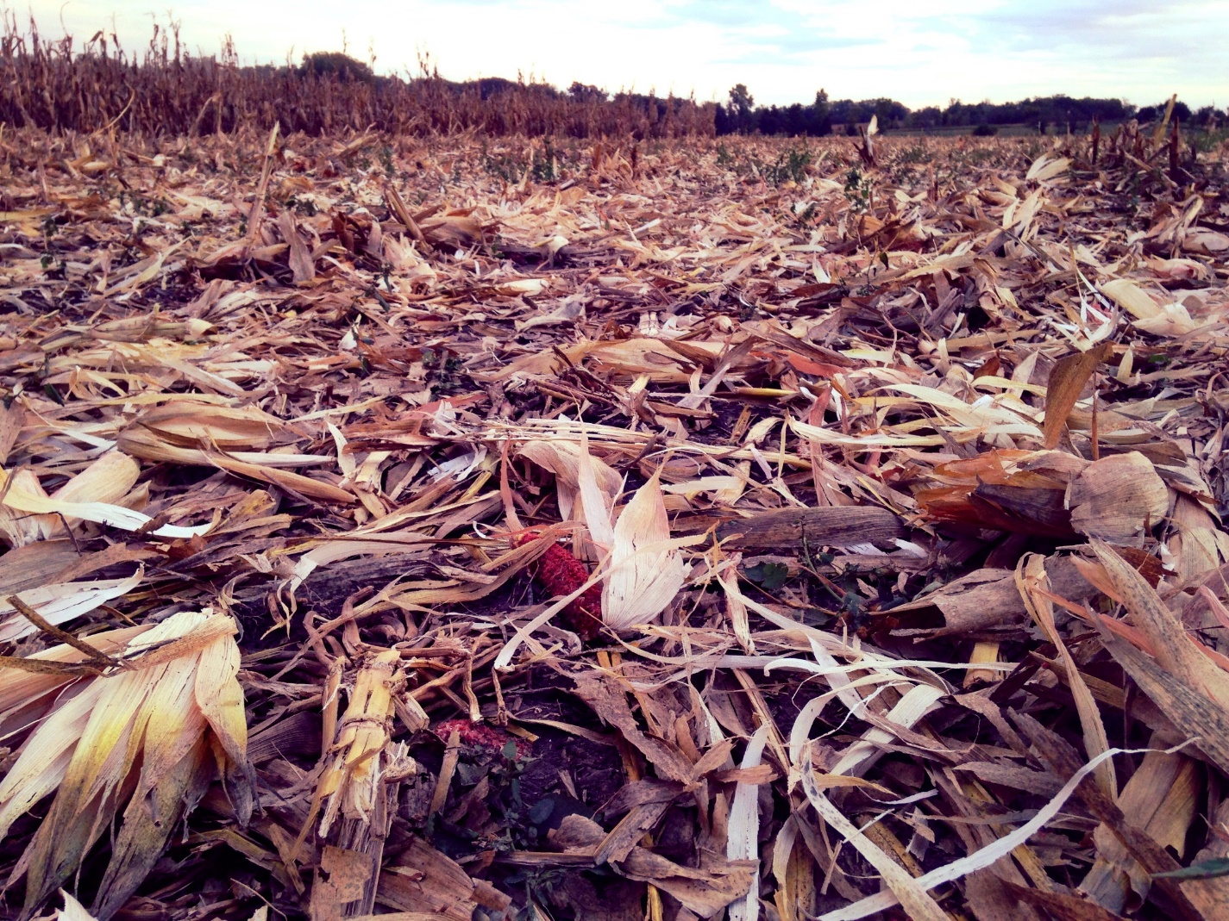
Crop Residue
Advantages
  Feed savings/additional weight gain
  Reduced wear-and-tear of facilities and equipment
  Additional income
Disadvantages
  Remove nutrients and organic matter
  Requires fencing and water source
  Lack of shelter
  Soil compaction?
Notes:
Dustin discuss this.
soil compaction is a myth.
Ask for a show of hands how many graze on crop residue. Why not?

Slide 56
Crop Residue
River Valley and Post Rock Extension Districts 2015 Leasing Survey
  Crop Residue: $9.00 per acre (Range $3-$25)
  Cover Crops: $12.50 per acre (Range $10-$15)
University of Nebraska 2015 Survey
  Corn Stalks: $11-$15 per acre
Iowa State University 2016 Cash Rental Rates Survey
  Corn Stalks: $12 per acre (Range $8-$19)
Notes:
Dustin

Slide 57
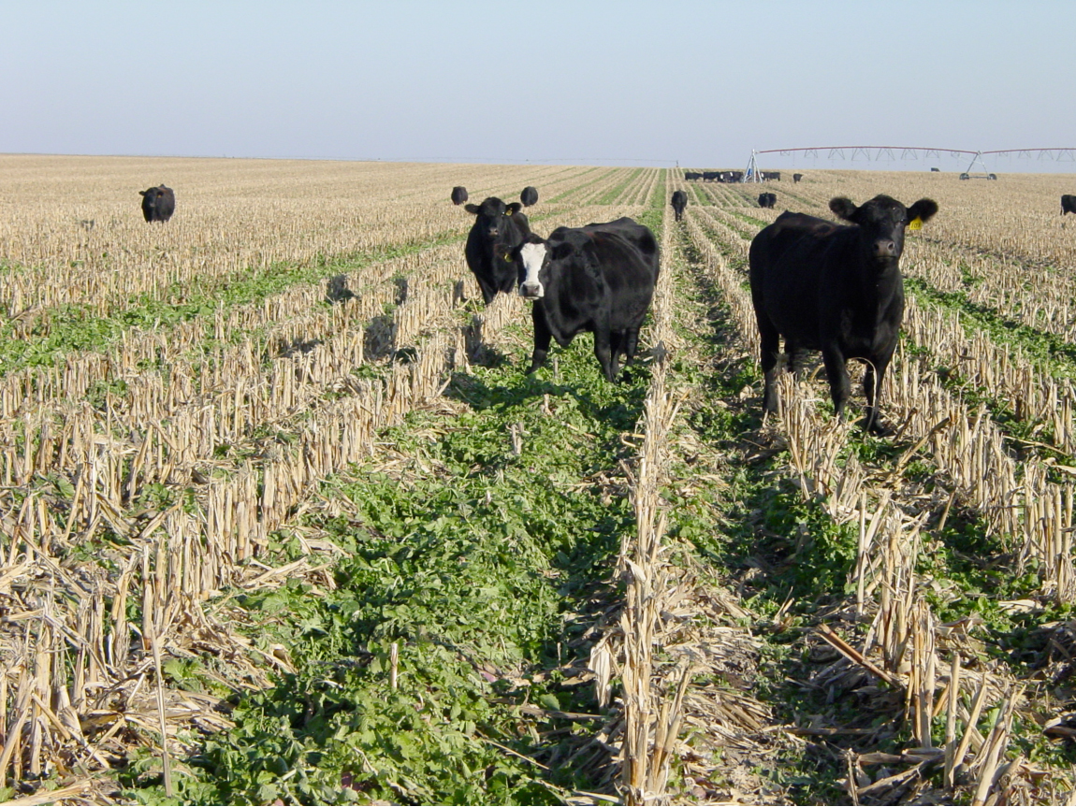
Cover Crops
Advantages
  Improve soil and water quality
  Erosion control
  Winter feed source
Disadvantages
  Increased costs, management and labor
  Require fencing and water source
  Insufficient yields will make grazing a net loss
Cover Crop Cost-Return Budget
  Budget on AgManager.info
Notes:
Mykel
pic: https://fromfieldtofield.com/2011/12/05/turnip-cover-crops/

Slide 58
Profitability depends on yields
Head/acre: 1, 1.5, 2.1
Rent charged: $0.75/head/day
75 grazing days
Department of Agricultural Economics -- Kansas State University, Manhattan, KS
Notes:
Mykel

Slide 59
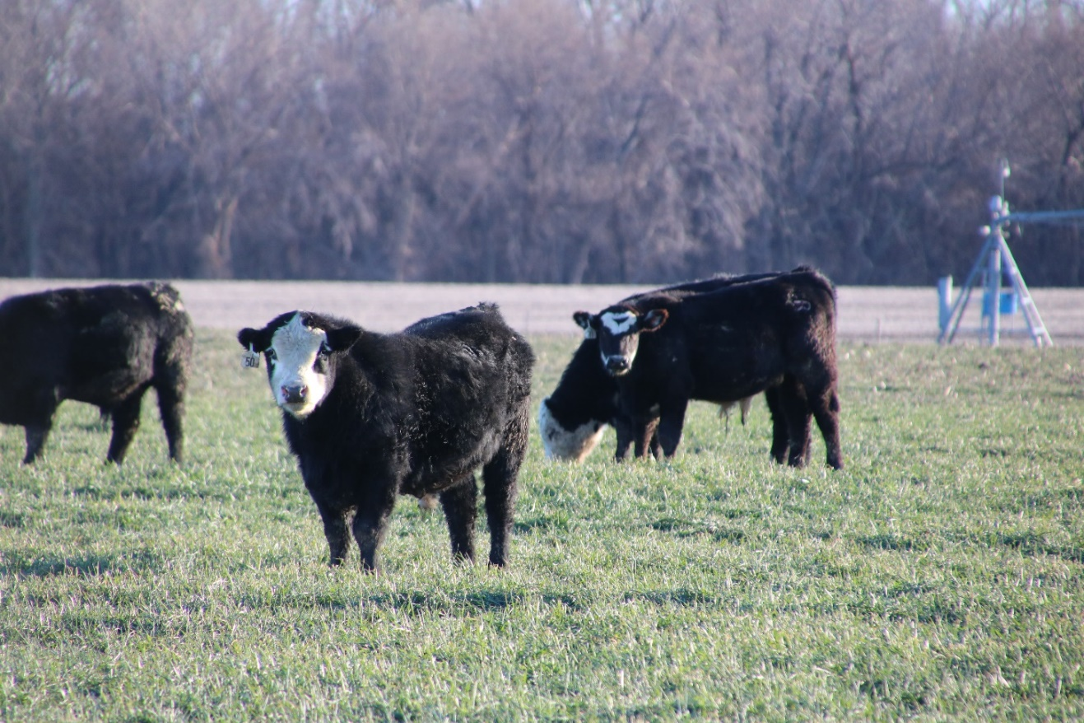
Winter Wheat
Dual purpose wheat
Wheat is grazed out
Tools
  Wheat Stocker Planner & Grazeout (OSU)
  Wheat Grazing and Wheat Graze-Out
    Budgets on AgManager.info
Notes:
Kansas is known as the wheat state because of its grain production. However, wheat is an excellent grazing crop, so producers may want to look at income from forage as well as the grain. Depending on weather and market conditions, producers can consider three basic wheat grain and forage strategies: harvest the wheat as grain only, as forage and grain, or as forage only (graze out). Many Kansas producers view wheat grazing as an opportunity for additional revenue.
There are a number of alternative arrangements for wheat pasture leasing: 1) dollar per hundredweight per month; 2) dollar per pound of gain; 3) dollar per head per day; or 4) dollar per acre.

Slide 60
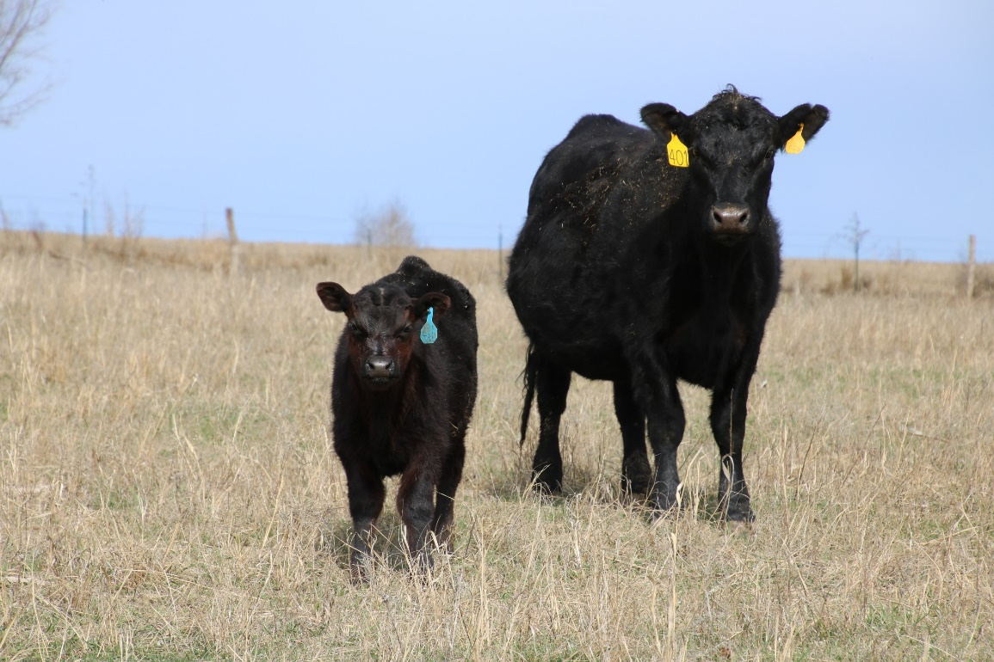
Conservation Reserve Program
2014 Farm Bill reduced available CRP acres and many KS expiring contracts are not being renewed
  Pasture supply increase, at least locally
Cropping not profitable in short run
  Quality of the land
  Low profitability
Pasture
  Investment in fencing and water (EQIP)
  Need for range management plan to optimize the stocking rate

Slide 61
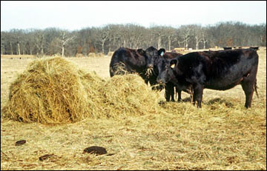
Minimize Feed Waste
Storage
  6% - 37% loss
Feeding
  Types of bales
  Feeding method
    4% - 50% loss
Losses due to storage and feeding
  +$12-$58/cow
Limit amount feed hay
Notes:
Stored on the ground; no cover -- 37% loss
Stored on the ground; covered -- 29% loss
Stored on tires; no cover -- 29% loss
Stored on tires; covered -- 8% loss
Net wrapped; stored on ground; no cover -- 19% loss
Stored in the barn -- 6% loss
Source: University of Tennessee
Feeding Round Bales to Cattle Feeding Method Waste, %
Roll-out on ground up to 50.0
Cradle Feeder 14.6
Trailer Feeder 11.4
Ring Feeder 6.1
Cone Feeder 3.5
Source: Colorado State University
Low Quality Feed
1375 lb cow with 1.5% body weight (dry bred cow) for 60 days
1375 lb cow with 2.0% body weight (lactating cow) for 60 days
High Quality Feed
1375 lb cow with 2.5% body weight (dry bred cow) for 60 days
1375 lb cow with 2.7% body weight (lactating cow) for 60 days
$65/ton for grass hay
Assuming 10% loss to storage and feeding method and assumption about cows, then $12 total hay costs for losses (avg. quality hay). Assuming 40% loss to storage and feeding method and assumption about cows, then $58 total hay costs for losses (avg. quality hay).

Slide 62
LMIC Beef Production and Price Quarterly Forecast (11/28/2016)

Slide 63
LMIC Beef Production and Price Quarterly Forecast (11/28/2016)
Notes:
If you want the story behind this, see AgManager (Glynn Tonsor) for more detail in his Beef-Cattle Outlook talk

Slide 64
Crops

Slide 65
Managing Costs & Returns
What are the cost-return categories that separate the top third profitable farms from the bottom third?

Slide 66
Managing Costs & Returns
Not really
  Price
Fixed costs driven by acres
  High 1/3: 488 ac
  Low 1/3: 312 ac

Slide 67
Managing Costs & Returns
Yes
  Fertilizer/lime
  Herbicides and insecticides
  Seed
  Hired machinery

Slide 68
Cost Management Strategies
Efficient fertility usage
  Apply fertilizers at a rate determined by soil tests
Input pricing
  Early buying, generics, group buying
Field management
  Scouting for most effective spray, timing of applications
Labor-machinery management
  Use of custom hire vs. own machinery

Slide 69

Efficient Nutrient Management
Multi- Nutrient
Variable Application
In-Season
Cues
Soil sampling needed to optimize inputs use without affecting yields
Nutrient management by priority
  Soil pH affects all other nutrient availability
Secondary
& Micros
N & S
P & K
Soil pH
Source: Brian Arnall, OSU

Slide 70
Soil pH Example
Winter Wheat Yield Response to AgLime
Lime Applied (ECC/ac) | Lime Cost ($/ac) | pH | Yield (bu/ac) | Value of Yield Increase ($/ac) @ $3.75/bu | Net Value ($/ac)
0 | 0.00 | 4.6 | 14 | -- | --
3,000 | 36.00 | 5.1 | 37 | 86.25 | 50.25
6,000 | 72.00 | 5.9 | 38 | 3.75 | -68.25
12,000 | 144.00 | 6.4 | 37 | -3.75 | -75.75
Source: David Mengel and Ray Asebedo
Lime price: $0.006/lb = $12/ton

Slide 71
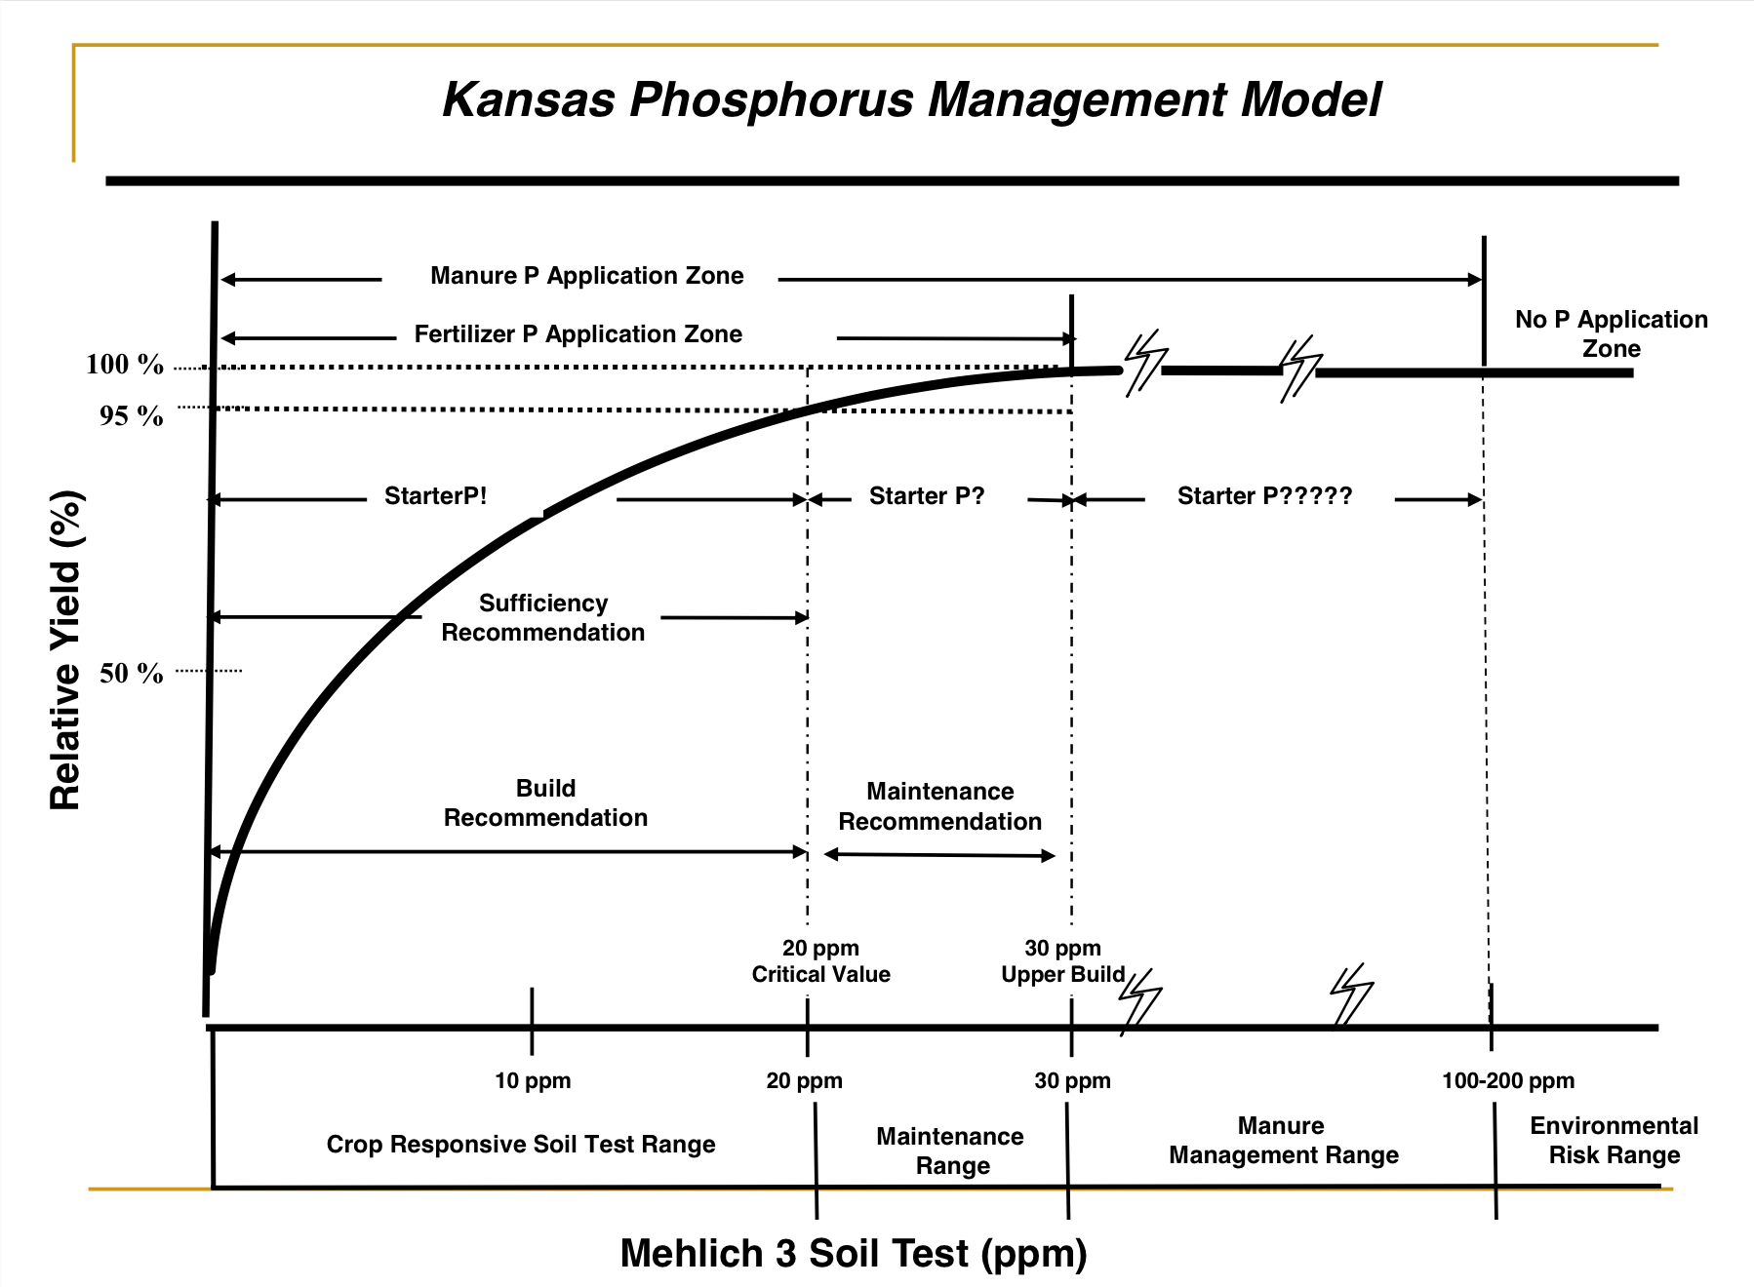
Phosphorus Management
Soil tests may show you don’t need to apply any P at all
  Consider a sufficiency approach
  Is a 50% increase in starter P worth a 5% increase in yield?

Slide 72
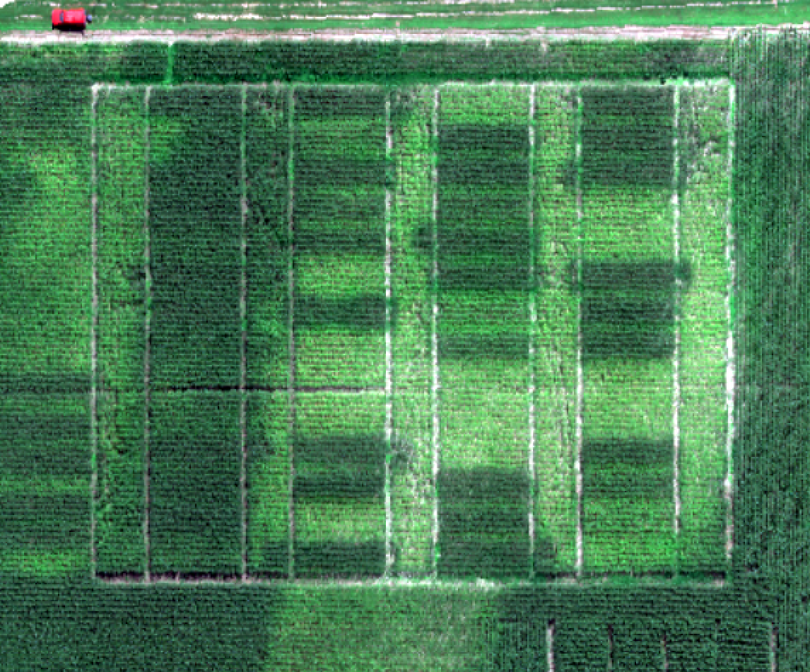
Nitrogen Management
Tools for cutting nitrogen costs without reducing yield
  Sensor technology
  Soil testing
Routine fertility (lime needs)
Profile nitrogen (residual nitrates)
  Surface sample (0-6 in)
  Subsoil sample (6-24 in)
“Many factors other than application rate influence N use efficiency and should be taken into account when developing the overall nutrient management plan.”
K-State Agronomy (MF-2586)
Photo credit: A. R. Asebedo, 2016

Slide 73
Secondary Macro and Micronutrients
Multi- Nutrient
Variable Application
In-Season
Cues
Do not apply secondary macro or micronutrients without having analytical confirmation (i.e. soil tests, plant analysis) that you need it
Skipping the first three steps of the nutrient management ladder will result in money lost
Secondary
& Micros
N & S
P & K
Soil pH
Source: Brian Arnall, OSU

Slide 74
Seed Cost Strategies
Strategies for buying seed
  Ask for bids from multiple dealers (negotiate)
  Offer full cash up front (avoid financing charges)
  Buy before cutoff date in fall (early buy discount)
  Buy all seed from same dealer (bulk discount)
What if I am not a 15,000 acre farm?
  Consider buying seed as a group with neighbors

Slide 75
Chemical Cost Strategies
Same purchase strategies used for seed
  Don’t buy the day before you apply
Timing of application is very important
  Use of a pre-emergent, recognize when it is wearing down
  Get into field for secondary spray while weeds are small
  Avoid having to spray multiple times and/or suffer yield declines due to weeds
What keeps you from getting into the field when you need to?

Slide 76
Labor-Machinery Management
Hired machinery costs are high for low 1/3 profit farms
  Three times higher than high 1/3 profit farms
If you are waiting on custom work, this could affect your total input costs (spraying example)
  Can you optimize your labor-machinery portfolio to reduce yield losses and input costs?

Slide 77
Managing Costs & Returns
Need good records to make these decisions
  Data on costs, yields, etc. underlie all these decisions
Sweat the small stuff
  Outlook not good for anyone in the next 2-3 years, so every cost category is important
Recognize the opportunities when they present themselves
  Determining where to spend money needs same analysis as where to save money

Slide 78
Thank You
Mykel Taylor, Robin Reid, and Dustin Pendell
Department of Ag Economics
Kansas State University

Slide 79
Maintaining Working Capital and Restructuring Debt
Dr. Allen Featherstone
Department of Ag Economics-Kansas State University
Allen M. Featherstone, Professor and Head of the Department of Agricultural Economics and Director of Masters of Agribusiness at Kansas State University, holds M.S. and Ph.D. degrees in agricultural economics from Purdue University. He also holds a B.S. in agricultural economics and economics from the University of Wisconsin-River Falls. Professor Featherstone is recognized as a leading scholar in agricultural finance. His work has resulted in teaching and research awards and quotation in the Wall Street Journal, the Economist, and other publications. He served as Associate Editor for the American Journal of Agricultural Economics and on the editorial board of Choices. He has more than 120 articles published in a variety of journals. He has experience lecturing and researching in Europe, Asia, Africa, and South America.
Email: afeather@ksu.edu Phone: 785-532-4441

Slide 80
Financial Performance
The farm economy has deteriorated substantially from a net income position in the last 24 months
Based upon current price expectations, it appears that this income situation will not increase dramatically over the next few years
What resources should be examined and how does one position the farm for these difficult times.

Slide 81
Liquidity
The ability to pay expenses in the next year is measured by a concept defined as liquidity
Can be measured in a number of ways
  Current Ratio
  Working Capital
  Working Capital Percentage (function of income)
  Working Capital Ratio (function of assets)
The key is to understand the current position and prepare for the future

Slide 82
Current Ratio
Current Assets / Current Liabilities
Decreasing current ratios signify weakening liquid positions
Notes:
Current ratios used to measure liquidity positions and serving short term debt.

Slide 83
Working Capital
Current Assets - Current Liabilities
Decreasing working capital signifies weakening liquid positions
Notes:
Current ratios used to measure liquidity positions and serving short term debt.

Slide 84
What is working capital?
Working Capital = Current Assets – Current Liabilities
Ability to cover current expenses with liquid assets
Typically reported as working capital/gross revenue or working capital/assets when comparing in order to be scale neutral

Slide 85
Working Capital/Assets
Decreasing ratios signify weakening liquid positions

Slide 86
Working Capital/Gross Farm Income
Decreasing ratios signify weakening liquid positions

Slide 87
Financial Statement Example
See Printed Full Page Spreadsheet

Slide 88
Conclusions
Looking at the long-term picture is critical regarding the future of your farming operation
Looking at potential strategies can be helpful to the long term survival of your operation
Have examined the long-term situation
May need to examine the short-term situation by constructing a regular cash flow

Slide 89

Farm Service Agency Loan Programs
Robert (Bob) White
Farm Loan Chief-Kansas FSA State Office
Robert (Bob) White has had the opportunity to serve farmers and ranchers as a Farm Service Agency (FSA) employee his entire professional life. Bob began as a student intern with Farmers Home Administration in 1984. In 1986, Bob relocated to his home-area of Southeast Kansas, where he continued FSA employment, including serving as the Farm Loan Manager in Girard, Kansas for 27 years. In April, 2015, Bob transferred to the Kansas FSA State Office in Manhattan to serve as the Farm Loan Chief. As Farm Loan Chief, Bob oversees the FSA Direct and Guaranteed Farm Lending programs for Kansas FSA, currently assisting over 3,600 borrowers with loans in excess of 700 million.
Email: robert.white@ks.usda.gov Phone: 785-564-4759
USDA is an equal opportunity provider, employer, and lender.

Slide 90
Farm Loan Programs
USDA is an equal opportunity provider, employer, and lender.

Slide 91
Farm Service Agency, Farm Loan Programs
Guaranteed Loans – FSA provides a guarantee of up to 95% to a commercial lender (such as a Bank or Farm Credit). Loan limit of $1,399,000.

Slide 92
Farm Service Agency, Farm Loan Programs
Guaranteed Loans
Farm Ownership (FO) – Funds may be used for the purchase or improvement of real estate or refinancing. Loan terms are limited to 40 years or less.

Slide 93
Farm Service Agency, Farm Loan Programs
Guaranteed Loans
Farm Ownership (FO)
Operating (OL) - Funds may be used to purchase machinery or breeding livestock, or for refinancing. Loan terms typically limited to 7 years.

Slide 94
Farm Service Agency, Farm Loan Programs
Guaranteed Loans
Farm Ownership (FO)
Operating (OL)
Line of Credit (LOC) – Funds to be used for annual crop or livestock inputs. Maximum term of 5 years.

Slide 95
Farm Service Agency, Farm Loan Programs
Guaranteed Loans
Farm Ownership (FO)
Operating (OL)
Line of Credit (LOC)
EZ Guarantee – Limited to $100,000, simplified application process for any of the above loan types and purposes.

Slide 96
Farm Service Agency, Farm Loan Programs
Direct Loans – Loans are made and serviced by FSA.

Slide 97
Farm Service Agency, Farm Loan Programs
For all Farm Loan Program (FLP) direct loans: Eligibility includes a requirement that the Applicant be unable to obtain sufficient credit elsewhere at reasonable rates and terms.
Examples:
  Inadequate security margin
  Limited cash flow
  New operation
  Recovering from a financial loss

Slide 98
Farm Service Agency, Farm Loan Programs
Direct Loans
Farm Ownership (FO) – Direct FO loans may include – Down Payment, 50/50, and 100%.

Slide 99
Down Payment FO Program
Required down payment of 5%
FSA’s interest rate is 1.5%, fixed
Max loan term of 20 years
FSA lends up to 45% of purchase price (FSA’s portion not more than $300,000)
50% of financing from participating lender
Must be an Underserved Applicant or Beginning Farmer

Slide 100
FO Participation (50/50) Loan
No minimum down payment required.
FSA loans 50%, participating lender 50%.
FSA loan rate of 2.5%, fixed for up to a 40 year term.
$300,000 loan limit for FSA’s portion.

Slide 101
FO 100% Loan
No minimum down payment required.
FSA loans up to 100%.
FSA loan rate of 3.625% (Jan. 2017) fixed for up to a 40 year term.
$300,000 loan limit.

Slide 102
Farm Service Agency, Farm Loan Programs
Direct Loans
Farm Ownership (FO)
Operating (OL) – Funds may be used for annual inputs, or machinery and breeding livestock purchases. In some cases, for refinancing debts. A maximum term of 7 years, with amortizations up to 21 years. 2.375% interest rate (Jan. 2017) $300,000 loan limit.

Slide 103
Farm Service Agency, Farm Loan Programs
Direct Loans
Farm Ownership (FO)
Operating (OL)
Microloans – Loans up to $50,000, reduced application requirements and potentially less security necessary. Either of the above loan types and purposes.

Slide 104
Farm Service Agency, Farm Loan Programs
Direct Loans
Farm Ownership (FO)
Operating (OL)
Microloans
Emergency (EM) – Actual Loss loan amounts are based on losses from a declared disaster. Interest rate of 3.375% as of Jan. 2017. $500,000 loan limit.

Slide 105
Farm Service Agency, Farm Loan Programs
Direct Loans
Farm Ownership (FO)
Operating (OL)
Microloans
Emergency (EM)
Youth (YL) – For applicants 10 to 20 years old, participating in 4-H or FFA. 2.125% interest rate. $5,000 loan limit.

Slide 106
Farm Service Agency, Farm Loan Programs
For current interest rates, additional information, or application materials see:
http://www.fsa.usda.gov/programs-and-services/farm-loan-programs
or contact your local FSA Farm Loan Team

Slide 107
Farm Storage Facility Loans
In addition to Farm Loan Program (FLP) loans, the FLP staff in Kansas administer Farm Storage Facility Loans (FSFL). The FSFL Program provides financing for producers to build or upgrade farm storage and handling facilities, as well as purchase of equipment. Qualified facilities include grain bins, hay barns and cold storage facilities. The current fixed rate for a seven year loan is 1.75% (Jan. 2017). Unlike FLP loans, eligible applicants may be able to obtain credit elsewhere.

Slide 108
Farm Service Agency, Farm Loan Programs
Guaranteed Loans
Farm Ownership (FO)
Operating (OL)
Line of Credit (LOC)
EZ Guarantee
Farm Storage Facility Loans
Direct Loans
Farm Ownership (FO)
Operating (OL)
Microloans
Emergency (EM)
Youth (YL)

Slide 109
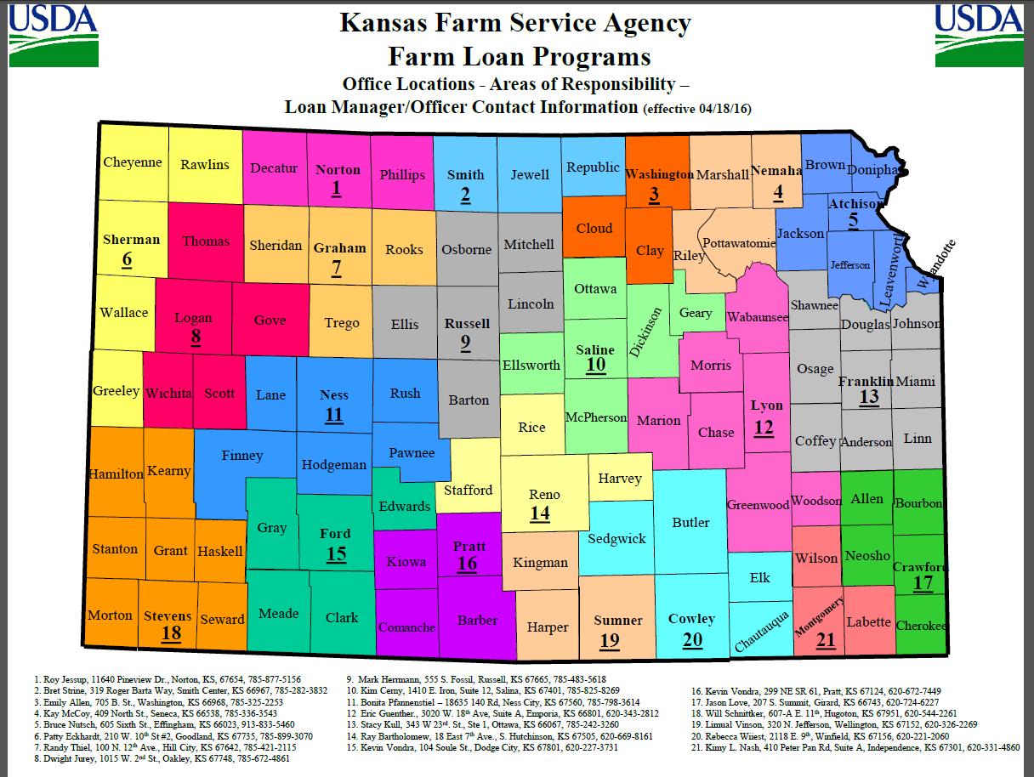

Slide 110
Contact Information
Bob White, Farm Loan Chief
Kansas FSA State Office
3600 Anderson Ave
Manhattan, KS 66503
PH: 785-564-4759
Fax: 855-782-9610
robert.white@ks.usda.gov
USDA is an equal opportunity provider, employer, and lender

Slide 111
How Long Can I Afford to Lose Money on Rented Ground?
Dr. Mykel Taylor
Department of Ag Economics-Kansas State University
Dr. Taylor’s research and extension programs are focused in the areas of crop marketing and farm management. She grew up on a cattle ranch in Montana and attended Montana State University majoring in Agribusiness Management. She has worked in extension positions at both Kansas State University and Washington State University. Some of her current research areas include measuring basis risk for commodity grains, understanding the implications of the 2014 Farm Bill, and analyzing trends in Kansas agricultural land values, rental rates, and leasing arrangements.
Email: mtaylor@ksu.edu Phone: 785-532-3033

Slide 112
Land Values
Affected by profitability in ag sector
But land values do not adjust as quickly as profitability to changes in commodity prices
Adjustment period due to
  Long-run reason for buying and holding land
  Expectations of buyers/sellers

Slide 113
Returns to Farming
Source: KFMA Enterprise Reports (http://www.agmanager.info/kfma)

Slide 114
Kansas Land Values
Source: USDA-NASS

Slide 115
Rental Rates
Source: USDA-NASS
Notes:
Don’t change much or quickly – lag

Slide 116
Rental Rates
Do not change quickly. Why?
  Multi-year leases (3-5 year average) with fixed cash rent
  Negotiating a lower rent is difficult and some landowners dislike volatility in returns
  Landowners may drop tenant rather than take a lower rate
Adjustment in rents will get messy…

Slide 117
Bad Situation
What if you find yourself in a situation where you are paying more for a leased parcel than you expect to profit from it?
Decision to drop a parcel is multi-dimensional and varies by farm and parcel
How do you approach this decision and what do you need to make the right one?

Slide 118
Decision Framework
Time horizon for your decisions
Short-run: cover your variable (cash) costs and you can keep going
  Variable costs: fertilizer, chemicals, seed, fuel, labor
  Fixed costs: depreciation on machinery, property taxes, utilities, management labor, owned land charge
Long-run: cover all your costs (variable + fixed) to keep going
We expect poor profitability for several more years
  How long is the short-run for you?

Slide 119
What is needed to make decision?
Data
  Up-to-date and going back several years
  Accrual-based balance sheet that is updated monthly
  Have to know your fixed and variable costs
Complete list of pros and cons specific to this parcel
  Location of parcel relative to home operation
  Non-pecuniary implications of keeping or losing parcel (family situation)

Slide 120
When to let it go…
Negotiations haven’t moved the needle on lowering rent
  Switching to a flex lease, crop share
  Switching to a single year rental rate rather than multi-year to allow for adjustment up as soon as profits improve
You can’t cover your variable costs of operating it
Your lender says you have to

Slide 121
Decision comes down to comparing your options
Costs of you keep the parcel
Costs if you let it go
Loss of dollars from farming it
  Covering cash costs
  Not paying yourself, no return to owned machinery
  Lower/no return to owned land
Can you cut other costs to keep land base (family living expenses)
Loss of dollars from subleasing it (might be able to lose less money)
Unlikely to get it back or find alternative parcel in the near future
Own too much machinery relative to land base
  Keep it idle if owned outright
  Use for custom work if need to offset loan payment
  Sell machinery: tax implications

Slide 122
Run the numbers…
KFMA enterprise data from 2015
  Corn, wheat, and soybeans at state level
  Highest 1/3 in profitability
  Corn: 475 acres
  Wheat: 762 acres
  Soybeans: 519 acres
Decide whether to drop 300 acre parcel
  Even crop mix (1/3)
  Estimate that you are paying 75% more per acre than you can afford

Slide 123
Returns by Enterprise

Slide 124
If you keep the land
Look at the profitability across the entire farm
  Using new crop bids for 2017 from Salina
Currently losing money across entire farm:

Slide 125
If you walk away…from unaffordable land
Don’t pay rent or other variable costs for those 300 acres
But overhead is now spread over a smaller land base
Result:
Walking away improves your financial situation by $6.65/acre (long run)

Slide 126
If you walk away…from affordable land
For land you are not overpaying on, profitability is reduced if you drop those leased acres
With land Without land
Walking away from affordable land worsens your financial situation

Slide 127
What to do?
Reduce costs using rationalization
  Unpaid operator labor ~ “I don’t have to be paid to be here”
  Land & interest charge ~ “The land is already paid for, so I don’t need a return”
Reduce costs in other ways
  Sell machinery, land
  Reduce family living expenses
  Intensify management decisions to lower cash costs of production

Slide 128



Managing Machinery Expenses
Dr. Gregg Ibendahl, Mark Wood, & Doug Stucky
Kansas State University
Email: ibendahl@ksu.edu mawood@ksu.edu dstucky@ksu.edu
Phone: 785-477-2071 785-462-6664 620-225-5600

Slide 129
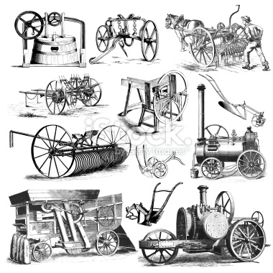
• Machinery costs as a percent of total costs have declined
- No till
- Size advantages
- Better machinery technology
- GMOs
• Still, machinery expense 35-40% of total costs
Based on KFMA data

Slide 130
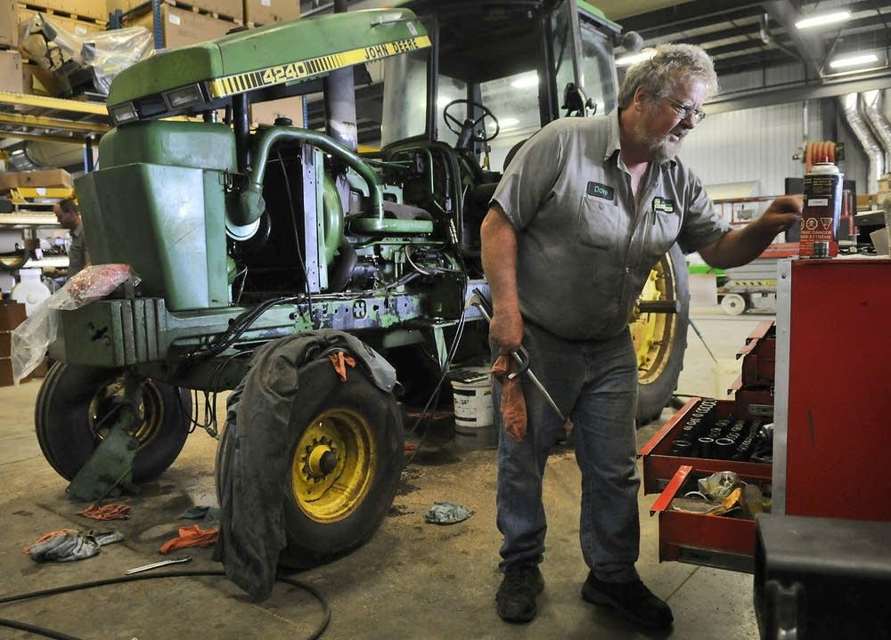
How did we get through the 80’s farm crisis?
• Farmers quit buying machinery during 1st farm crisis
- Farmer’s choice or lender’s requirement?
- By 1989, machinery investment was only 25% of pre-crisis level
• Recovery of machinery investment by early 1990’s
• Newer or additional machinery added started in 2007
• Machinery reserve?
Adjusted for inflation

Slide 131
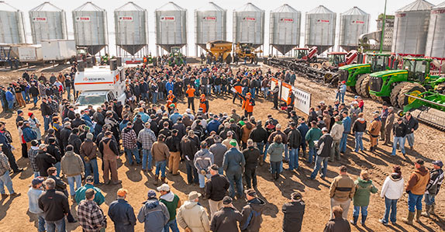
Strong correlation between NFI and machinery purchases
• 0.69 correlation
• No indication of any lag
- Farmers react quickly to changes in NFI when
making machinery purchase decisions
- Trying to take advantage of 179 depreciation?

Slide 132
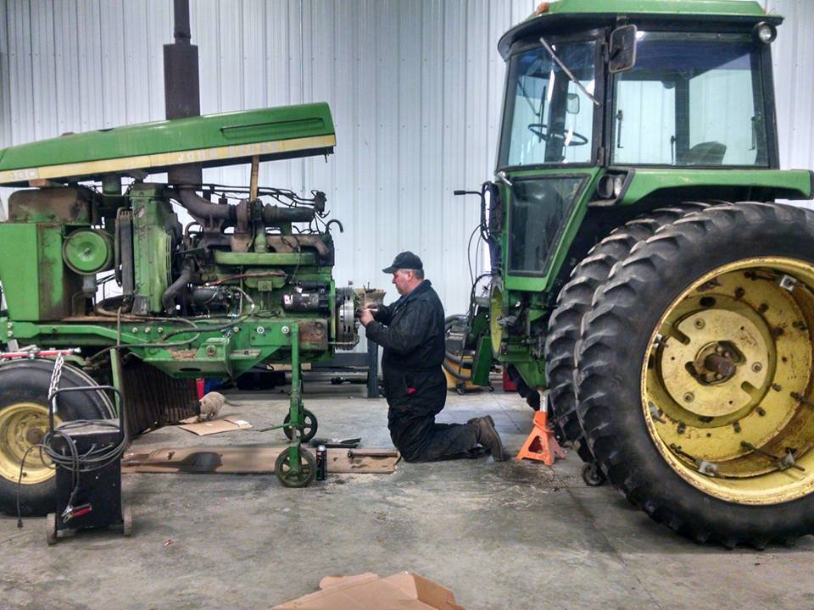
• Lack of purchases during 1980 crisis did not lead to greater repairs
- More repairs done on farm?
- Are on-farm repairs possible today?
• Gradual decline in repairs per acre until 2007

Slide 133
Options for Machinery
Purchase
  Replace frequently
  Replace something every year
  Replace when cash is available
  Keep it forever
Lease
Rent
Custom Hire

Slide 134
Questions to Consider
How much will it cost? (total cost and $/acre) Will the machine increase efficiency or profitability on my operation? Can my capital be used more profitably in other areas of my farm? (ROI)
Can I afford it? How much capital do I need? How will it impact my working capital and cash flow?
Are there tax advantages to owning? (Depends on your situation)
What about reliability and timeliness?

Slide 135
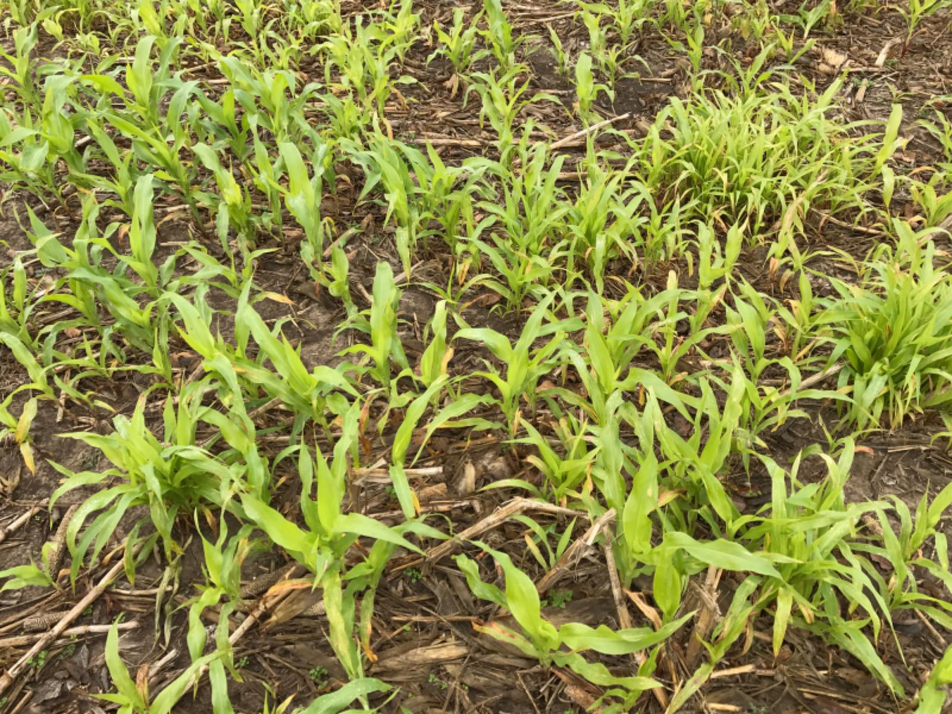
First, Make Sure Equipment is Running Well
• Half of corn loses at corn head
• 2 kernels per ft² = 1 bu acre loss
• 1 ear in 436 ft² = 1 bu acre loss
(loss in 1/100 of an acre)
Seeds per sq ft = 1 bu for other crops
• Wheat – 20 seeds per ft ²
• Soybeans – 4 seeds per ft²
• Sorghum – 31 seeds per ft²

Slide 136
Option 1: Purchase
Advantages
  Control over use of machine, easier management, timeliness
  Generally considered less expensive in the long run
  Tax advantages – expense up to $500,000; no SE tax when sold
Disadvantages
  May require more cash up front, tie up capital
  Farmer pays for all operating expenses (labor, fuel, repairs, insurance, taxes)

Slide 137
Reasons to Replace
Cost minimization
  Rule of thumb: Replace when the annualized total cost of owning and operating the machine begins to increase
    i.e., Depreciation and interest decrease over time while repairs increase and fuel costs stay constant
  Models are very sensitive to estimates
    Requires some knowledge of future repairs
  Typical curves are very flat
    i.e., wide possible range of replace ages

Slide 138
Example of cost minimization

Slide 139
Reason to Replace (cont)
Reliability
  Previous cost minimization left this out
  Ability to get crop planted or harvested at the optimal times
    Small harvest windows
    Weather damage the longer crop stays in the field
  Difficult to measure
    Intuition?

Slide 140
Reason to Replace (cont)
Other
  Pride of ownership
  New technology
  Need for capacity

Slide 141
Replacement Strategies
Replace frequently
  More reliable equipment
  Equipment under warranty
Replace something every year
  Evens out equipment spending
  May reduce borrowing needs
Replace when cash is available
  Levels out NFI
  Difficult to predict

Slide 142
Replacement Strategies (cont)
Keep it forever
  May be least costly option
  May be best for cash flow
  Reliability becomes a factor
    Need for backup equipment
  Sacrificing latest technology

Slide 143
Option 2: Lease
Advantages
  Control over use of machine, timeliness
  Locks in payments (i.e., inflation hedge)
  Conserves capital for other uses (lease payments may be lower than loan payments)
  Good option for rapidly expanding business or farmer planning to retire in 3 – 5 years
Disadvantages
  Does not allow for the buildup of equity
Notes:
Operating – farmer may purchase equipment for market value at end of lease
Finance/Capital – similar except farmer takes ownership up front so total value goes on deprecation schedule

Slide 144
Option 3: Rent
Advantages
  Short-term contract (hours, days, weeks, or months)
  Low capital commitment
  Better control over machine operation
Disadvantages
  The number of rental companies might be limited
  Farmer needs to operate machine
  May need insurance on machine

Slide 145
Option 4: Custom Hire
Advantages
  Producer not responsible for machine repairs, daily maintenance, selling machine, etc.
  Free up time and avoid hiring part-time help
    i.e., Operator is part of package
  No long-term capital commitment
  Ideal for specialized work
  Know your costs in advance (no surprises)
Disadvantages
  Less control over timeliness and quality of work

Slide 146
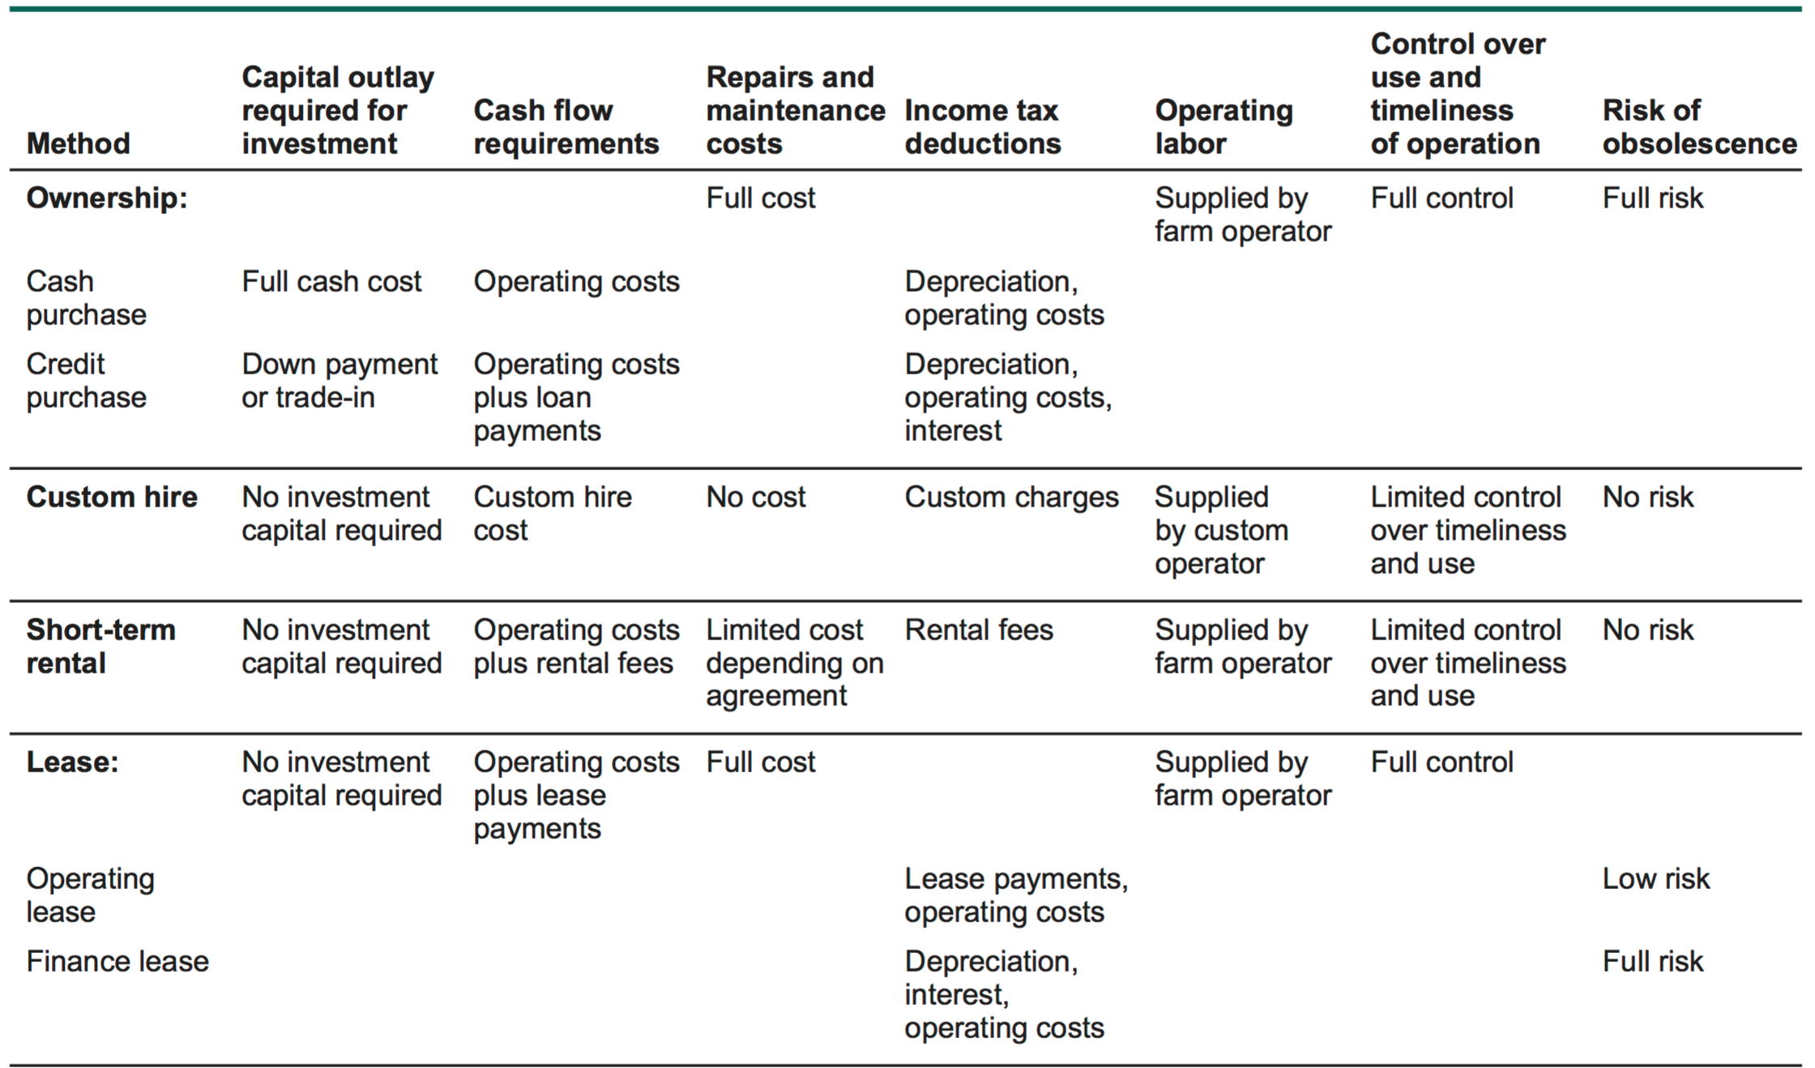
Summary of methods of acquiring machinery
From Iowa State Publication A3-21

Slide 147
Summary –
Considerations for farmers for the next few years
Many farmers built up a “bank” of machinery
  Time to draw down these reserves
  Reducing machinery investment per acre by 50% would put farms inline with historical norms
Proper maintenance can help reduce field loses as well as reduce repairs
When equipment is needed, analyze all options for impacts to profitability as well as cash flow.

Slide 148
Examples
Lease vs Purchase spreadsheet (Iowa State) - https://www.extension.iastate.edu/agdm/crops/xls/a3-21_35machfinancing.xls
Machine ownership vs Custom hire (Iowa State) –
https://www.extension.iastate.edu/agdm/crops/xls/a3-33ownerch.xlsx

Slide 149
Lease or Purchase Example: Case IH 9230 Combine
Purchase Price | $317,500
Down Payment | 20%
Interest Rate | 6.90%
Loan Length (years) | 5
Annual Payment | $61,782
Salvage Value (in 5 years) | $162,000
Section 179 Deduction | $500,000
Book Value (in 5 years) | $58,963

Slide 150
Example: Case IH 9230 Combine
Annual Insurance and Housing | $2,242
Annual Repairs | $2,540
Annual Labor | $4,112
Annual Fuel and Oil | $8,811
Total Fixed and Variable Costs | $17,705
Federal Tax Rate | 18.0%
Self Employment Tax | 15.3%
State Tax Rate | 0.0%
Total Tax | 33.3%

Slide 151
Purchase Case IH 9230 Combine
Net Cash Flows for Purchase
Year | Down/Loan Payment | Remaining Value When Sold | Repair Costs | Tax Savings or Payments | Net Cash Flow
0 | $ 63,500 |  |  |  | $ 63,500
1 | 61,782 | $ - | $ 1,265 | $ (101,356) | (38,308)
2 | 61,782 | - | 2,054 | (5,999) | 57,838
3 | 61,782 | - | 2,872 | (5,276) | 59,379
4 | 61,782 | - | 3,713 | (4,495) | 61,001
5 | 61,782 | (109,274) | 4,571 | (3,649) | (46,570)
6 | - | - | - | 32,151 | 32,151
Total | $ 372,412 | $ (109,274) | $ 14,475 | $ (88,622) | $ 188,991
Cash flow is now a more important consideration
Source: Iowa State University Extension
Selling combine creates income tax

Slide 152
Lease Case IH 9230 Combine
Net Cash Flows for Lease
Year | Lease Payments | Remaining Value When Sold | Repair Costs | Tax Savings or Payments | Net Cash Flow
0 | $ 42,000 |  |  |  | $ 42,000
1 | 42,000 | $ - | $ 1,265 | $ (13,408) | 29,857
2 | 42,000 | - | $ 2,054 | (13,811) | 30,242
3 | 42,000 | - | $ 2,872 | (14,063) | 30,809
4 | 42,000 | - | $ 3,713 | (14,325) | 31,388
5 | - | - | $ 4,571 | (14,593) | (10,022)
6 | - | - | $ - | (1,459) | (1,459)
Total | $ 210,000 | $ - | $ 14,475 | $ (71,659) | $ 152,816
Source: Iowa State University Extension

Slide 153
Purchase vs. Lease Comparison
Yearly After-tax Cash Outflows
Year | Purchase | Lease
0 | $63,500 | $42,000
1 | -$38,308 | $29,857
2 | $57,838 | $30,242
3 | $59,379 | $30,809
4 | $61,001 | $31,388
5 | -$46,570 | -$10,022
6 | $32,151 | -$1,459
Total cash flow | $188,991 | $152,816
Present value | $169,928 | $142,203
Annual cost | $38,819 | $32,485
Adjustment for time value of money
Source: Iowa State University Extension

Slide 154

Purchase vs. Custom Hire: 1,825 acres
Source: Iowa State University Extension

Slide 155

Purchase vs. Custom Hire: 1,825 acres
KSU 2016 Custom Rates based on yield
Source: Iowa State University Extension

Slide 156
Alternative 1: Joint Ownership
Must reach agreement
  Work habits and care of the machine
  Scheduling
  Labor and repairs – who is responsible?
Written agreement to dissolve
  Disagreement
  Termination from farming by one party (retirement, death, expansion)
  Method to determine machine’s value
Notes:
Can work really well, but need to think through all different scenarios before jumping in.

Slide 157
Alternative 2: Rent Out Machinery
Generates additional revenue
Spreads machinery costs over more acres
Works best to rent outside of local area (when you don’t need the machine)

Slide 158
Questions or comments?
Gregg Ibendahl
ibendahl@ksu.edu
785-477-2071
Twitter: @ibendahl

Slide 159

Farm Safety Nets
Dr. G.A. (Art) Barnaby
Department of Ag Economics-Kansas State University
Dr. Art Barnaby was raised on a diversified farm, located in Elk County, Kansas. Art received his B.S. degree from Fort Hays State University, M.S. from New Mexico State University and a Ph.D. in Agricultural Economics from Texas A&M University. Art joined the Agricultural Economics faculty in 1979. He currently holds the rank of Professor. Art conducts national extension education programs on market risk, government commodity programs, crop insurance and public policy. He has authored several research projects on crop insurance issues and their impacts on farmers. His research work with the private sector was the basis for the first revenue insurance contract.
Email: barnaby@ksu.edu Phone: 785-532-1515

Slide 160
Big Wheat Crop Exceeds Storage Causing Weak Basis on MYA price
Current KS cash wheat prices are under the national cash price and will cause government payments to be less than farmers expect because cash prices are higher in the rest of the country.
Some of the KS crop was (is being) put under loan. Those bushels are temporarily off the cash market.
In 9 months those loans will expire and farmers will repay the loan at market or the Posted County Price (PCP) price. Then there is no “floor” under the market.
LDP, ARC and PLC payments from all crops are included in the $125,000 limit, so larger farmers don’t want to use up their $125,000 limit with LDP/Loan Gains; therefore re-pay loans with certificates.
There is no payment limit or means testing required for farmers using certificates
1

Slide 161
Big Wheat Crop Exceeds Storage Causing Weak Basis on MYA price
Loan Rates are set at the county level and the Posted County Price (PCP) should approximately equal the local cash price and determines LDPs.
Price Loss Coverage (PLC) payments are triggered by the Marketing Year Average (MYA) price that accounts for prices across all regions of the USA.
Agriculture Risk Coverage (ARC) payments are triggered by the Marketing Year Average (MYA) price and county yields.
The MYA price is based on a survey of elevators who report total bushels purchased and total dollars paid during a month. That data is aggregated to the national level to get an average price for the month. At the end of the marketing year, the monthly prices are weighted based on the % of the crop sold in each month.

Slide 162
2016/17 Estimated MYA Corn Price

Slide 163
2016/17 Estimated MYA Sorghum Price

Slide 164
2016/17 Estimated MYA Soybean Price

Slide 165
2016/17 Estimated MYA Wheat Price

Slide 166
Nobody is Selling Wheat for $3.70 ????
It is a national average price, and wheat was over $4 in the NW USA.
A part of the KS crop is under loan, so those bushels are not showing up in the survey as cash sales.
I used the SRW CME wheat contract to drive my model. In recent weeks SRW has traded at a premium to HRW, and this would cause my estimate to be too high.
I adjusted for a wide basis, but it may need to be widened.
Current KSU estimate for 2016/17 MYA wheat price is at $3.73.
Because more than 3 NASS wheat prices have been published, it is expected the KSU model’s estimated MYA wheat price will be near the final MYA price.
Current KS cash prices vs. the MYA price is wider than normal.

Slide 167
Commodity Programs Don’t Cover Local Basis Risk, NASS Monthly Price vs. Colby Monthly Cash Price

Slide 168
I Picked the wrong ^&*## Program!
Will 2016/17 corn PLC payments Exceed ARC? Likely many corn counties will generate no ARC payments, even with low prices, because of “high” yields.
It is correct that “high” county revenue eliminates ARC program payments, but that is the way ARC was designed to work.
Why did my neighbor across the road in a neighboring county get a big ARC payment and I received none?
Where does FSA get their county yields?
FSA uses the total production in the county as reported by NASS divided by NASS harvested acres + RMA failed acres. Approved FSA county yields are set by FSA. NASS sets the MYA price.

Slide 169
I Picked the wrong ^&*## Program!
A large number of counties don’t have a NASS county yield because not enough surveys were returned by farmers.
FSA’s county yield may not account for all of the acres gong to corn silage, wheat pasture, seed corn, and the split with irrigation.
Crop insurance yields are reported with criminal liability attaching, so RMA data could be used to supplement NASS data and determine county yields.
USDA will have up to 4 different county yields; NASS, FSA, RMA-ARP and RMA-Supplemental Coverage.

Slide 170
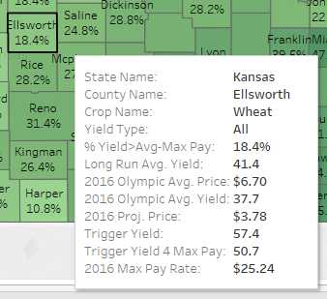
The percentage that the 2016 county yield, as reported by FSA, needs to be above or below the Long Run Average Yield for the maximum payment to be triggered. For example, Ellsworth County can have a 2016 county yield up to 19.4% above it’s 41.4 bushel long-run yield and still receive the maximum ARC-CO payment.
A 10-year RMA (crop insurance) reported yield used to represent a longer run “normal” yield for this county
An Olympic average of the last 5 years of National Marketing Year Average prices
An Olympic average of the last 5 years of county yields as reported by FSA
The current estimate for the 2016/2017 National Marketing Year Average Price
If the County Yield is below this number, some level of ARC-CO payment will be received (given the current price estimate)
If the County Yield is below this number, the maximum ARC-CO Payment will be received (given the current price estimate)
Maximum Payment this county could receive (10% of Guaranteed Revenue)
Maps can be found at: http://www.agmanager.info/ag-policy/arc-co-20162017-percentage-maps (also maps for Corn, Soybeans and Sorghum with each irrigation practice)

Slide 171
Ellsworth County Wheat

Slide 172
Ellsworth County Wheat

Slide 173
Ellsworth County Wheat

Slide 174
Ellsworth County Wheat

Slide 175
Ellsworth County Wheat

Slide 176
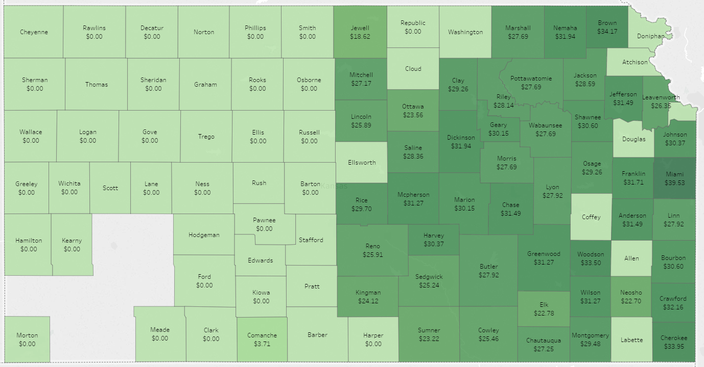
2016/2017 ARC-CO Estimated Payments for Wheat
Map can be found at: http://www.agmanager.info/ag-policy/arc-co-20162017-projected-payment-maps/20162017-kansas-arc-co-wheat-projections

Slide 177
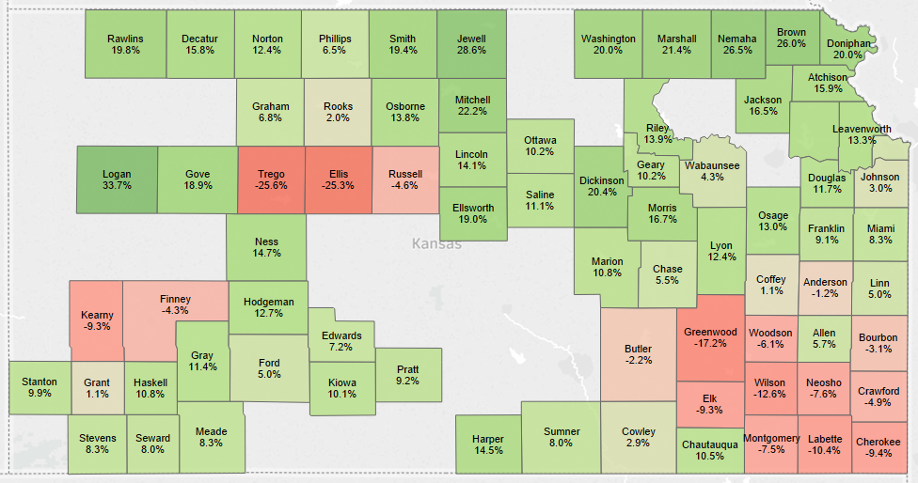
2016/2017 ARC-CO Yield Percentage for Corn
Maps can be found at: http://www.agmanager.info/ag-policy/arc-co-20162017-percentage-maps (also maps for Corn, Soybeans and Sorghum with each irrigation practice)

Slide 178
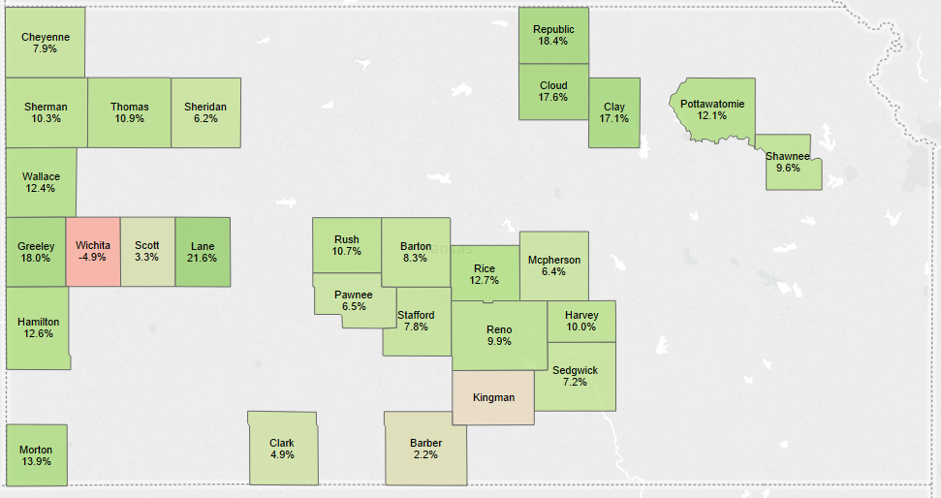
2016/2017 ARC-CO Yield Percentage for Irrigated Corn
Maps can be found at: http://www.agmanager.info/ag-policy/arc-co-20162017-percentage-maps (also maps for Corn, Soybeans and Sorghum with each irrigation practice)

Slide 179
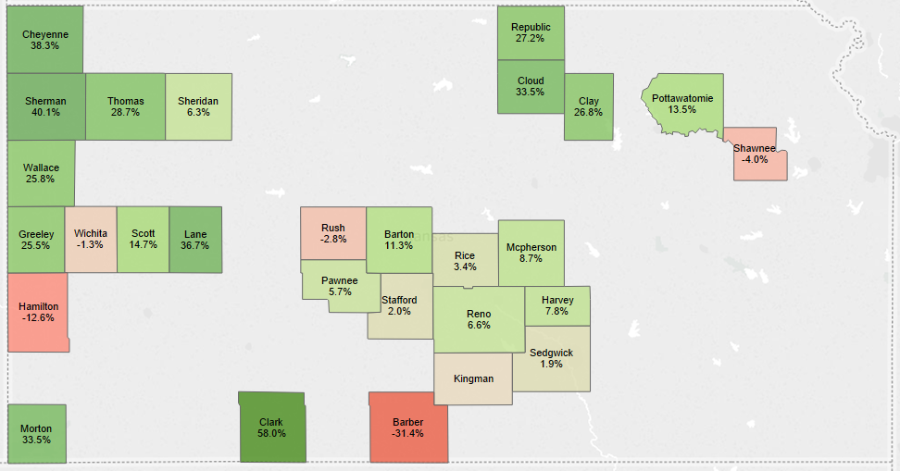
2016/2017 ARC-CO Yield Percentage for Dryland Corn
Maps can be found at: http://www.agmanager.info/ag-policy/arc-co-20162017-percentage-maps (also maps for Corn, Soybeans and Sorghum with each irrigation practice)

Slide 180
Why Ringgold County Iowa Corn Example?
Iowa drives Ag Public Policy because it is the one Ag state all Presidents visit.
Iowa example answers the question why did Northern Iowa receive “large” ARC payments and Southern Iowa none?
Why didn’t ARC provide shallow loss coverage?
Multiple year county yield and price losses has made the ARC coverage less than many farmers expected.
In 2018/19 counties with yield equal to the county’s 5 year Olympic average yield will likely require a MYA corn price below $3.18 to trigger ARC payments, unless there is a major change in the market in 2017.
Did farmers fully understand the impact of the yield averaging method when they selected between PLC & ARC?

Slide 181
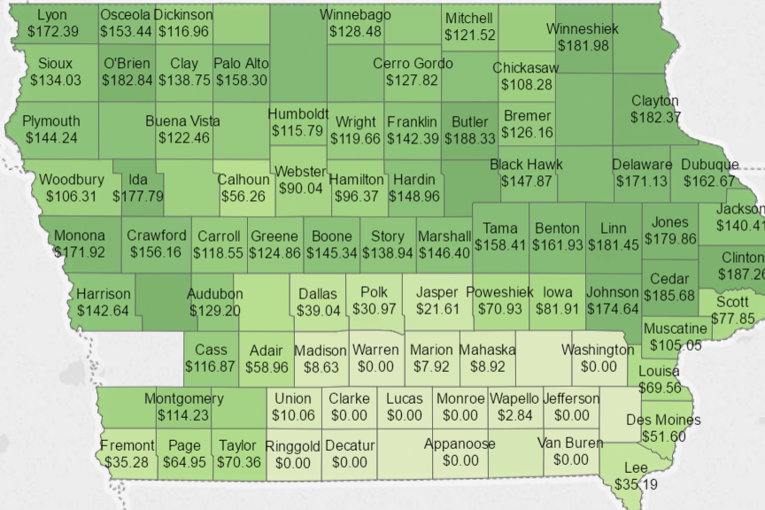
2014 & 2015 Combined Iowa Corn ARC Payments`
`

Slide 182
Actual & Estimated MYA Prices for Major Cropsª

Slide 183
Actual & Estimated Price Loss Coverage (PLC) Payment Rate for Major Crops

Slide 184
Historical Yields and MYA Prices for Ringgold, Co. IA
Actual & Estimated Ringgold, Co. IA, ARC Payments
Notes:
Change Ringgold county 2015 yield to 146

Slide 185
I Picked the wrong ^&*## Program!
ARC is a revenue guarantee so if a county has a yield higher than their “expected” or “average” county yield and it eliminates the ARC payment, then help is not needed from the government because farmers met their revenue guarantee.
Multiple year losses drive down the 5 year Olympic Average Yield. Ringgold County had a crop bust in 2010 and 2012 and a low yield in 2011. In a 5-year Olympic average yield 2 of the 3 yields are low that are included in the 3 year average.
The key question is does the 5 year Olympic average yield represent the “normal” Ringgold County, IA yield or does the 133 bu. crop insurance T-yield represent the “normal” yield? If ARC is using a below normal yield, then the ARC revenue guarantees will be low.

Slide 186
I Picked the wrong ^&*## Program!
So if the ARC is not effective coverage, then they should just buy a higher crop insurance coverage level or add Supplemental Coverage. Right?
There is a good chance that corn in Ringgold County Iowa will Receive no ARC payments for the entire 5 years of the program.
  No payment scenario for Ringgold will require an average yield (100% T-Yield) or better in 2017 and 2018, and no change in current market conditions.

Slide 187
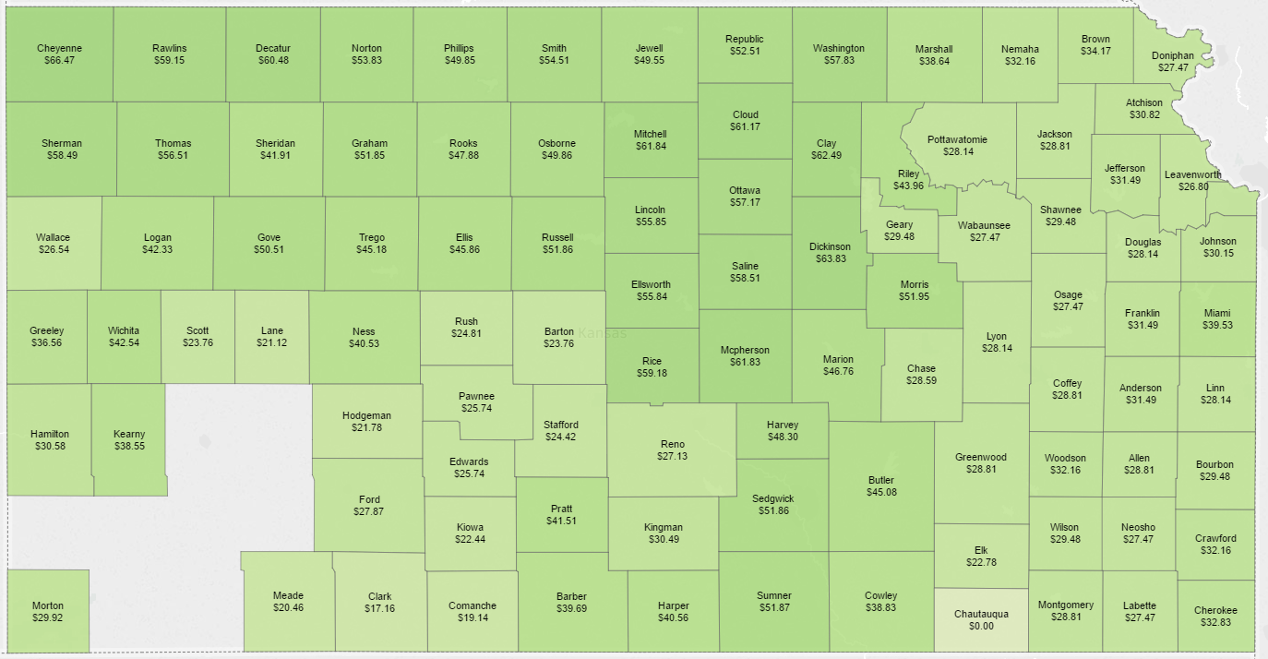
2014 & 2015 Combined ARC-CO Wheat Payments
Maps can be found at http://www.agmanager.info/ag-policy/arc-co-payment-maps (also maps for Corn, Soybeans and Sorghum with each irrigation practice)

Slide 188
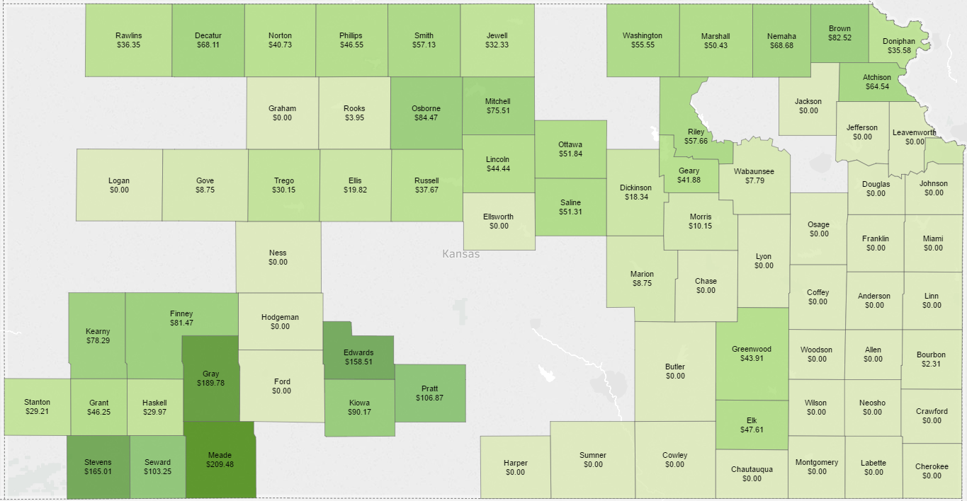
2014 & 2015 Combined ARC-CO Corn Payments
Maps can be found at http://www.agmanager.info/ag-policy/arc-co-payment-maps (also maps for Corn, Soybeans and Sorghum with each irrigation practice)

Slide 189
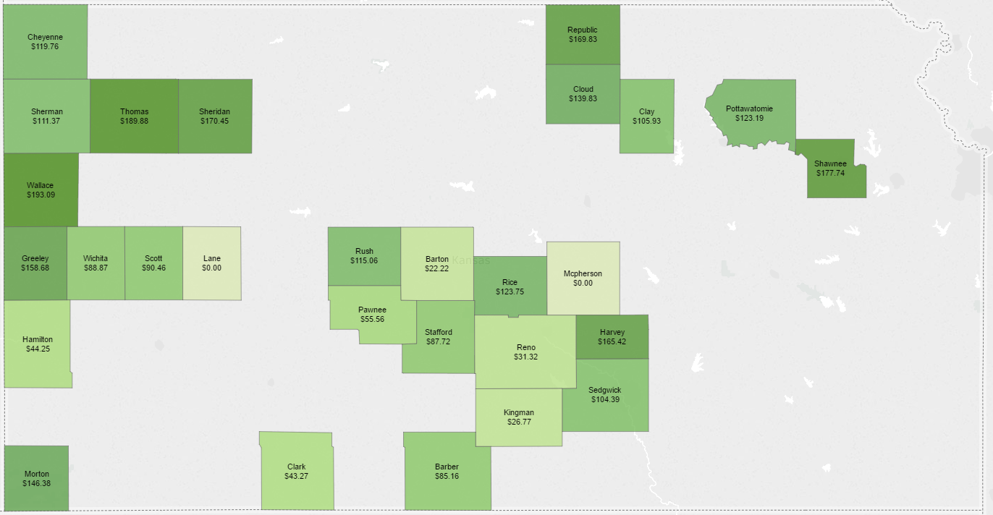
2014 & 2015 Combined ARC-CO Corn Payments-Irrigated
Maps can be found at http://www.agmanager.info/ag-policy/arc-co-payment-maps (also maps for Corn, Soybeans and Sorghum with each irrigation practice)

Slide 190
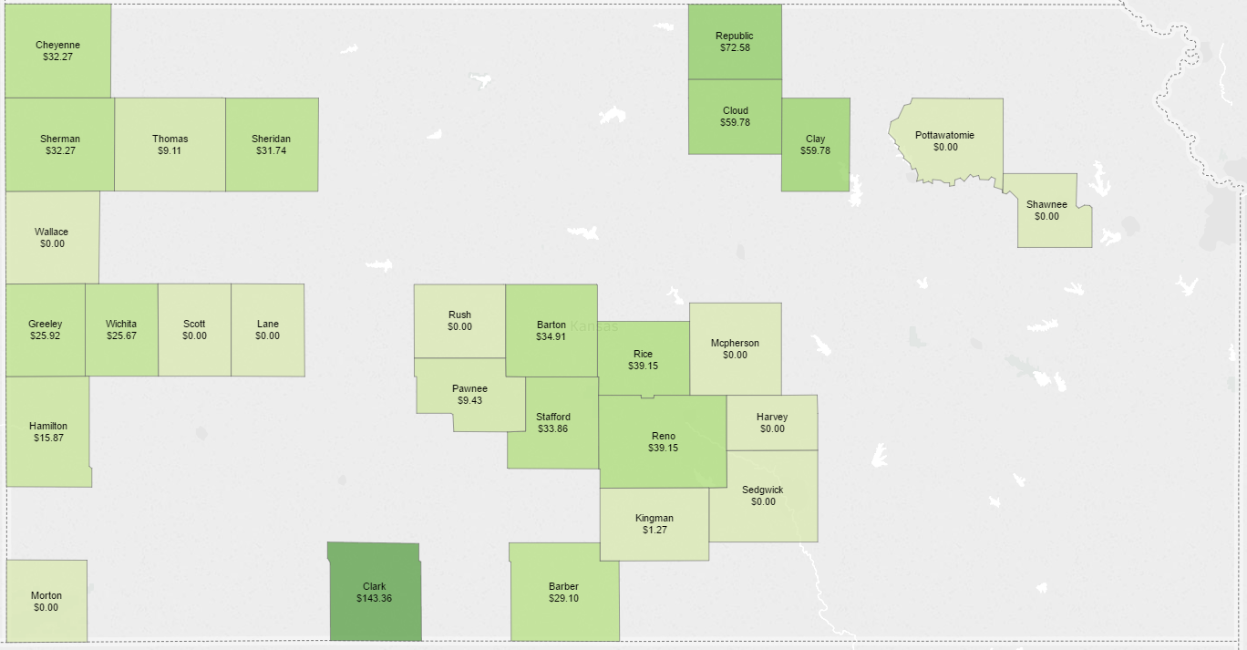
2014 & 2015 Combined ARC-CO Corn Payments-Dryland
Maps can be found at http://www.agmanager.info/ag-policy/arc-co-payment-maps (also maps for Corn, Soybeans and Sorghum with each irrigation practice)

Slide 191
Summary on Selecting ARC vs PLC
If farmers had a do over, ARC enrolled farmers would likely switch milo and wheat to PLC, but not soybeans. Corn will depend on the county yield distribution and the FSA approved farm program corn yield.
When farmers signed up for ARC, many were worried about low yields over the next 5 years. If 2016 had been a drought year then unlikely PLC would have paid, but ARC would have paid in counties with low yields.
MYA price does not account for basis nor does crop insurance.
There is nothing to cause the MYA price to converge with local cash or futures.
A return to normal wheat crop production levels will likely cause convergence between futures and cash.

Slide 192
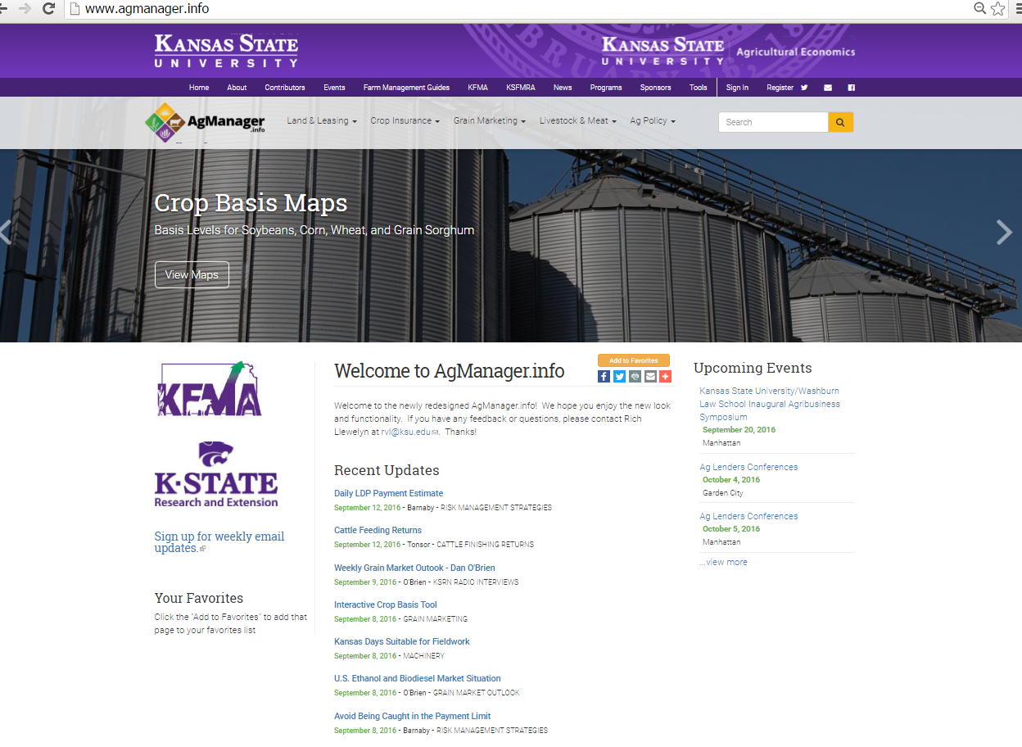

Slide 193
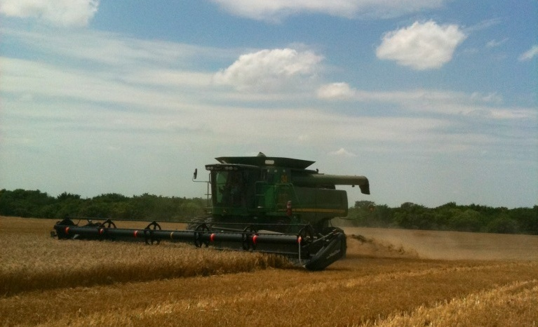
Thank You
DR. G. A. “ART” BARNABY, JR.
KANSAS STATE UNIVERSITY
PHONE: 785-532-1515
EMAIL: barnaby@ksu.edu
Check out our WEB page at
http://www.AgManager.Info
Copyright 2016, All Rights Reserved

Slide 194

Income Tax Management
Mark Wood, Doug Stucky, & Cody Holland
Kansas Farm Management Association
Kansas State University
Email: mawood@ksu.edu dstucky@ksu.edu codyholland@ksu.edu
Phone: 785-462-6664 620-225-5600 316-321-1371

Slide 195

Income Tax Management
Mark Wood, EA
Kansas Farm Management Association
Kansas State University
mawood@ksu.edu
785-462-6664

Slide 196
Tax Planning is Critical
Planning in low income years is just as important as in high income years
Don’t leave anything on the table:
  Net Operating Losses (NOLs) Traps
  Maximize credits when available
  Avoid potential tax traps:
    Farm & Hobby Loss Rules
    Leases, Cancellation of Debt, and Financial Distress Transactions

Slide 197

TAX UPDATES

Slide 198
Federal Tax Updates
FAFSA (student loan application) no longer looks at current year tax return, no need to file early
New filing deadlines:
  1099s and W2s moved from 3/31 to 1/31
  Form 1065 (partnerships) moved from 4/15 to 3/15
  Form 1041 (estates and trusts) moved from 4/15 to 3/15
  Form 1120S (S-corps) remains 3/15
  Form 1120 (C-corps) moved from 3/15 to 4/15

Slide 199
Federal Tax Updates
 | 2016 | 2017
Standard Deduction (MFJ) | 12,600 | 12,700
Personal Exemption | 4,050 | 4,050
§179 Deduction | 500,000 | 510,000
Bonus Depreciation | 50% | 50%
MFJ Bracket
10% | 0-18,550 | 0-18,650
15% | 18,550-75,300 | 18,650-75,900
25% | 75,300-151,900 | 75,900-153,100
28% | 151,900-231,450 | 153,100-233,350
33% | 231,450-413,350 | 233,350-416,700
35% | 413,350-466,950 | 416,700-470,700
39.6% | >466,950 | >470,700

Slide 200
Kansas Tax Updates
Refund of sales tax paid on fire damaged agricultural fence available (application required)
Kansas return filing deadlines did not change with federal changes
Tax brackets, standard deduction, exemptions unchanged
  2.7% & 4.6% marginal rates
Low income exclusion
  No tax if taxable income <12,500 (MFJ)

Slide 201

NET OPERATING LOSSES

Slide 202
Net Operating Loss (NOL)
NOL is a loss created when deductions exceed income
NOLs always result in unused deductions
NOL is created by:
  Non-farm business (Schedule C)
  Casualty or theft of personal property
  Small business property loss due to a federally declared disaster (includes farm businesses)
  Farm (Schedule F)

Slide 203
Farm Net Operating Loss
Only created when taxable income is negative
Not always created when taxable income is negative
Only created when farm income is negative
By default, farm NOL is carried back 5 years
NOL is consumed as it offsets income in 5th year back, then 4th year, etc
If not fully consumed in carryback period, it is carried forward 20 years
No longer available after 20 years

Slide 204
Farm Net Operating Loss
Farmers can elect to waive 5-year carryback and carry back 2 years instead
Or elect to waive carryback completely and only carry the NOL forward

Slide 205
Recalculate Years Affected by Carried NOL
Reduces adjusted gross income (AGI) as well as taxable income in an affected year
Reduced AGI may affect other calculations
  Taxable portion of Social Security
  Passive loss limit from rentals (25,000 loss limit)
Reduced taxable income results in a refund of tax liability

Slide 206
NOL Consumption
Amount of NOL consumed does not always equal taxable income reduction
If taxable income in carried year is greater than NOL
  NOL is fully consumed
If taxable income in carried year is less than NOL
  More NOL is consumed than income is offset
  Exemptions are lost for that year
Some NOL is wasted for every year it is carried to
Avoid NOLs!
  Target zero taxable income (or zero plus LT capital gain) at a minimum

Slide 207
Avoid NOLs – Increase Income
If you can plan ahead:
  Sell inventory
  Sell appreciated or low basis assets (either farm or non-farm)
  Sell equipment outright rather than trade
  CCC loans treated as income
  Convert Traditional IRA to Roth IRA
  Distribute S-corp assets
  Distribution of S-corp earnings & profit from C-corp years

Slide 208
Avoid NOLs – Increase Income
If you can’t plan ahead:
  Elect out of installment treatment on deferred sales contracts
    For grain and livestock sales, tax proceeds in the year of sale rather than the year received
    Election made at tax prep time
  Deemed dividend from S-corp with E&P

Slide 209
Avoid NOLs – Decrease Expenses
If you can plan ahead:
  Delay purchases or prepays
If you can’t:
  Capitalize certain fertilizer expenses
  Slow down depreciation
    Elect to depreciate assets using straight-line (SL)
    Elect to depreciate assets using SL method and ADS (10 vs 7 years)
  Capitalize long life repairs
    Depreciate rather than deduct

Slide 210
NOL Take Aways
Avoid NOLs!
If unavoidable, carry to the fewest years possible

Slide 211

OPTIONAL METHOD OF SE TAX CALCULATION

Slide 212
Optional Method of SE Tax Calculation
Allows farmers to use an inflation adjusted plug amount for self-employment tax calculation
  Substitute negative F with ≈$5,457 (2016)
  Equates to $5,040 of SE income (4 SS credits for disability)
  Adds $771 of SE tax
No impact on taxable income
May allow partial deduction of SE health insurance or small SEP, SIMPLE, or 401(k) contributions
May increase credits available, sometimes significantly!

Slide 213

TAX CREDITS

Slide 214
Earned Income Credit
  Credit for low income earners
  Not available if investment income >$3,400
  Credit available in an income range depending on filing status with maximum credit somewhere in the middle
  2016 EIC: MFJ with 2 dependents, no other income
  Income range: $0 - 50,198
  Maximum credit: $5,572
In low income years, income can be manipulated (up or down) to optimize credit

Slide 215
Credit for Child and Dependent Care Expenses
  Credit equals 20-35% of smallest of:
  $3,000 ($6,000 if two or more qualifying individuals)
  Total qualified dependent care expenses
  Taxpayer’s earned income
  Spouse’s earned income
Credit percentage decreases as AGI increases
  AGI above $43,000, credit fixed at 20%

Slide 216
Retirement Savings Contribution Credit
  Credit equals 10-50% of IRA (Traditional & Roth), SEP, SIMPLE, and 401(k) contribution
  Limited to contribution of $2,000 for taxpayer and spouse
  Applies if AGI < $61,500 MFJ ($30,750 single)
  Why not let the government fund a part of your retirement?
  Need to have cash available to make contribution by return due date

Slide 217
Premium Tax Credit
  Credit for enrolling in a qualified plan through the Health Insurance Marketplace
  Advance Premium Tax Credit paid to insurance provider
  Based on estimates of income at sign-up
  If income is higher than estimated, some advanced payments may need to be repaid ( on 1040)
    If APTC is greater than PTC, tax owed on the return increases
  Use caution if estimates are based on a low income year

Slide 218

FARM LOSSES & HOBBY LOSSES RULES

Slide 219
Farm Losses and Applicable Subsidies
Excess farm losses are not deductible if certain applicable subsidies are received
Excess losses are losses greater than the larger of:
  $300,000 ($150,000 if MFS)
  Total NFI in prior 5 years
Applicable subsidies:
  CCC loan
  Direct or counter-cyclical payment (would appear to not include ARC/PLC)
Does not apply to C-Corporations

Slide 220
Hobby Loss Rules
Facts and circumstances tests to determine if a farm is a hobby (and not a business)
If determined to be a hobby:
  Income reported as Other Income (1040 line 21)
  Expenses reported as Miscellaneous Itemized Deduction
    Subject to 2% of AGI floor
  Expenses exceeding income cannot be reported
    Losses cannot be deducted
Presumed to be a for-profit business if profit reported in 3 of last 5 years (2 of 7 for horse farms)

Slide 221
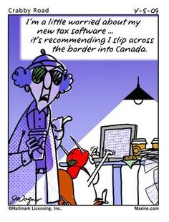
KANSAS ISSUES

Slide 222
Kansas Issues
Kansas doesn’t tax farm income and ignores NOLs
Kansas subtraction modification to exclude a portion of net gain from breeding livestock sales (shown on Form 4797) if Schedule F is negative
  Exclusion amount is smaller of gain or the loss on Schedule F

Slide 223

LEASES

Slide 224
Equipment Leases
Why lease?
  Effect on balance sheet and financial ratios
  “Deduct” a purchase faster than normal depreciation allows
  Equipment dealers & certain lenders encourage leases
Leases are either capital or operating
  Depends on the intent of the parties in addition to facts and circumstances
  Capital lease = conditional sales contract
    Treated like a financed purchase for income tax purposes

Slide 225
Equipment Leases
IRS says an agreement that contains any of the following may be considered a conditional sales contract (capital lease):
  A portion of each payment is allocated to equity
  Title is transferred after a certain number of payments
  Amount paid over the entire lease is a large portion of the purchase price
  Lessee has option at the end to buy at a price lower than FMV
  Lessee has option at the end to buy at a low price when compared to total amount paid during lease
  A portion of each payment is designated as interest

Slide 226
Equipment Leases - Capital
Capital leases are a debt financed purchase
  Interest portion of a payment is deductible, remainder is non-deductible principal
  Asset is depreciated
  Asset and liability included on balance sheet
  Trade in is treated as like-kind exchange

Slide 227
Equipment Leases - Operating
Operating leases are not a debt financed purchase
  The entire payment is deductible
  Asset is not depreciated
  Neither asset or debt is listed on balance sheet
  If an owned asset is traded in on an operating lease:
    The traded asset is treated as sold with sale proceeds applied towards prepayment of lease
    Lease prepayments are not deductible up front, they are spread out over the life of the lease
    May be significant tax consequences!

Slide 228

CANCELLATION OF DEBT

Slide 229
Cancellation of Debt
Forgiveness of farm debt is normally taxable and included as income on Schedule F (subject to SE tax)
Exceptions:
  Debtor is in bankruptcy
  Debtor is insolvent, exclude up to the amount that they are insolvent
  Debtor is solvent and the debt is qualified farm debt
    May be limited depending on tax attributes
Canceled debt excluded from income may affect tax attributes
  May result in reduced NOL carryovers, tax credits, capital loss carryovers, or asset basis

Slide 230

FINANCIAL DISTRESS TRANSACTIONS

Slide 231
Financial Distress Transactions
Tax avoidance strategies in the past may catch up in times of distress
  §179 deduction or bonus depreciation on financed equipment creates low or zero basis assets, potentially with debt equal to FMV
  Little to no cash left after sale to pay tax on recapture
Property surrendered to lender to satisfy debt
  Treated as if asset were sold
  Debt > FMV may be taxable cancellation of debt
  FMV > basis is taxable depreciation recapture

Slide 232
For More Information
https://www.agmanager.info/kfma/newsletters/september-2016
http://www.agmanager.info/finance-business-planning/financial-management/income-tax-aspects-and-consequences-financial

Slide 233

QUESTIONS?

Slide 234

Is it Time to Retire? What about the Next Generation?
Dr. Gregg Hadley
Department of Ag Economics-Kansas State University
Gregg Hadley is the assistant director of extension agriculture, natural resources, and community development for K-State Research and Extension, beginning that role in September, 2011. Prior to that, he served as associate professor and extension farm management specialist at the University of Wisconsin–River Falls, Department of Agricultural Economics. His professional focus has been in farm financial performance, capital investment analysis, farm management, strategic management, farm business planning and human resource management. Areas of emphasis also have included team management, farm succession, international producer education and manure management economics. He earned Ph.D. and master’s degrees in ag economics at Michigan State, and a bachelor’s degree, also in agricultural economics, at Purdue University.
Email: ghadley@k-state.edu Phone: 785-532-5838

Slide 235

Is it time to retire?

Slide 236
Is it time to retire?
Yes!
No!
Maybe?
I do not know!

Slide 237
Is it time to retire?
Will I be useful if I turn over the reins?
What will I do?
Will I be able to afford to retire?
Given the change in commodity prices should I retire now?

Slide 238
Visualization:
Many farmers’ identity is in their farms.
Occupation is usually very diversified
Few farmers have hobbies
1st step is to visualize what retirement will be.

Slide 239
Retirement Visualization Exercise
“It is not whether you are retiring. It is a matter of what you are retiring to” - Stacey Warner
Draw three to four things that represent your ideal retirement

Slide 240




Retirement Visualization Exercise
Gregg’s retirement

Slide 241
What Does Your Retirement Picture Tell You:
Does this picture involve opportunity?
Mentoring grandchildren
Opportunity to do things you always wished you had time to do before retirement.

Slide 242
Roles with community or faith organizations:
Improving relationships with old friends.
Seeing some other parts of the country or the world.
Maybe buy that sports car you always wanted when you were younger.

Slide 243
What do you want to contribute, give or help to bring about in retirement?
This could be financial or time related.
It could be political or social change related.
What are your passions to make a difference?

Slide 244
Be Practical
How many of us know someone who sold the farm moved to town and passed away within a year?
Without a plan we feel our value is lost.
We all need to be needed.
We have worth to our community our family and our creator.

Slide 245
Financial Groundwork
What are the financial obligations?
Long term debt?
New investments to provide for the following generation?
Health Care issues?
How do I factor in inflation and increasing life expectancies?
Is selling part of the farm the answer?
What about just selling/gifting the improvements?
Can I use my net worth to provide a suitable retirement?

Slide 246
How do I analyze my options?
Social Security, what age do I take my SS?
Cash rent or crop share?
Sell the cows or lease them out?
Sell land on a 30 year contract to provide annual living expenses?

Slide 247
Analyze carefully to arrive at the answer.
Many are surprised after analyzing all the alternatives.
A productive retirement takes planning and time to implement.
Maybe NOW is the time to consider some form of retirement.
Commodity prices are low but any arrangement with a successor has to work for both parties.
You can’t start too early!

Slide 248
Resources
Family Resource Management Program Focus Team
Adult Development and Aging Program Focus Team
Farm Management Program Focus Team
Duane and the Farm Analyst Team
KFMA Economists

Slide 249
What About The Next Generation?

Slide 250
Critical Questions
Is now not the time for the next generation to come back?
What if the next generation already has come back and now the business can’t support them?

Slide 251
The Answers
Is now not the time for the next generation to come back?
  Yes
  No
  Maybe
  I do not know!

Slide 252

Yes!
Now Is Not The Time For The Next Generation To Come Back

Slide 253

No!
Now Is The Time For The Next Generation To Come Back.

Slide 254
Maybe!
Now Might Or Might Not Be The Time For The Next Generation To Come Back.
What problems do farm and ranch families typically have in a succession?

Slide 255

Maybe!
Now Might Or Might Not Be The Time For The Next Generation To Come Back.

Slide 256
I Don’t Know!
It Is Really Case Dependent

Slide 257
Resources
Me
Duane Hund and the Farm Analyst Team
Charlotte Olsen & Charlie Griffin
Forrest Buhler and Char Henton from KAMS
Family Resource Management Program Focus Team
Farm Management Program Focus Team
KFMA Economists
Trained Agent and KAMS Mediator Succession Facilitators
http://www.ksre.k-state.edu/kams/succession/
  Check out the Planning for the Future succession workshop series coming to Dodge and Lawrence this winter!

Slide 258


Slide 259

Family Living Expenses
Dr. Monte Vandeveer
Department of Ag Economics-Kansas State University
Monte Vandeveer joined the KSU Extension Farm Management team in February 2016 as the Southwest Area extension agricultural economist, based in Garden City. He grew up on a farm in south-central Kansas with wheat and cow-calf operations. He received B.S. and M.S. degrees in agricultural economics from Kansas State University and a Ph.D. in ag economics from Purdue University. Besides working for K-State Research and Extension, he also has experience working with the Economic Research Service, (USDA), the University of Nebraska-Lincoln’s Extension Service, and volunteer service in Vietnam. He has a special interest in risk management, particularly crop insurance.
Email: montev@ksu.edu Phone: 620-275-9164

Slide 260
Can we tighten our belts?
Farm Household Income and Family Living Expenses
Dr. Monte Vandeveer
KSU Extension Agricultural Economist
Agent Update, November 2016

Slide 261
Overview
How have farm incomes and living expenses changed over the past several years?
What categories of household spending might offer some promise for reduction?
Some simple tools for managing family spending decisions
Notes:
Overview of presentation – should be self-explanatory

Slide 262
KS farm household income and expenses
KFMA member records over 2004-2015
    ≈ 1,200 members in 2015
    ≈ 400 kept detailed records for family living expenses
Income: farm and non-farm
Expenses: 17 expense categories
Caveat: no household is “average”
Notes:
Our analysis of farm household income and expenses is based on KFMA member records.
Not all KFMA families keep detailed records; only about 400 households out of 1,200 total members kept detailed records on family living expenses.
The income records include both farm and non-farm sources of income. Not all non-farm income is from off-farm wages; it also includes things like rents, oil and gas royalties, and a variety of other sources.
There are 17 expense categories; should be enough to get a general idea of spending patterns.
Results shown on following slides are AVERAGES for the entire group. Every household will have its own unique features (e.g., spending will be different if children are still at home, if farm operation is new or already well-established, etc.)

Slide 263
KFMA net farm incomes, 2004-2015 two groups
Notes:
Want to be sure that our sub-set of farmers with detailed records are reasonably representative of the entire population.
On the income side, it looks like the sub-group tracks fairly well with the entire population. So hopefully we aren’t looking at farms that are significantly larger or smaller than the general group.
NOTE: this slide isn’t an important one; could be skipped, or covered very quickly.

Slide 264
KFMA Total HH income (all sources), 2004-2015 for ≈ 400 families with detailed records
Source: KFMA annual reports of family income and living expenses
Notes:
Let’s start by looking at overall farm household income – that is, income from all sources.
The period of 2004-2015, overall, was a pretty positive period for the KFMA households. Average income was almost $131K, and reached a peak of $196K in 2011.
The “ethanol boom” started in 2007, and was the first of several years of what was the most profitable period for KFMA households on record.

Slide 265
Farm and non-farm income
Max = $164,743
Min = $12,165
Average = $91,579
Source: KFMA annual reports of family income and living expenses
Notes:
Now let’s break down income into farm and non-farm sources.
Non-farm income averaged about $39K through this period, and was relatively stable, compared to farm income. Remember, this isn’t just off-farm wages, but includes all sources of non-farm income.
Farm income averaged about $91K, but it varied widely over these years. Max was $164K in 2011, but then farm income shrank to only $12K in 2015.
NOTE: I think KFMA net farm income in 2015 actually came out to a negative number, averaged across the entire 1,200 members. The $12K number is for our 400 households with detailed records.

Slide 266
Spending: family living expenses & taxes
Average = $14,250
Max = $74,447
Min = $41,985
Source: KFMA annual reports of family income and living expenses
Notes:
On the spending side, we’ll consider both family living expenses, as well as taxes paid.
The tax bill average $14K over this period, and of course it was higher for the higher income years. The only consolation of lower farm income is that farm income taxes will be lower, too. But savings on taxes isn’t going to provide us with all the savings we are going to need.
Family living expenses averaged $58K, but showed a substantial increase over time. Family living cost $41K in 2004, and maxed out at $74K in 2014. Family living expenses went up 77% during this run of several years with record farm incomes.

Slide 267
Inflow vs. Outflow
Source: KFMA annual reports of family income and living expenses
Notes:
Now let’s compare income to expenditures for this period.
Two interesting points:
Every year but one showed a surplus of income over spending (including tax payments) during this period. Several of these years showed a substantial surplus. Key question will be how that surplus was managed; was it handled in a way that it is still available now to help with shortfalls in the bad years?
The year of shortfall was 2015, when spending exceeded total HH income by about $40K. How did households cover this deficit? If 2016 and succeeding years also have low incomes, how much carry-over surplus will still be available to help cover losses?

Slide 268
So the situation is…
On the income side:
  Farm income represents the major source of household income for KFMA families
  Farm income is highly variable
  Farm income was at record high levels for several years, so there was an extended period with significant potential savings
Notes:
Just a re-cap of observations from the preceding slides….

Slide 269
So the situation is…
On the income side:
  Farm income has declined 4 consecutive years from 2011 peak; 2016 probably will be 5th year
  Farm income prospects for next few years are meager
  Non-farm income not sufficient to cover family living expenses for typical household
  Significant increase in non-farm income is not likely for many HH’s; limited off-farm income opportunities in many rural areas
Notes:
More re-cap….

Slide 270
So the situation is…
On the spending side:
  Household spending increased significantly (over 70%) during this period; are there places to cut back?
Where will we make up the difference?
  Average household had a $40K deficit of spending over income
  Consolation: income taxes will decline as farm income declines
  Need to take closer look at family living expenses…
Notes:
More re-cap.
Try to set up discussion in following slides….

Slide 271
KFMA family living expenses, 2004-2015
Max = $74,447
Min = $41,985
Source: KFMA annual reports of family income and living expenses
Notes:
Here’s a look at the same family living expense chart we saw earlier.
Average was $58K, but amount ranged from about $42K up to max of $74K in 2014. Increase from lowest to highest was 77%, much higher than the rate of inflation, as measured by the CPI. So farm households were buying a bigger or nicer bundle of goods and services as time went by in this period.
But with farm incomes down, can living expenses be reduced very much? Already started to see some reduction in 2015, as farm income fell, but is there room to squeeze out more?
In the following tables, we’ll look at the 17 household spending categories and see how they changed over time. As we look over the entire HH budget, can you come up with a large savings – say, $10K?

Slide 272
Family living expenses, by category
Average household: average expense, low, high, % difference over 2004-2015
Expense Category | Average | Lowest | Highest | % difference, Low to High
Personal - Recreation | $ 8,994 | $ 6,212 | $ 11,535 | 85.7%
Household Operation | $ 7,409 | $ 5,131 | $ 9,997 | 94.8%
Food Purchased | $ 7,141 | $ 5,751 | $ 8,617 | 49.8%
Health Insurance | $ 6,006 | $ 4,153 | $ 8,320 | 100.3%
Doctor - Other Medical | $ 4,520 | $ 4,147 | $ 4,882 | 17.7%
Contributions | $ 4,106 | $ 2,492 | $ 5,608 | 125.0%
House Upkeep & Repairs | $ 3,809 | $ 1,857 | $ 6,490 | 249.5%
Gifts | $ 2,986 | $ 1,737 | $ 4,680 | 169.4%
Life Insurance | $ 2,985 | $ 2,237 | $ 3,816 | 70.6%
(versus overall family living increase of 77%)
Source: KFMA annual reports of family income and living expenses
Notes:
Here I have arranged the expense categories from highest spending amount to lowest (8 more categories on next page).
The table shows the average annual spending over the entire 2004-2015 period, along with the lowest and highest amounts, and the percentage increase from lowest to highest.
Remember that overall spending on family living increased 77% during this time period; I have BOLDED the categories which increased at rates higher than 77%.
“Personal and Recreation” was our highest spending category. In a period with record incomes, one can imagine many families taking great vacations or taking more expensive outings of other kinds. Other households might have bought a boat, motor home, or some other “dream toys.” This is a category where there is probably a lot of room for a reduction in spending.
“Household Operation” is our second highest spending category. It is a catch-all category for all kinds of items for the home that don’t fit into the other categories. I’m not sure what the largest items in this category would be, to be honest. But it’s clear that they increased significantly – almost doubled over the 12 years – certainly a higher rate of increase than inflation in general. May be some room for savings here.
“Food Purchased” was one of the categories where spending went up less than average. Our best hope of reducing spending on food might be eating out less often.
“Health Insurance” may be the category of greatest concern. Note that spending basically doubled over the 12 years here. But with the major changes in the insurance laws and plans in recent years, it appears that health insurance costs may increase even more, probably by significant amounts. Our table shows an average of about $700/month on health insurance for the “highest” level, but we have heard many reports of health insurance premiums for self-employed families running well over $1000/month, and that comes with much higher deductibles, too. Health insurance reform was promised by the incoming Administration, but in the meantime this will be a category for spending increases rather than savings. It is an open question whether some households will try to go without insurance. Some of the savings from other categories may get eaten up by increases in health insurance costs.
“Doctor and other Medical” costs showed the lowest percentage increase of any spending category. If some farm households give up on health insurance, this category might increase significantly.
“Contributions” more than doubled over the 12 years. This is a category where households have wide discretion, so we could expect some cutbacks here.
“House Upkeep & Repairs” showed one of the highest rates of increase. In a lot of households, Ma finally got that kitchen renovated, and Pa might have built him a man-cave. Other households may have just made some long overdue repairs. In any event, many farm households will go back into the mode of deferring improvements until times get better.
“Gifts”, similar to Contributions, more than doubled (by far) over this time period. This is also a category where households have wide discretion, and cutbacks are likely.
“Life Insurance” increased by slightly less than the 77% average rate of spending increase. One wonders if some households made major upgrades on their policies during this time; not clear if they would be willing to cut back?

Slide 273
Family living expenses, by category
Average household: average expense, low, high, % difference over 2004-2015
Expense Category | Average | Lowest | Highest | % difference, Low to High
Auto Expense | $ 2,511 | $ 2,023 | $ 3,198 | 58.1%
Utilities - Telephone | $ 2,255 | $ 1,800 | $ 2,583 | 43.5%
Clothing | $ 1,717 | $ 1,428 | $ 2,000 | 40.1%
Furniture - Equipment | $ 1,520 | $ 1,045 | $ 1,913 | 83.1%
Education | $ 1,512 | $ 1,181 | $ 1,752 | 48.3%
Bank Interest | $ 554 | $ 363 | $ 698 | 92.3%
Miscellaneous Expense | $ 547 | $ 328 | $ 1,066 | 225.0%
Child Care | $ 340 | $ 192 | $ 652 | 239.6%
Source: KFMA annual reports of family income and living expenses
(versus overall family living increase of 77%)
Notes:
“Auto Expenses” showed a smaller than average rate of increase. Figures out to about $250/month. Included not just car payments but maintenance, etc.
“Utilities – Telephone” also showed smaller than average increase. Savings on phone plan possible? Cutting other utilities might be difficult.
“Clothing” not showing huge increase. Perhaps modest savings potential here, at best.
“Furniture – Equipment” did show a higher rate of increase. Hopefully we have made some upgrades here that will last us a while.
“Education” – probably not used by many in our 400 HH’s; spending on higher ed might get deferred?
“Bank Interest” – high rate of increase, but not a big number. Those who have debt already may have trouble getting out.
“Miscellaneous Expense” – Big rate of increase, but not a big number. Modest savings potential in absolute terms.
“Child care” – high rate of increase, probably used by only a small share of families. High rate of increase might mean savings unlikely for those families with children.

Slide 275
Some households already in deep water:
KFMA 2015 net farm income distribution
Net Income Range | % of Farms
Over $300K | 2.77
$200K to $300K | 3.45
$100K to $200K | 10.09
$50K to $100K | 14.58
$0 to $50K | 24.68
$0 to $50K loss | 21.66
More than $50K loss | 22.78
(44.44% negative)
Source: KFMA Executive Summary, 2015 PROFITLINK Analysis
Notes:
Our previous discussion looked at household spending by an “average household.” Of course, spending patterns are unique to each family, and each family will have different needs.
Families will also differ on the income side, and this chart shows how wide that difference was for NET FARM INCOME in 2015 across the entire 1,200 households in the KFMA system. As you can see, there was a wide range of observed outcomes across the entire system.
Our “average family” across the 400 households with detailed records actually had about $12K in net farm income. That puts them in the largest group of farms, those with net farm income between $0 and $50K. Most of those households would have started to feel the pinch, perhaps not quite being able to cover family living expenses. About 30% of households were doing a little better, with net farm incomes of $50K or more. But most troubling is the large number of households with a net farm LOSS – over 44% of our KFMA households. Trimming a little from family living expenses isn’t going to fix all of their problems.

Slide 276
Getting a handle on HH spending
Better records!
    Gives us more information on our actual spending
    Better able to identify which expenses to change, and how much change might be possible
    Software like Quicken is inexpensive and relatively easy to use
Notes:
In any event, almost every household may take a closer look at their living expenses and try to find some savings. How can they do a better job on that?
A first – and rather obvious – suggestion is to keep better records on that spending. It’s harder to manage something when you haven’t been measuring it. Better records can help us get a much better idea on how much we are spending in each area, which then gives us a better sense of WHERE savings are possible, and HOW MUCH savings might be possible.
Software like QUICKEN is widely available, is relatively inexpensive and easy to use. The hardest parts will be getting it set up for your operation and getting into a regular pattern of entering information. However, once you get it set up, it can generate a variety of reports that provide outstanding information if data have been entered accurately.

Slide 277
Household budgeting tools
Lots of resources available from extension
  KSU: Spend Some, Save Some, Share Some: Family Budgeting fact sheet (MF3306) and leader’s guide (MF3307)
  Iowa State: “Managing Farm Family Finances,” C3-51, https://www.extension.iastate.edu/agdm/wholefarm/pdf/c3-51.pdf
  Minnesota: “Live Healthy, Live Well,” http://www.extension.umn.edu/family/live-healthy-live-well
    Healthy Wallets
    Healthy Minds / Getting Through Tough Times
Notes:
Another simple and familiar tool for managing expenses is a household budget. The basic idea is to develop a target level of spending, based on your income, and then create a detailed spending plan that tries to match the spending target you developed. Start with actual spending, then start making adjustments where you think savings are possible or needed. It might take several iterations to come up with something that works.
University Extension programs across the country have developed many resources that families can use. This slide shows a variety of options:
KSU has some fact sheets that help families think about their different priorities;
Iowa State has a fact sheet that focuses on issues related to farm families;
Minnesota has a website with a wide variety of information, not just on finances but also on dealing with stress in difficult times

Slide 278
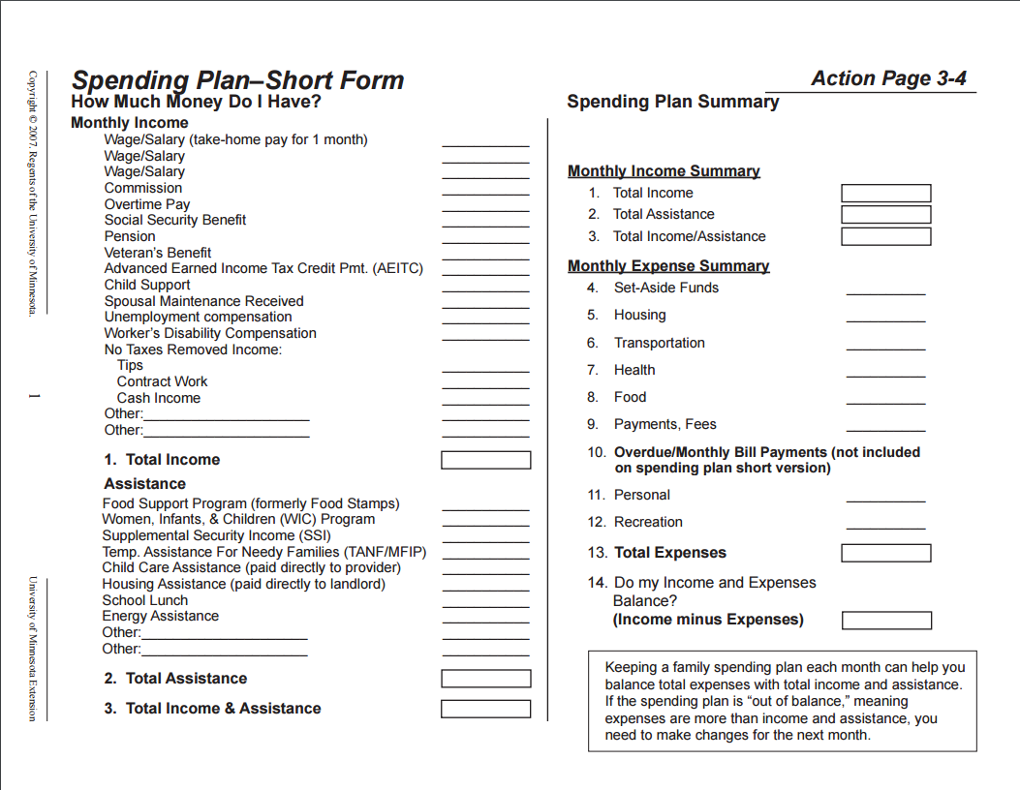
Notes:
This slide and the next show a simple budgeting framework that is typically used by most of these Extension tools.
The first section (left column) shows detailed income categories that list a variety of possible sources of income or assistance. The right column is a TOTALS section, where one lists the total income and expenses from the detailed section and checks whether they balance.
The following slide shows the detailed spending categories.

Slide 279
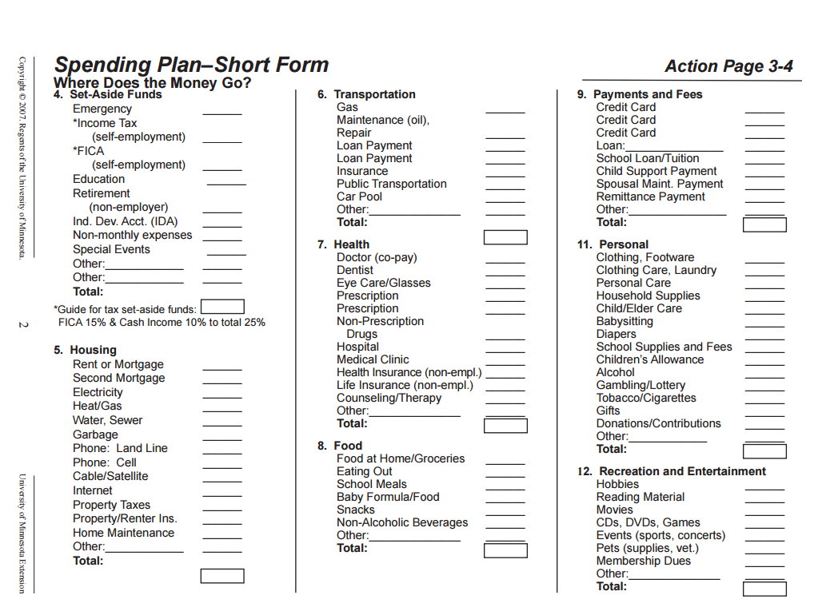
Notes:
This slide shows the detailed spending categories. Note how detailed these are; it helps us not to overlook some expenses that we might not account for otherwise. This is where household spending records can really help us develop an honest accounting of our spending patterns. It’s easy to overlook some seemingly minor items – but it’s not until we add up those minor things that we realize how much they actually amount to.
As mentioned before, it may take us several iterations before we can come up with a spending plan that meets our target. Also, there are always unexpected expenses, so the budget should include some kind of cushion or allowance for unplanned items.

Slide 280
Closing observations….
Farm income is down, and family living expenses will have to be cut for many farm households
Categories where spending may be reduced? Some good candidates:
    Personal / recreation • Gifts
    Household operations • Furniture & equipment
    House upkeep & repairs • Contributions
Notes:
TO SUMMARIZE…..
KFMA data indicate that most farm households started to feel a serious pinch in 2015, as lower commodity prices resulted in lower farm incomes. This comes on the heels of an extended period of strong farm incomes, where family living expenses increased at a significant rate. With 2016 being another tough year, and 2017 promising more of the same, most farm households will need to look for savings on family living as farm incomes are pinched.
A review of KFMA household spending patterns suggest that there are some promising categories to reduce spending. Most of these categories are those where wide discretion exists, and where spending increased most rapidly during the years of high incomes. Things like vacations, recreation, home improvement, gifts and contributions, etc., may need to be cut back or deferred until better times, as the case may be. Other categories of regular monthly spending may offer much less potential for savings, and indeed some categories like health insurance may require some major increases.

Slide 281
Closing observations….
Better records: where cuts are possible, how much might be saved
Time for HH budget review; defer some spending
Cutting household expenses will not be sufficient for some families
    Will have to draw upon savings or other resources to cover a share of family living expenses
Notes:
CONTINUE SUMMARY…..
A better set of household spending records will help us monitor our spending, as well as give us a better idea of WHICH areas can promise savings and HOW MUCH savings might be possible.
There are plenty of budgeting tools available to help households review their spending patterns and come up with a spending plan that works for them. Once we know how much the regular expenses require, we can have a much better idea of how much is left for discretionary items. Many farm households will have to put some purchases on hold until things improve.
Finally, making some cuts in family living expenses won’t solve the financial squeeze for some farm households over the next year or two. They will need to draw upon the savings accrued during the years of high farm incomes, and also look for ways to raise farm income and reduce farm expenses wherever possible.

Slide 282

Questions?
Comments?
Thank you!
Dr. Monte Vandeveer
KSU Extension Agricultural Economist
Email: montev@ksu.edu
Phone: 620-275-91641
K-State Research and Extension is a statewide network of educators sharing unbiased, research-based information and expertise on issues important to Kansas. K-State Research and Extension is an equal opportunity provider and employer.

Slide 283
K-State Resources for Assistance
Kansas Agricultural Mediation Center
K-State Farm Analyst Program
Kansas Farm Management Association
Supplemental Publications:
Enterprise Diversification
Balance Sheet, Income Statement, Cash Flow, & Financial Ratios

Slide 284

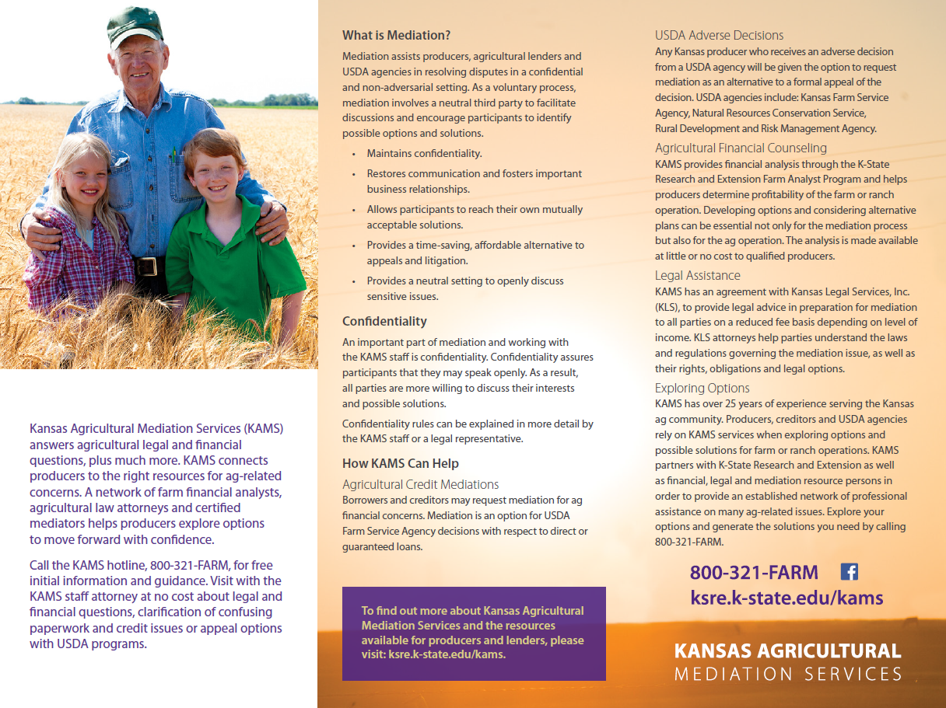

Slide 285

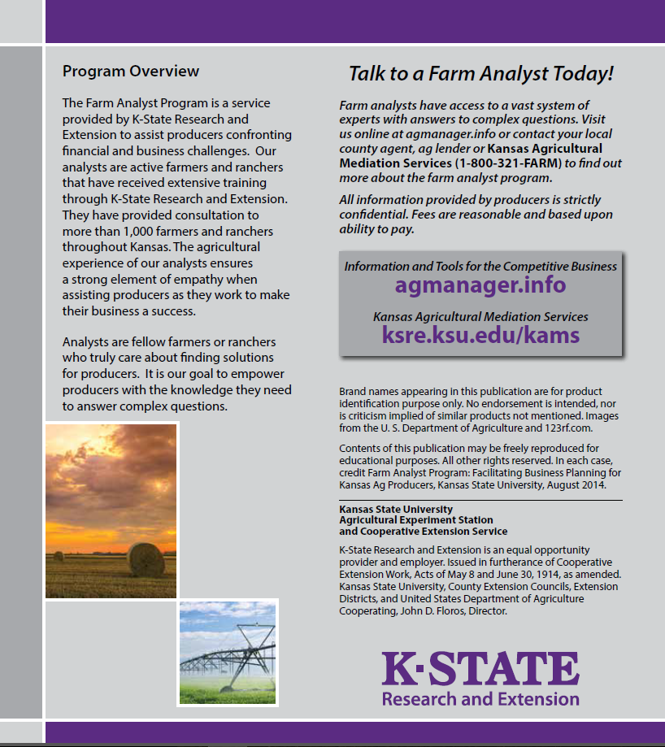


Slide 286

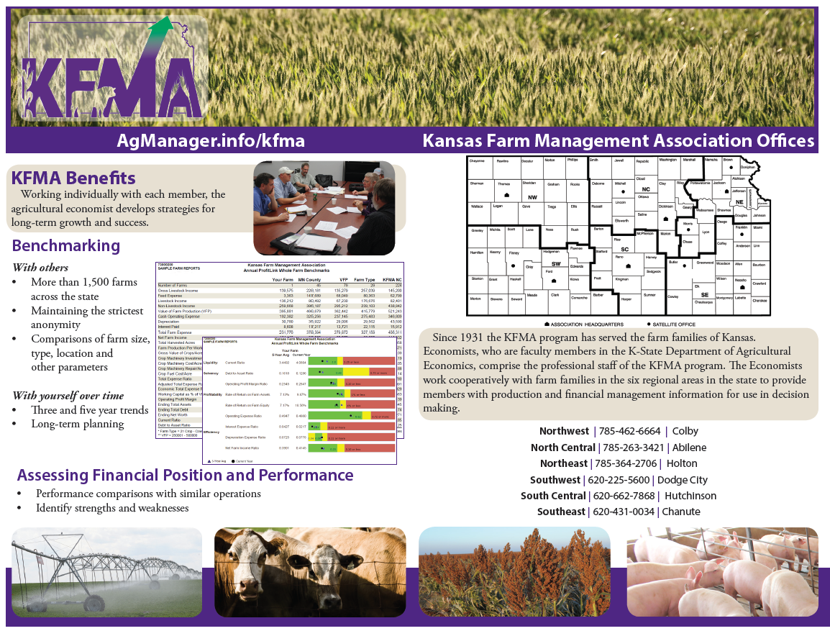

Slide 287
Thank you for attending today!!!

