Slide 1
Things you need to know:
There will be a face-to face training for KSRE Agents on all of this closer to when producers are signing up for these programs (March?)
You will likely be asked to do a county presentation along with your FSA office
The Ag. Econ. department will be doing 10 in-depth regional meetings in Kansas closer to the sign-up period
  Dates and locations will be determined when we know more from FSA
  **This PowerPoint will be made available to you after this webinar that you can use for initial meeting requests in your county/district
Notes:
) If this is your first exposure to Farm Bill, it will sound like I am talking a foreign language!
) This is a GREAT opportunity for you as an agent to be the expert in your county/district. FSA can talk about the program changes, but they assist producers in making decisions. Our part of the process is providing producers with education and economics to make decisions.

Slide 2

Agricultural Improvement Act of 2018 (2018 Farm Bill)
By Robin Reid
K-State Department of Ag. Economics
www.AgManager.info
Notes:
Make sure to Thank Art!

Slide 3
2018 Farm Bill Titles
Title I: Commodities
Title II: Conservation
Title III: Trade
Title IV: Nutrition
Title V: Credit
Title VI: Rural Development
Title VII: Research, Education, and Related Matters
Title VIII: Forestry
Title IX: Energy
Title X: Horticulture
Title XI: Crop Insurance
Title XII: Miscellaneous
Notes:
Commodities: Farm programs, marketing loans, sugar, dairy
Conservation: CRP, EQIP (environ. Quality incentives program), conservation easements
Trade: Food for Peace Act, Ag Trade Act,
Nutrition: SNAP (supplemental nutrition assistance program)
Credit: Farm ownership loans, Farm operating loans, Emergency loans, Beginning farmer program
Rural development: Rural infrastructure and community development loans and grants, Value-added agriculture and business development grants
Energy: Renewable energy loan and grant program, Biomass crop assistance program, Biobased product marketing and manufacturing assistance programs (including advanced biofuels)
Miscellaneous: Livestock, socially disadvantaged and limited resource producers, etc.

Slide 4
Decisions to be made…
TENANT OR BOTH IF SHARED RISK
  Elect a Program
Decision for each Commodity (85% of base)
All Commodities on Farm (65% of total base)
PRICE LOSS COVERAGE
(PLC)
AGRICULTURAL RISK COVERAGE
- County Level -
(ARC-CO)
AGRICULTURAL RISK COVERAGE
- Individual Level -
(ARC-IC)
Supplemental Coverage Option
(SCO)
Purchased on Planted Acres
Notes:
PLC and ARC-CO can be selected commodity by commodity (i.e. Corn can go in PLC and Wheat in ARC-CO, etc). ARC-IC takes all commodities and lumps them together to determine a loss, therefore the whole farm has to sign up for ARC-IC.
Program selection is made by FSA farm number. So a producer with multiple farm numbers can make different decisions on each farm.
You have the OPTION to purchase SCO if you are not enrolled in an ARC program.

Slide 5
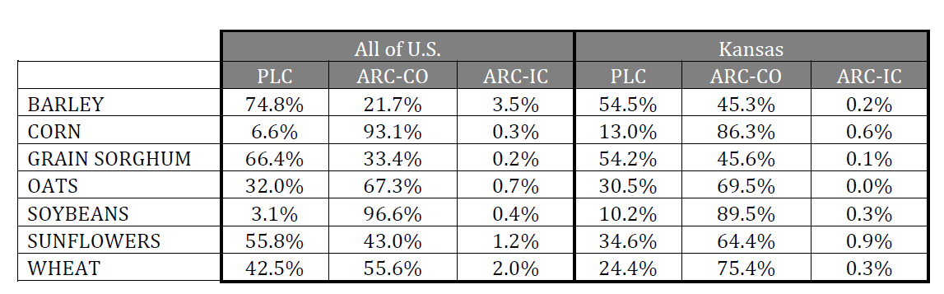
Percentage of total base acres in each program for the 2014 Farm Bill

Slide 6
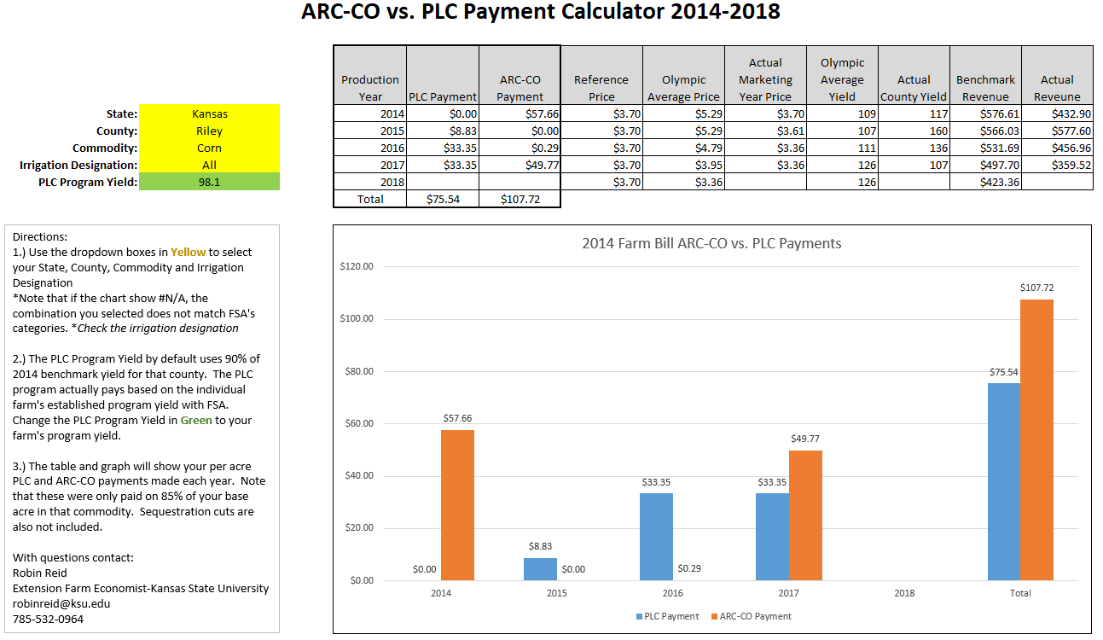
Did we make the “right” decision?

Slide 7
This Spring Farmers will Select either ARC or PLC
Farmers will elect ARC or PLC per commodity for 2019 & 2020, but will be able to change elections annually beginning in 2021 (but don’t have to).
This change will allow farmers to select their preferred program based on more current market conditions.
Reduces the psychological pressure of making a 1 time program decision for 5 years.
Notes:
In the past farmers had to select one program that they were locked into for a life of that Farm Bill (5-years)

Slide 8
PLC review
Catastrophic price decline protection
  Payments occur then prices fall below reference prices
  Payments made on base acres and program yields
Example:
Farm X has 100 base acres of corn and 120 bushel program yield
Reference price is $3.70
The MYA Corn price is $3.50
  Corn payment per acre = ($3.70 - $3.50) X 120 = $24.00 per acre
  Total corn payment= $24.00 X 100 base acres X 85% = $2,040.00

Slide 9
What Changed in PLC?
“Effective Reference Price” instead of just the statutory reference prices
Commodity | 2018 Farm Bill Statutory Price ($/bu) | Highest “Effective” Reference Price Possible (115% of Statute)
Wheat | 5.50 | 6.33
Corn | 3.70 | 4.26
Sorghum | 3.95 | 4.54
Soybeans | 8.40 | 9.66
Notes:
Statute

Slide 10
Effective Reference Price
Starts with the Olympic average of the five most recent Marketing Year Average prices (MYA’s) times 85%.
If this is greater than the statute reference price, then the calculated effective reference price is used for calculating payments, otherwise use the statutory price.
The effective reference price is capped at 115% of the statute reference price.
Will possibly have no effect on Kansas commodity payments in PLC because over the last 5 years MYA prices have been “low”.
Soybean example:
2014/15 MYA | 2015/16 MYA | 2016/17 MYA | 2017/18 MYA | 2018/19 MYA (projected) | Average * 85%
$10.10 | $8.95 | $9.47 | $9.33 | $8.60 | $7.86

Slide 11
What Changed in PLC?
2.) Payment Yield Update will again be offered by 2020
The 2020 update is intended to benefit farmers who sustained multiple years of losses during the 2008‐2012 crop years used to calculate the 2014 updated program yield.
Will use the farm’s yields from 2013-2017, excluding any years that the crop was not planted
Low yield years will be replaced by 75% of the county average yield from 2013-2017
The average farm yield over these years (after low yield replacement) will be multiplied by 90% and then by a “detrending” factor
**Don’t get caught up in the formula. FSA will run this for you. If the update is higher than your current, update, even if in PLC

Slide 12
“Detrending” Factors or Yield Update Factors
Commodity | Factor*
Wheat | 0.9767
Corn | 0.9000
Grain Sorghum | 0.9000
Soybeans | 0.9000
*The yield update factor is the ratio of the national average yield for the commodity from 2008‐2012 and 2013‐2017 (limited to not less than 90 percent or more than 100 percent).
Example: Wheat grower with an adjusted average 2013-2017 wheat yield of 35 bushels times 90% times 0.9767 yield update factor equals 30.8 bushels.

Slide 13
ARC review-2014 Farm Bill
Revenue protection program
  Payments are made if per acre revenue falls below 86% of benchmark
ARC-County benchmark
  5-yr Olympic avg. national MYA price X 5-yr Olympic avg. county yield
ARC-Individual benchmark
  5-yr Olympic avg. of the weighted per-acre revenues
Payments max out at 10% of benchmark revenue
Notes:
Olympic average = drop the high and the low numbers, average the remaining three

Slide 14
ARC-County Example-2014 Farm Bill
Setting the REVENUE guarantee
Marketing Year Average Price
2009/2010 | $3.70
2010/2011 | $5.18
2011/2012 | $6.22
2012/2013 | $6.89
2013/2014 | $4.46
Olympic Average | $5.29
County Yield
2009 | 100
2010 | 120
2011 | 80
2012 | 70
2013 | 110
Olympic Average | 96.7
ARC Benchmark: $5.29 X 96.7 = $511.54 per acre
ARC Guarantee: $511.54 X 86% = $439.92 per acre
ARC Maximum payment: $511.54 X 10% = $51.15

Slide 15
ARC-County Example
ARC Guarantee: $439.92, ARC Maximum payment: $51.15
Current Year: $3.50 MYA corn price, 110 bushel county yield
Current year revenue= $3.50 x 110 = $385.00
Revenue Loss = $439.92 - $385.00 = $54.92
Payment= $51.15 X 100 corn base X 85% = $4,347.75

Slide 16
Changes made to ARC County
Increase the transitional yield plug to 80% from 70% used for the Olympic average yield calculation for ARC.
County Yield
2015 | 100
2016 | 120
2017 | 80
2018 | 30
2019 | 110
Olympic Average | 96.7
What this means:
Low years in yield history will be replaced by a higher number
This will bring the average up in some cases, raising the ARC-CO guaranteed revenue

Slide 17
Changes made to ARC County
The policy intends for FSA to implement a trend yield adjustment, similar to crop insurance’s SCO trend adjustment, to be applied to ARC.
This trend adjustment will include using more than just the five years of the guarantee.
Trend yield adjustments will be positive or neutral.

Slide 18
Changes made to ARC County
FSA will use the “effective reference price” to calculate the ARC guarantee.
Marketing Year Average Price |  | 2014 Farm Bill | 2018 Farm Bill
2014/2015 | $3.70 | $3.70 | $4.26
2015/2016 | $3.61 | $3.70 | $4.26
2016/2017 | $3.36 | $3.70 | $4.07
2017/2018 | $3.36 | $3.70 | $3.70
2018/2019 (proj.) | $3.60 | $3.70 | $3.70
Olympic Average | $3.52 | $3.70 | $4.01

Slide 19
Changes made to ARC County
Make ARC payments based on county where base acres are located rather than administrative county.
Provide a separate irrigated and non-irrigated yield ARC guarantee in every county.
Prioritize RMA data in the calculation of county yields used for the ARC guarantee and actual yields.

Slide 20
Changes made to ARC County
In counties where an irrigated practice is scarce and RMA data is limited, sources of yield information such as representative farms in adjacent counties or the crop reporting district will be used to determine a county’s yield.
In some counties that have nearly 80% of a crop by practice insured, then the sample county average is nearly the population and should be more accurate than NASS county yield.
However, in counties that have a limited number of insured crop acres in either irrigated or non-irrigated acres, then the county yield is no more accurate than using the current method base on NASS data.
One would expect there will still be cases where a county receives an ARC payment and the county across the road receives no payment. This was a major complaint by a number of farmers.

Slide 21
Payment Limits-Both Programs
The individual payment limit remains the same at $125,000.
Spouse will also continue to receive a payment limit
Extends the definition of family to nieces, nephews, and first-cousins.
This is really no change from the current number of payment entities.
The Adjusted Gross Income cap remains at $900,000.
The Marketing Assistance Loans (MAL) and Loan Deficiency Payments (LDP) payments are no longer counted towards the $125,000 payment limit for ARC and PLC programs.

Slide 22
No Loss of Base Acres?
Farmers-ranchers who planted their entire farm to grass and pasture all years from 2009-2017 will have their base “unassigned”.
Question: What is NOT grass and pasture?
  All program crops.
  Alfalfa
  Farmers who planted base acres to wheat or oats and harvested it as hay or pasture are considered planted to a program crop.
  CRP is considered planted and not grass/pasture
  Farmers who planted triticale, brome, or similar forages for hay or grazing are in a “gray” area. What is the definition of “grass”? It will need to be interpreted by the Secretary.
  Base acres converted to grass hay or native grass pasture are NOT considered planted to a crop.

Slide 23
No Loss of Base Acres?
Farmers (ranchers) who have their base “unassigned” will continue have their acres considered “planted” to program crops during the life of this farm bill so it will maintain the base for future legislation.
These base acres will be “unassigned” from receiving commodity payments, but eligible for the Conservation Stewardship Program (CSP) grasslands program payment at a rate of $18/acre.
They will need to sign up for this NRCS program (not automatic) and address at least one resource concern

Slide 24
Dairy
Enhancements to this program were initially made in the Bipartisan Budget Act of 2018 (Feb. 2018)
Dairy Margin Protection Program (MPP) developed in the 2014 Farm Bill now got re-birthed as Dairy Margin Coverage (DMC) in the 2018 Farm Bill
  Higher coverage levels available for the first 5 million pounds ($8.50,$9.00, $9.50)
  Coverage levels from 5% to 95% of production history
  Premiums have changed, significantly lower for larger farms at a low margin
    25% discount if the farm chooses the same options for the life of the farm bill (5 years)
  Can make separate coverage level choices for Tier 1 (the first 5 million pounds of production) vs. Tier II (over 5 million pounds)

Slide 25
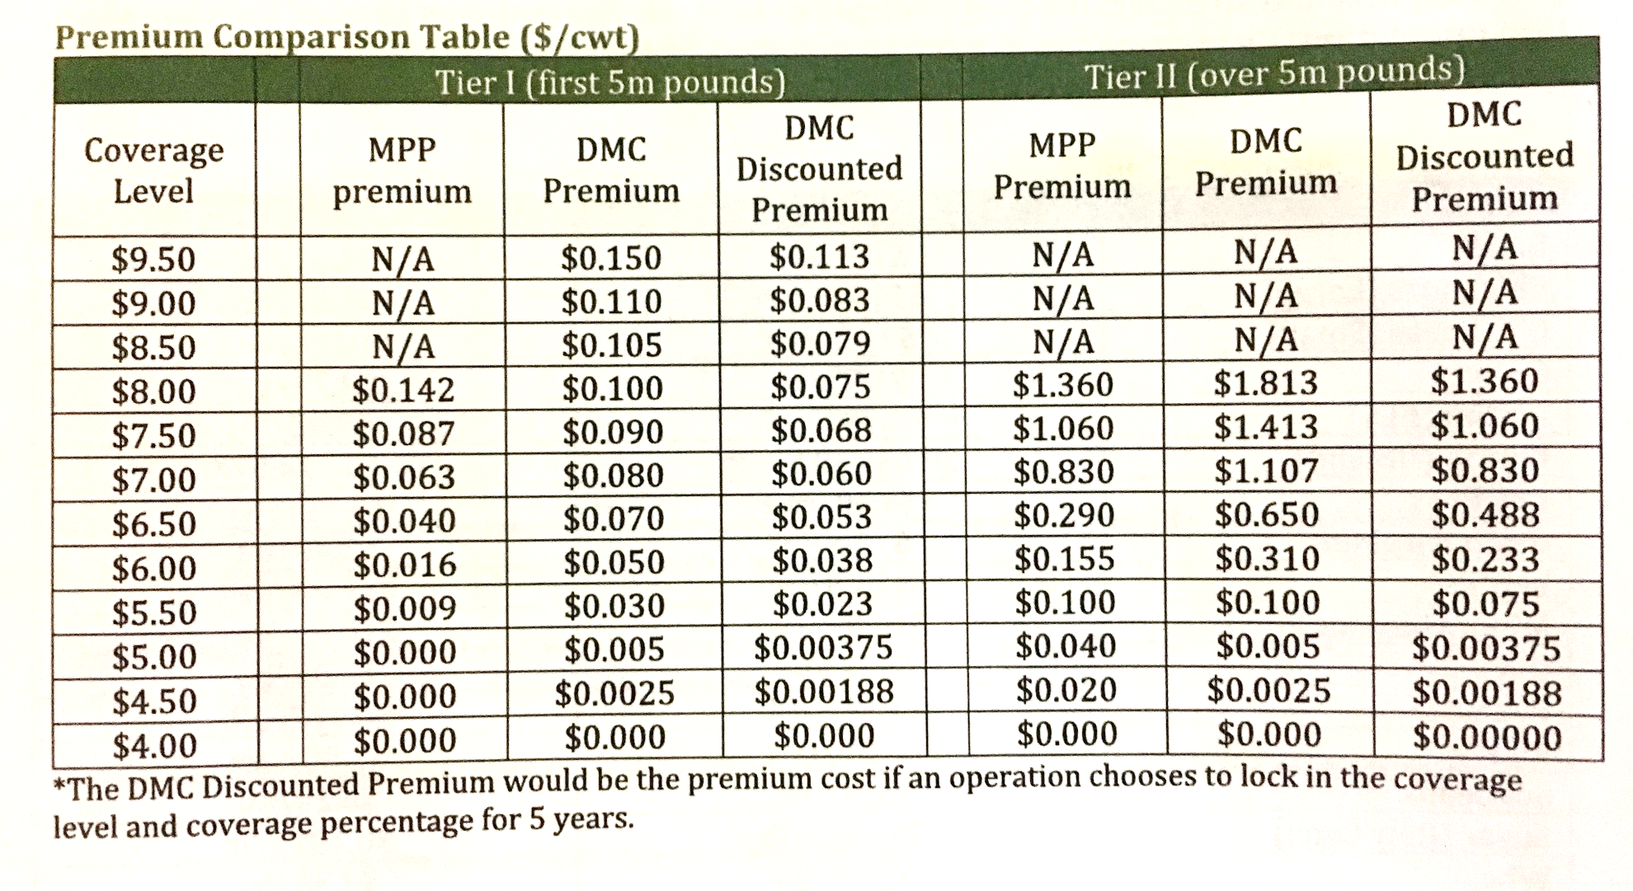
Dairy

Slide 26
Dairy
Dairy producer now have the freedom to participate in any/all of DMC, Livestock Gross Margin-Dairy, and Dairy Revenue Protection (Dairy-RP)
  Can retroactively sign up for coverage if prohibited after the premium reductions in February
Dairy producers have the opportunity to utilize 75% of the net premium they paid in 2014-2017 as credit for future DMC premiums
  Alternatively they can elect to receive 50% of the net premium back as a refund

Slide 27
Crop Insurance Title
At the request of virtually every farmer, rancher, rural business owner, and lender in the country, policy makers protected crop insurance.
Enterprise units are now allowed across county lines.
While discussed, no income limits or payment limits were applied to crop insurance.
Retained the Harvest Price Option (HPO) that provides yield replacement coverage, that allows farmers to maintain their hedge.
May increase the use of cover crops in some areas due to how cover crops are counted.
Requires RMA to consider expanding availability of limited irrigation crop insurance but doesn’t require it. This likely means RMA will continue expanding, but only after they are satisfied the limited irrigated data is scientifically sound.

Slide 28
Credit Title
Increased the direct loan limit (loans directly from FSA) for farm ownership loans from $300,000 to $600,000.
Guaranteed ownership loan increased from $1,399,000 to $1,750,000.
Direct operating loan limit increased from $300,000 to $400,000
Guaranteed operating loan limit increased from $1,399,000 to $1,750,000.

Slide 29
Conservation Title
The CRP acre cap will be increased over time from 24 million acres currently to 27 million acres by 2023.
CRP rental rates will be reduced to 85% of the average county rental rate for general sign-ups and 90% of the county average for continuous CRP enrollment.
Conservation Stewardship Program (CSP) will be phased out as a standalone acre-based program and be administered with the current Environmental Quality Incentives Program (EQIP).

Slide 30
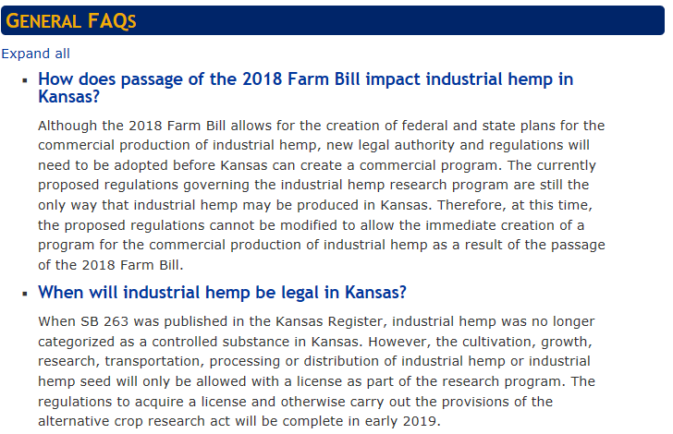
Industrial Hemp
https://www.northwest.k-state.edu/agronomy/industrial_hemp_resources.html

Slide 31
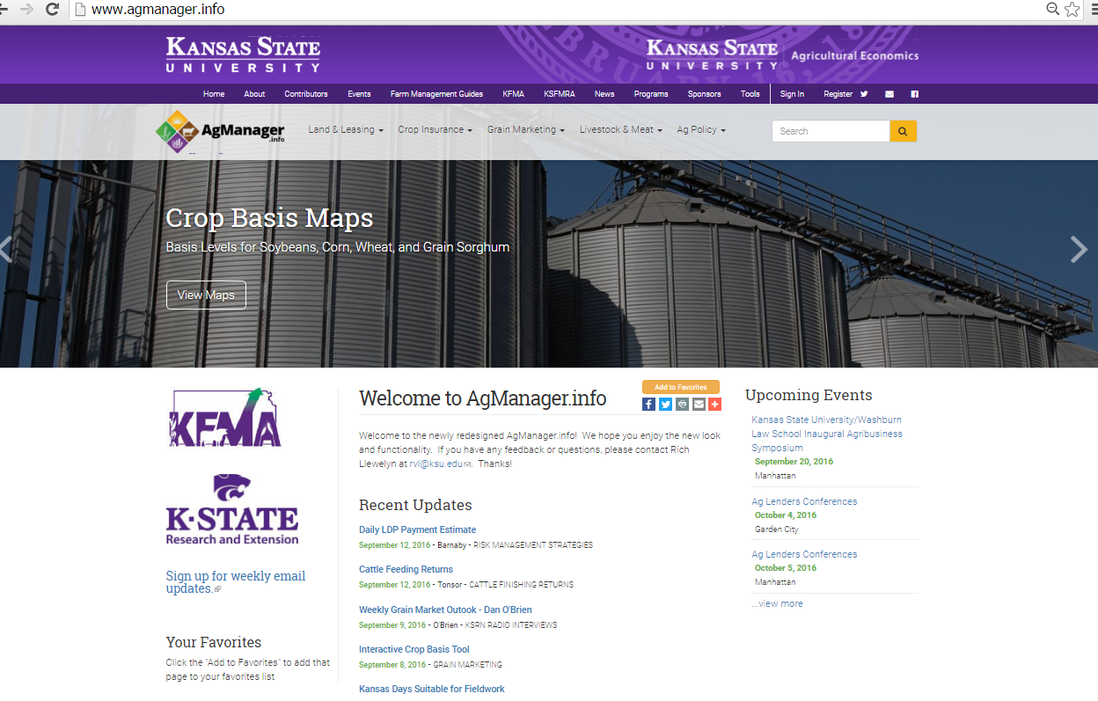

Slide 32
Thank You
Robin Reid
KANSAS STATE UNIVERSITY
PHONE: 785-532-0964
EMAIL: robinreid@ksu.edu
Check out our WEB page at
http://www.AgManager.info
Copyright 2019, All Rights Reserved

